Slide 1
Finding your Work
Bringing life to those dry bones

Slide 2
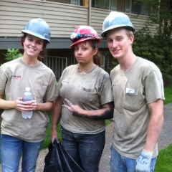
There is much to do….
We are designed for pursuit of good work
2Thes 3:10 - For even when we were with you, we used to give you this order: if anyone is not willing to work, then he is not to eat, either.
Eccl 2:24 - There is nothing better for a man than to eat and drink and tell himself that his labor is good. This also I have seen that it is from the hand of God.

Slide 3
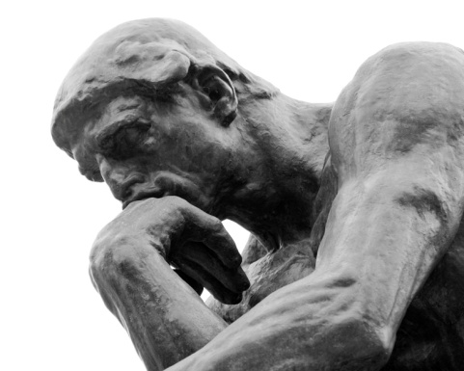
But what do we pursue?
Our pursuits are fueled by our priorities
We need to carefully consider our priorities
Luke 22: 41-42 - And He withdrew from them about a stone’s throw, and He knelt down and began to pray, ⁴² saying, “Father, if You are willing, remove this cup from Me; yet not My will, but Yours be done.”

Slide 4
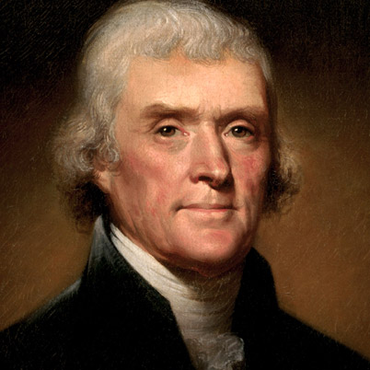
Isn’t my work valuable?
Born April 13, 1743 – Died July 4, 1826
Known for many things, wanted to be remembered for three primary things listed on his headstone
Author of Declaration of American Independence
Author of the Statute of Virginia for Religious Freedom
Father of the University of Virginia
Died in significant debt
Within 6 months, all his worldly possessions auctioned off

Slide 5
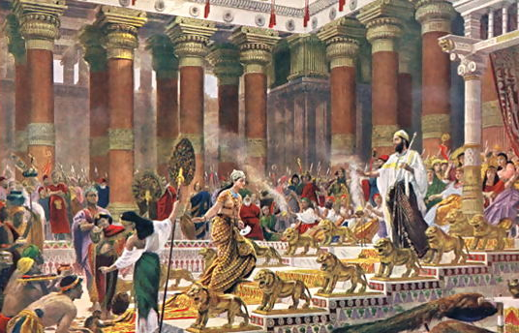
Vanity of Vanities!
Eccl 1:2-4 - ² “Vanity of vanities,” says the Preacher, “Vanity of vanities! All is vanity.”³ What advantage does man have in all his work which he does under the sun? ⁴ A generation goes and a generation comes, but the earth remains forever.
Eccl 1:11 - There is no remembrance of earlier things; And also of the later things which will occur, there will be for them no remembrance among those who will come later still.

Slide 6
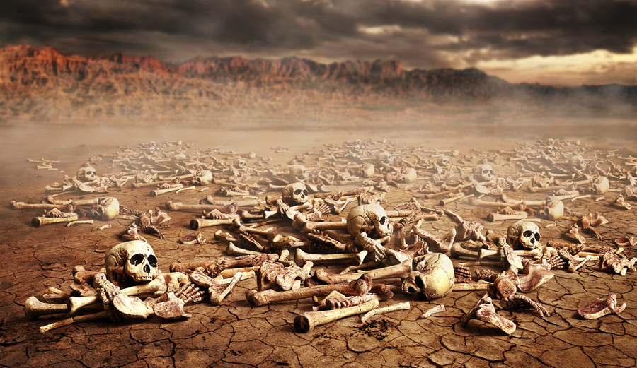
Valley of the dry bones
Ezekiel 37:1-14

Slide 7
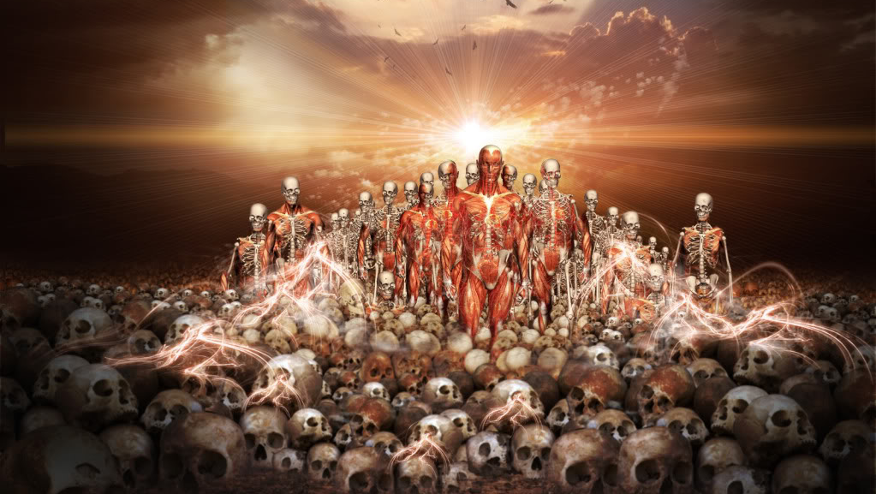
God’s Promise
Ezekiel 36: 23-28

Slide 8
Good afternoon Mr. Ambassador
2Cor 5:16-21 Therefore from now on we recognize no one according to the flesh; even though we have known Christ according to the flesh, yet now we know Him in this way no longer. ¹⁷ Therefore if anyone is in Christ, he is a new creature; the old things passed away; behold, new things have come. ¹⁸ Now all these things are from God, who reconciled us to himself through Christ and gave us the ministry of reconciliation,¹⁹ namely, that God was in Christ reconciling the world to Himself, not counting their trespasses against them, and He has committed to us the word of reconciliation.²⁰ Therefore, we are ambassadors for Christ, as though God were making an appeal through us; we beg you on behalf of Christ, be reconciled to God. ²¹ He made Him who knew no sin to be sin on our behalf, so that we might become the righteousness of God in Him.

Slide 9
Thus saith the Lord
1 John 2:5-6 - but whoever keeps His word, in him the love of God has truly been perfected. By this we know that we are in Him: ⁶ the one who says he abides in Him ought himself to walk in the same manner as He walked.
James 1:27 -Pure and undefiled religion in the sight of our God and Father is this: to visit orphans and widows in their distress, and to keep oneself unstained by the world.
Matt 25: 34-36 - ³⁴ “Then the King will say to those on His right, ‘Come, you who are blessed of My Father, inherit the kingdom prepared for you from the foundation of the world. ³⁵ For I was hungry, and you gave Me something to eat; I was thirsty, and you gave Me something to drink; I was a stranger, and you invited Me in; ³⁶ naked, and you clothed Me; I was sick, and you visited Me; I was in prison, and you came to Me.’

Slide 10
There are many parts
1 Cor 12:12-18 - For even as the body is one and yet has many members, and all the members of the body, though they are many, are one body, so also is Christ. ¹³ For by one Spirit we were all baptized into one body, whether Jews or Greeks, whether slaves or free, and we were all made to drink of one Spirit.¹⁴ For the body is not one member, but many. ¹⁵ If the foot says, “Because I am not a hand, I am not a part of the body,” it is not for this reason any the less a part of the body. ¹⁶ And if the ear says, “Because I am not an eye, I am not a part of the body,” it is not for this reason any the less a part of the body. ¹⁷ If the whole body were an eye, where would the hearing be? If the whole were hearing, where would the sense of smell be? ¹⁸ But now God has placed the members, each one of them, in the body, just as He desired.

Slide 11
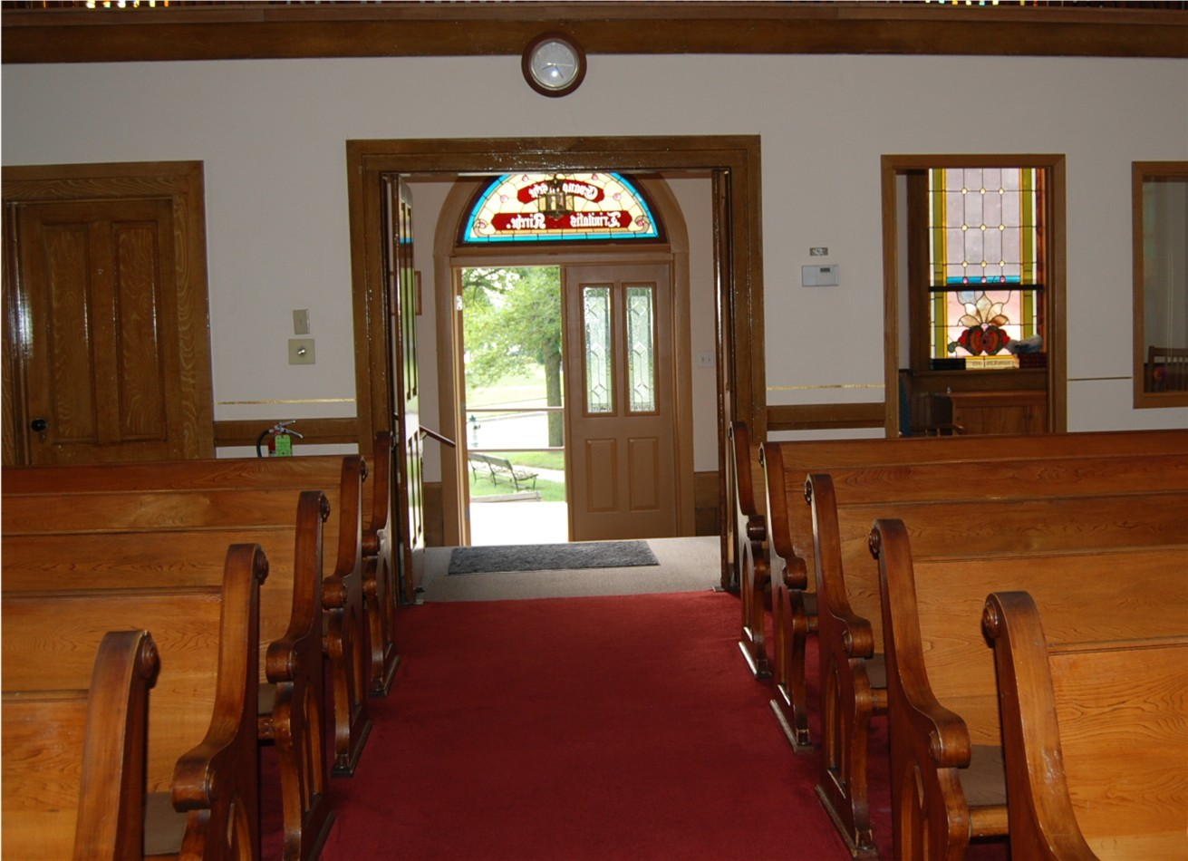
You have to take it out!

