Slide 1
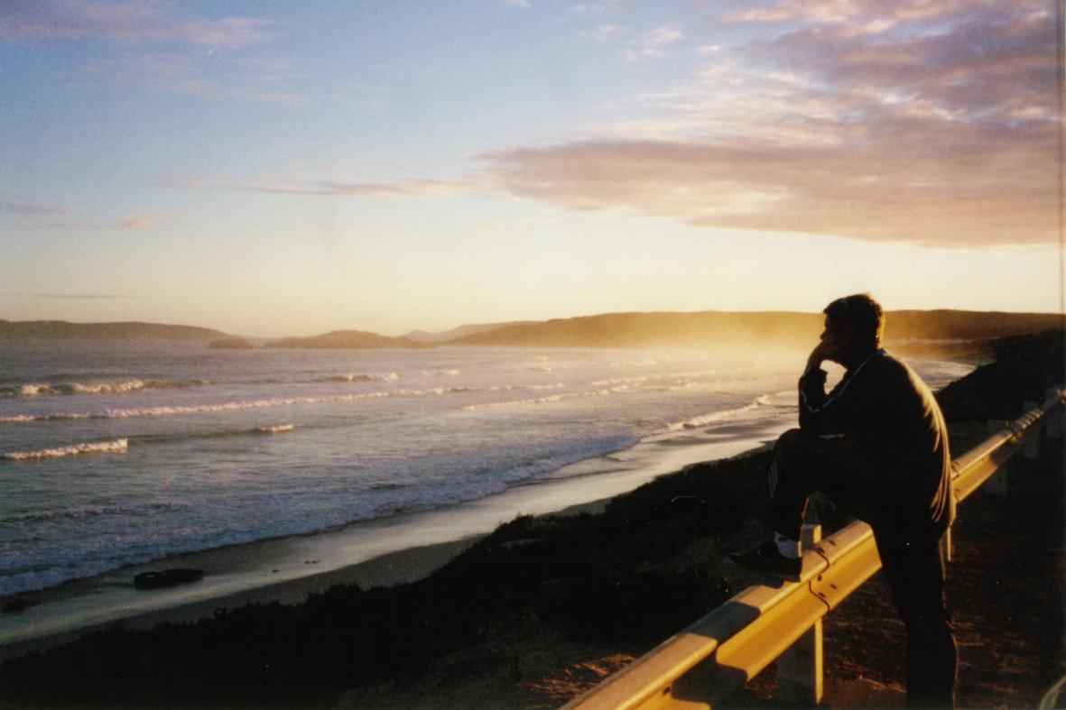
A Savior who Understands
Hebrews 4:14-16

Slide 2
“Nobody understands..”

Slide 4
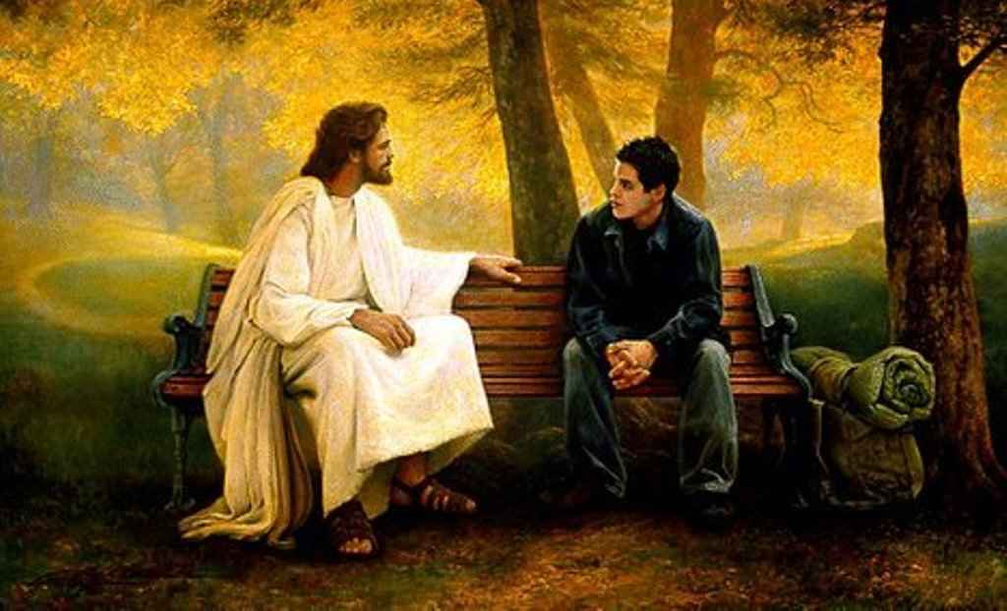
“For we do not have a High Priest who cannot sympathize with our weaknesses, but was in all points tempted as we are.. yet without sin..”
Hebrews 4:15

Slide 6
Jesus understands me..
16 Let us therefore come boldly to the throne of grace, that we may obtain mercy and find grace to help in time of need.

Slide 7
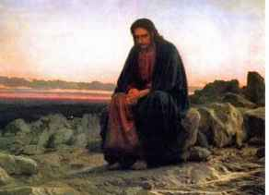
Matthew 14 …
A day in Jesus’ life that shows Jesus understands me …

Slide 8
Matthew 14:1-11..
Jesus understands when death darkens your door…

Slide 9
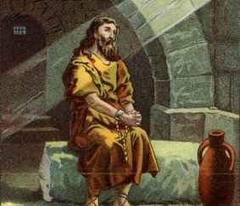
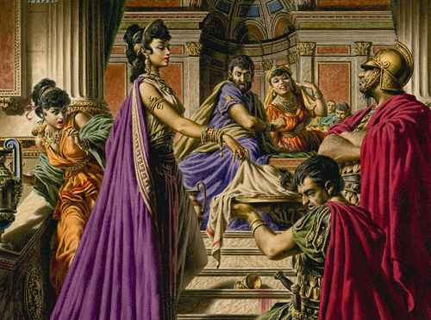
Death of His cousin..
Matthew 14:12 Then his disciples came and took away the body and buried it, and went and told Jesus.

Slide 10
Death of His cousin..
John 11:35-36 Jesus wept. 36 Then the Jews said, "See how He loved him!"
Matthew 11:11 "Assuredly, I say to you, among those born of women there has not risen one greater than John the Baptist..

Slide 11
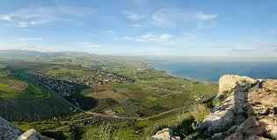
Jesus seeks solitude..
Matthew 14:13 When Jesus heard it, He departed from there by boat to a deserted place by Himself…

Slide 12
When death darkens your door… Jesus understands
So take it to the Lord in prayer…

Slide 13
Matthew 14:13-21
Jesus understands when stress interrupts your peace…

Slide 14
Jesus seeks solitude..
Matt 14:13 When Jesus heard it, He departed from there by boat to a deserted place by Himself. But when the multitudes heard it, they followed Him on foot from the cities.
Mark 6:33 But the multitudes saw them departing, and many knew Him and ran there on foot from all the cities. They arrived before them and came together to Him.

Slide 15
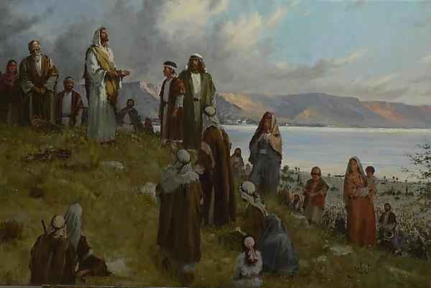
Jesus’ response..
Mark 6:34 And Jesus, when He came out, saw a great multitude and was moved with compassion for them, because they were like sheep not having a shepherd. So He began to teach them many things.

Slide 16
Spinning out of control..
Jesus understands that…
He has been tempted in all points.. yet without sin
So take it to the Lord in prayer..

Slide 17
Mark 6:35-44..
Jesus understands when people disappoint your expectations…

Slide 18
Feeding the multitude…
Mark 6:39-44 Then He commanded them to make them all sit down in groups on the green grass. 40 So they sat down in ranks, in hundreds and in fifties. 41 And when He had taken the five loaves and the two fish, He looked up to heaven, blessed and broke the loaves, and gave them to His disciples to set before them; and the two fish He divided among them all. 42 So they all ate and were filled. 43 And they took up twelve baskets full of fragments and of the fish. 44 Now those who had eaten the loaves were about five thousand men.

Slide 19
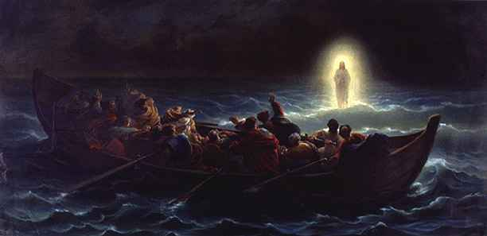
Jesus sends the disciples ahead..
Mark 6:45-52 Now when evening came, the boat was in the middle of the sea; and He was alone on the land. 48 Then He saw them straining at rowing, for the wind was against them. Now about the fourth watch of the night He came to them, walking on the sea, and would have passed them by. 49 And when they saw Him walking on the sea, they supposed it was a ghost, and cried out; 50 for they all saw Him and were troubled.

Slide 20
Jesus sends the disciples ahead..
Mark 6:45-52 49 And when they saw Him walking on the sea, they supposed it was a ghost, and cried out; 50 for they all saw Him and were troubled. But immediately He talked with them and said to them, "Be of good cheer! It is I; do not be afraid." 51 Then He went up into the boat to them, and the wind ceased. And they were greatly amazed in themselves beyond measure, and marveled. 52 For they had not understood about the loaves, because their heart was hardened.
.

Slide 21
When people disappoint your expectations..
Remember that Jesus understands…
John 13:1 Now before the Feast of the Passover, when Jesus knew that His hour had come that He should depart from this world to the Father, having loved His own who were in the world, He loved them to the end.

Slide 22
We only have one friend who will never disappoint us..
He understands when death has come..
When you’re stressed out..
When people disappoint you..
Jesus understands.. cares..

Slide 23
A Savior who Understands
Hebrews 4:14-16

