Slide 1
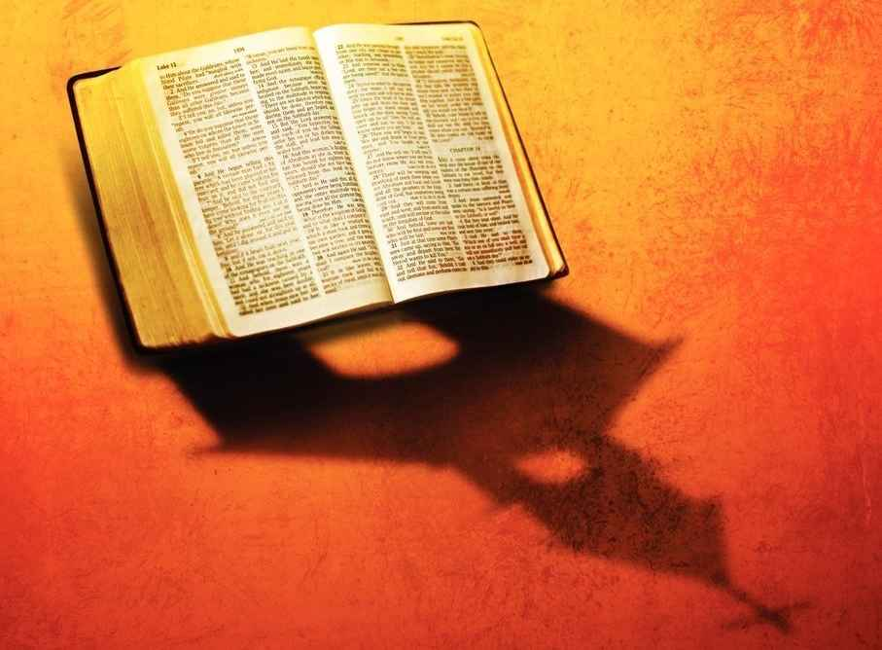
New Testament Shaped Churches
1 Timothy: 3.14-16

Slide 2
Doctrine downplayed…
Fundamentals of Christianity …
Belief that Jesus saves
Doing nice things for others
What really matters in a church ..
A warm, welcoming church
Emotionally moving services
Impact for good in community

Slide 3
Doctrine still matters..
When choosing a church..
1st make sure doctrine is right
Is it warm and welcoming?
Are services uplifting and edifying?
Are they making an impact for good?
Only then ..

Slide 4
Tell me about the churches of Christ?
What is the difference between the church of Christ and _________ ?
Cannot answer in official sense
General unity beliefs and practices

Slide 5
Are churches of Christ evangelical churches?
“Evangelical” churches basic beliefs…
The Bible is literally God’s Word
2 Tim 3:16-17 .. 2 Pet 1:21
Salvation only through Jesus Christ
John 14:6 .. Acts 4:12
A Christian must live a changed life
Col 3:5-10 .. 1 Pet 1:14-16

Slide 6
But not just another evangelical church..
Some significant differences..
Doesn’t mean more sincere, devoted
Not more respect for Bible as God’s word
Not claiming we are more Christ-like

Slide 7
A Different Goal.. Restoration
Martin Luther .. The Reformation
Goal: to reform the corrupt Catholic establishment of their day
Luther’s 95 theses (Oct 31, 1517)
One step further… Restoration
Goal: restore the true church of Jesus Christ beliefs and practices of church in the N.T.
Not just Bible-believing but Bible-shaped

Slide 8
Why Restoration?..
This idea is endorsed in the Bible..
God has always given His people instructions (how organized, how to worship, moral life)
God has always demanded obedience
Lev 26:14ff; Deut 30:15-20; Eccl 12:13-14
Matt 7:21-27; John 14:21-24)
People don’t always obey God (some defy God, others get lost to will of God) ..

Slide 9
When God’s will is lost, He wants His way restored..
Days of Nehemiah (Nehemiah 8)
The people meet to read the law .. 1-5, 13
Discover Feast of tabernacles .. vs 14 (had been lost for 1000 years)
Their response.. Vs 15-17 (go get branches to make booths… as it is written) …
“the sons of Israel had not done so from the days of Joshua … and there was great rejoicing”

Slide 10
When God’s will is lost, He wants His way restored..
Days of David (2 Samuel 6)
David thought to return ark to Jerusalem after events of 1 Samuel 4
30,000 people assembled for honor guard to bring it seven miles (2 Sam 6:1)
Musicians (2 Sam 6:5)
Brand new cart to show utmost respect (vs 3)
Cart hits bump, Uzzah tries to steady ark (vs 7)

Slide 11
When God’s will is lost, He wants His way restored..
Days of David (2 Samuel 6)
David gets angry (vs 8-11) .. What went wrong?
David gets out Bible, discovers God’s instructions .. Ark to be carried by Levites (Exod 25:12-15; Numb 4:5-6,15)
David does it right (1 Chron 15:15:2,11-15)

Slide 12
New Testament contains a pattern..
1 Cor 14:33 all congregations of saints (who could speak in assembly)
Acts 14:20-22 elders in each church (Phil 1:1: Acts 15:2; 20:17)
1 Cor 16:1-2 first day of week
Acts 20:7 break bread first day of week
1 Tim 2:8 men to pray in every place

Slide 13
Plea for unity of believers..
Matt 16:18 will build by church
Romans 16:16 churches of Christ
1 Cor 1:10-13 let be no divisions
John 17:20-21 pray may all be one

Slide 14
New Testament Shaped Churches
1 Timothy: 3.14-16

