Slide 1
What Have They Seen in Your House?
2 Kings 20:1-15

Slide 2
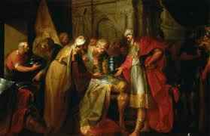
King Hezekiah’s sickness and recovery (vs 1-11) …
Hezekiah’s foolish mistake (12-15)
Showed Babylonians treasures in his house..
“What have they seen in your house?” – “Everything..”
Isaiah’s rebuke for his vain display (16-19)

Slide 3
What have they seen in our houses? ..
Why it matters ..
“As goes the home, so goes the nation”..
The home instituted by God ..

Slide 4
What have they seen in our houses? ..
What God sees …
What our own family sees ..
What others may see ..

Slide 5
What have they seen in our houses? ..
Some are observing our homes ..
What impresses them .. a house or a home?
Our treasures .. or values that guide our home?

Slide 6
What has God seen?..
Hebrews 4:13 And there is no creature hidden from His sight, but all things are naked and open to the eyes of Him to whom we must give account.

Slide 7
Psalms 33:13-14 The Lord looks from heaven; He sees all the sons of men. 14 From the place of His dwelling He looks on all the inhabitants of the earth..

Slide 8
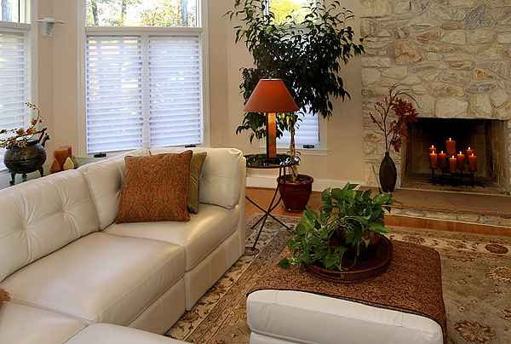
What has He seen of our thoughts?
Psalms 94:11 The Lord knows the thoughts of man, that they are vanity.

Slide 9
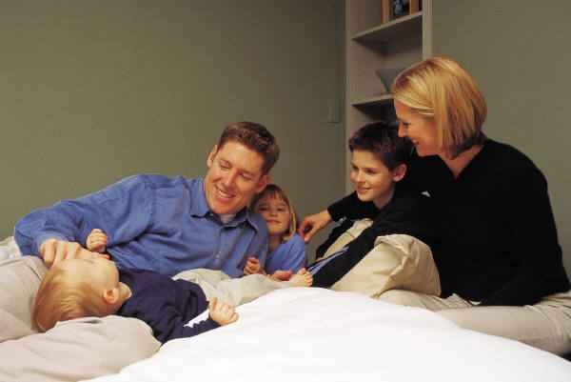
What has He seen of our words?
Proverbs 18:21 Death and life are in the power of the tongue, and those who love it will eat its fruit.
Prov 15:26 the words of the pure are pleasant.

Slide 10
What has He seen of our words?
Ephesians 5:25, 28 Husbands, love your wives, just as Christ also loved the church and gave Himself for her...
Colossians 3:19 Husbands, love your wives and do not be bitter toward them.
Ephesians 5:33 and let the wife see that she respects her husband.

Slide 11
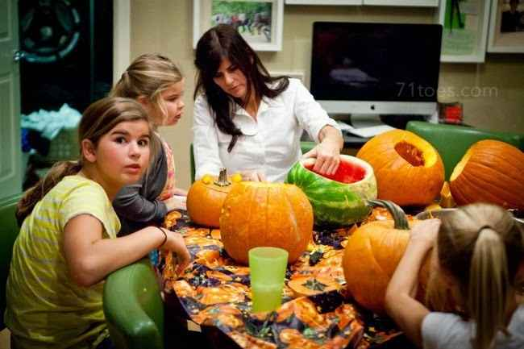
What has He seen of our words?
Proverbs 25:11 A word fitly spoken is like apples of gold In settings of silver.
Colossians 4:6 Let your speech always be with grace, seasoned with salt, that you may know how you ought to answer each one.

Slide 12
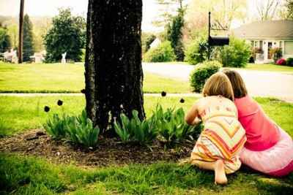
What has He seen of our actions in our home?
Matthew 5:16 Let your light so shine before men, that they may see your good works and glorify your Father in heaven.

Slide 13
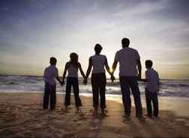
Godly activities in the home…
Fellowship..
Prayer
Hospitality..
Benevolence..
Bible study..

Slide 14
What have our children seen in our homes?
Proper spiritual priorities..
Attend worship together every week..
Occasion of edification or occasional edification?
Take them to church.. or touch their hearts?

Slide 15
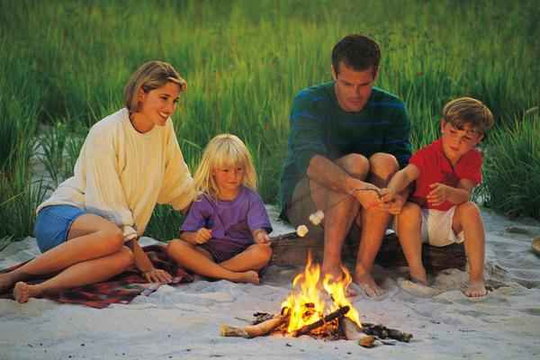
What do they see of love in the home?
Home is the domain of love…
Need to see love of father and mother..

Slide 16
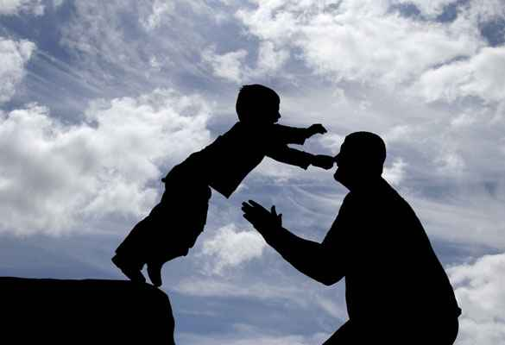
What do they see of loving discipline?
Hebrews 12:9 Furthermore, we have had human fathers who corrected us, and we paid them respect. Shall we not much more readily be in subjection to the Father of spirits and live?
Proverbs 1:8 My son, hear the instruction of your father, and do not forsake the law of your mother..

Slide 17
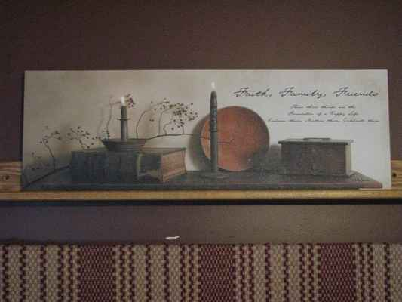
Purity in the home..
Romans 12:1-2 I beseech you therefore, brethren, by the mercies of God, that you present your bodies a living sacrifice, holy, acceptable to God, which is your reasonable service. 2 And do not be conformed to this world, but be transformed by the renewing of your mind, that you may prove what is that good and acceptable and perfect will of God.

Slide 18
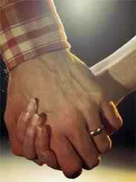
What have others seen in our homes?
Matthew 19:4-6 "Have you not read that He who made them at the beginning 'made them male and female,' 5 and said, 'For this reason a man shall leave his father and mother and be joined to his wife, and the two shall become one flesh'? 6 So then, they are no longer two but one flesh. Therefore what God has joined together, let not man separate."

Slide 19
The husband-wife relationship..
Ephesians 5:33 Nevertheless let each one of you in particular so love his own wife as himself, and let the wife see that she respects her husband.
Ephesians 5:22 Wives, submit to your own husbands, as to the Lord.

Slide 20
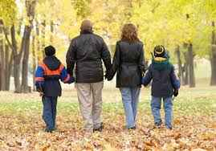
The children..
Ephesians 6:1 Children, obey your parents in the Lord, for this is right.
Colossians 3:20 Children, obey your parents in all things, for this is well pleasing to the Lord

Slide 21
What would a visitor see?
If they stayed for a week?
At the dinner table?
Spiritual atmosphere ?
A Christian home?

Slide 22
What Have They Seen in Your House?
2 Kings 20:1-15

