Slide 1
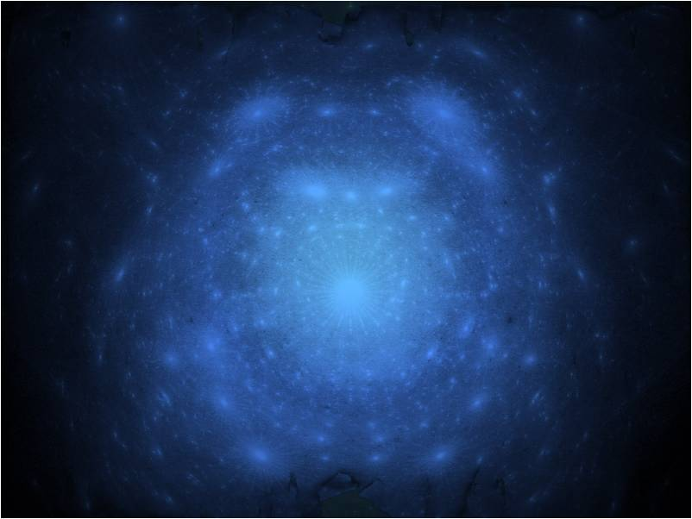
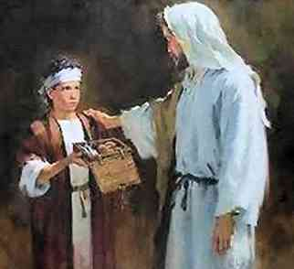
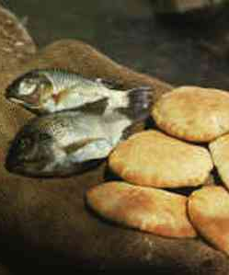
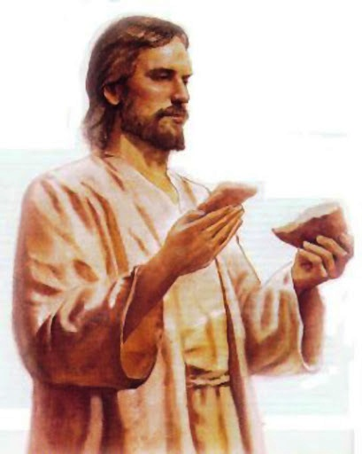
Jesus and Your Impossibilities
John 6:1-15 .. 35-51

Slide 2
Impossibilities in life..
Familiar sayings ..
Yet Jesus did the impossible ..
Your list of impossibles ..

Slide 3
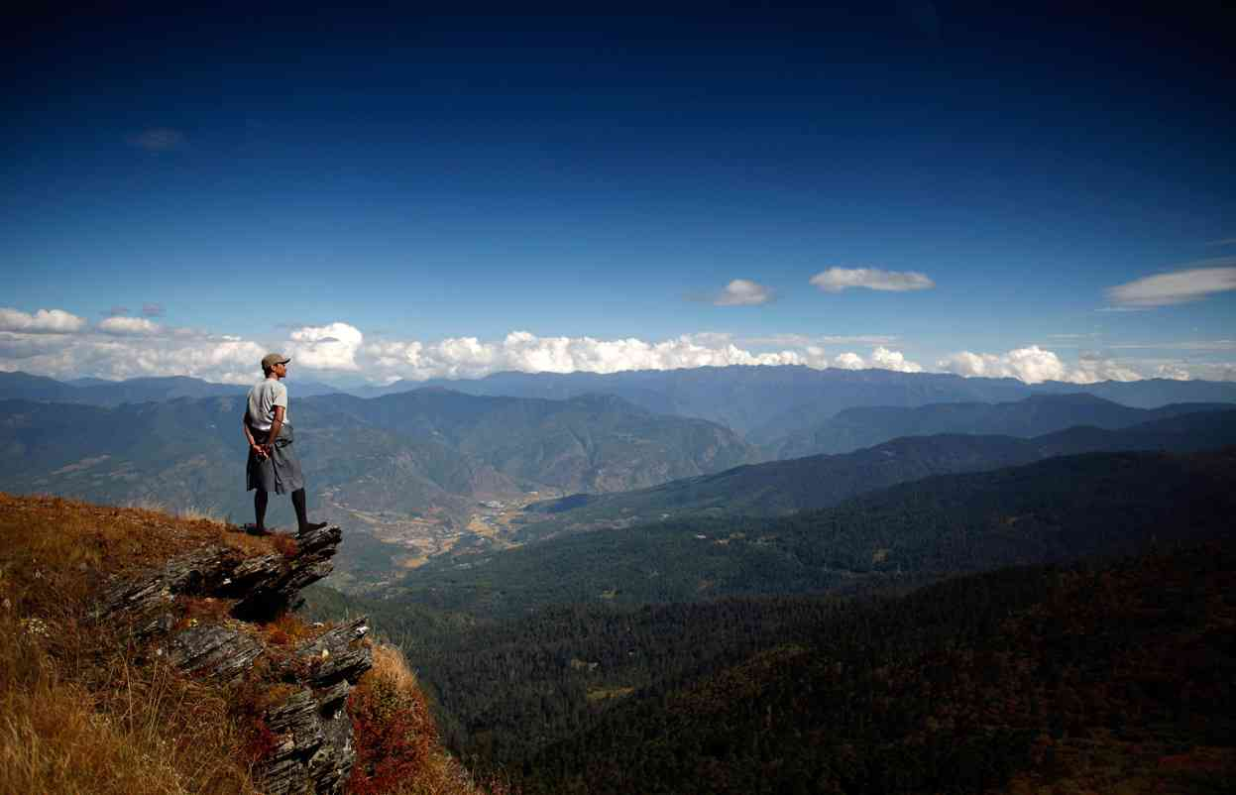
Human or divine perspective..
Jeremiah 32:27 “I am the Lord.. I am the God of every person on the earth. You know that nothing is impossible for Me.”
Luke 1:37 “For nothing will be impossible with God..” 18:27 “The things impossible with men are possible with God.”

Slide 4
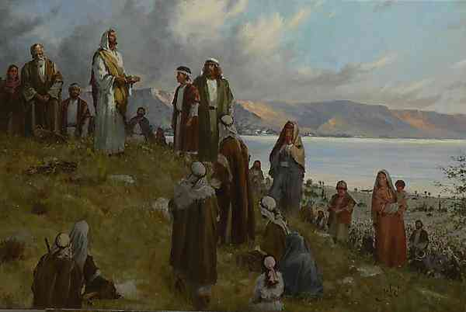
John 6.. Jesus confronts human impossibility...
John 6:1-5 After these things Jesus went over the Sea of Galilee, which is the Sea of Tiberias. 2 Then a great multitude followed Him, because they saw His signs which He performed on those who were diseased. 3 And Jesus went up on the mountain, and there He sat with His disciples.
4 Now the Passover, a feast of the Jews, was near. 5 Then Jesus lifted up His eyes, and seeing a great multitude coming toward Him, He said to Philip, "Where shall we buy bread, that these may eat?“

Slide 5
No problem too big to solve ...
6But this He said to test him, for He Himself knew what He would do.
7 Philip answered Him, "Two hundred denarii worth of bread is not sufficient for them, that every one of them may have a little."

Slide 6
No person too small to use...
8 One of His disciples, Andrew, Simon Peter's brother, said to Him, 9 "There is a lad here who has five barley loaves and two small fish, but what are they among so many?"

Slide 7
Transferring what you have to Jesus ...
Luke 6:38 Give, and it will be given to you: good measure, pressed down, shaken together, and running over will be put into your bosom. For with the same measure that you use, it will be measured back to you."
Mark 14:8 She has done what she could. She has come beforehand to anoint My body for burial.

Slide 8
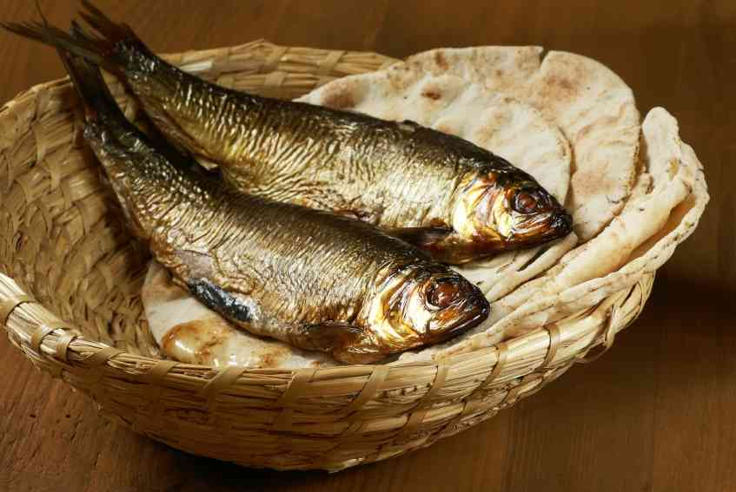
Jesus can transform the small...
Luke 6:38 Give, and it will be given to you: good measure, pressed down, shaken together, and running over wilMark 12:41-44 widow's two mites
1 Corinthians 1:26-27 For you see your calling, brethren, that not many wise according to the flesh, not many mighty, not many noble, are called. 27 But God has chosen the foolish things of the world to put to shame the wise, and God has chosen the weak things of the world to put to shame the things which are mightyl be put into your bosom. For with the same measure that you use, it will be measured back to you."

Slide 9
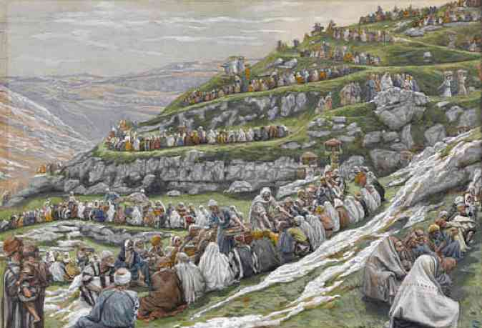
No hunger too great..
10 Then Jesus said, "Make the people sit down." Now there was much grass in the place. So the men sat down, in number about five thousand. 11 And Jesus took the loaves, and when He had given thanks He distributed them to the disciples, and the disciples to those sitting down; and likewise of the fish, as much as they wanted. 12 So when they were filled, He said to His disciples, "Gather up the fragments that remain, so that nothing is lost." 13 Therefore they gathered them up, and filled twelve baskets with the fragments of the five barley loaves which were left over by those who had eaten.

Slide 10
Going beyond the miracle to Jesus ..
John 6:14-15 Then those men, when they had seen the sign that Jesus did, said, "This is truly the Prophet who is to come into the world." 15 Therefore when Jesus perceived that they were about to come and take Him by force to make Him king, He departed again to the mountain by Himself alone.

Slide 11
Jesus is the true bread Himself ..
John 6:27-29 Do not labor for the food which perishes, but for the food which endures to everlasting life, which the Son of Man will give you, because God the Father has set His seal on Him." 28 Then they said to Him, "What shall we do, that we may work the works of God?" 29 Jesus answered and said to them, "This is the work of God, that you believe in Him whom He sent."

Slide 12
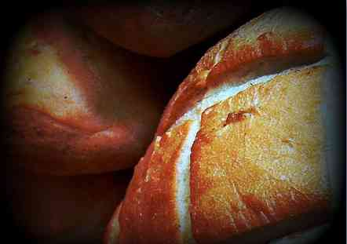
The living bread..
John 6:32-35 Then Jesus said to them, "Most assuredly, I say to you, Moses did not give you the bread from heaven, but My Father gives you the true bread from heaven. 33 For the bread of God is He who comes down from heaven and gives life to the world." 34 Then they said to Him, "Lord, give us this bread always." 35 And Jesus said to them, "I am the bread of life. He who comes to Me shall never hunger, and he who believes in Me shall never thirst.

Slide 13
The living bread..
John 6:38-40 For I have come down from heaven, not to do My own will, but the will of Him who sent Me. 39 This is the will of the Father who sent Me, that of all He has given Me I should lose nothing, but should raise it up at the last day. 40 And this is the will of Him who sent Me, that everyone who sees the Son and believes in Him may have everlasting life; and I will raise him up at the last day."

Slide 14
The living bread..
John 6:47-51 Most assuredly, I say to you, he who believes in Me has everlasting life. 48 I am the bread of life. 49 Your fathers ate the manna in the wilderness, and are dead. 50 This is the bread which comes down from heaven, that one may eat of it and not die. 51 I am the living bread which came down from heaven. If anyone eats of this bread, he will live forever; and the bread that I shall give is My flesh, which I shall give for the life of the world."

Slide 15
Jesus and Your Impossibilities
John 6:1-15 .. 35-51

