Slide 1
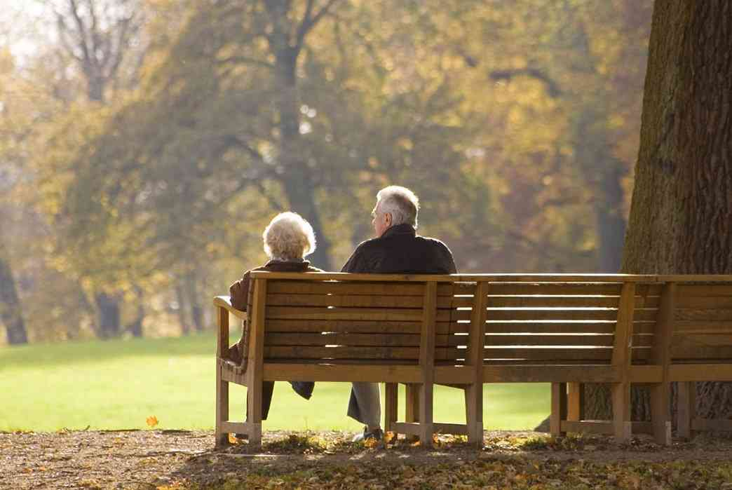
The Best is Yet to Come
John 2:1-11

Slide 3
If you are a Christian..
Don’t have to dread aging because the best is yet to come..

Slide 4
As you walk with Him..
He’s with you with His great power …
He changes everything and promises a great future …

Slide 5
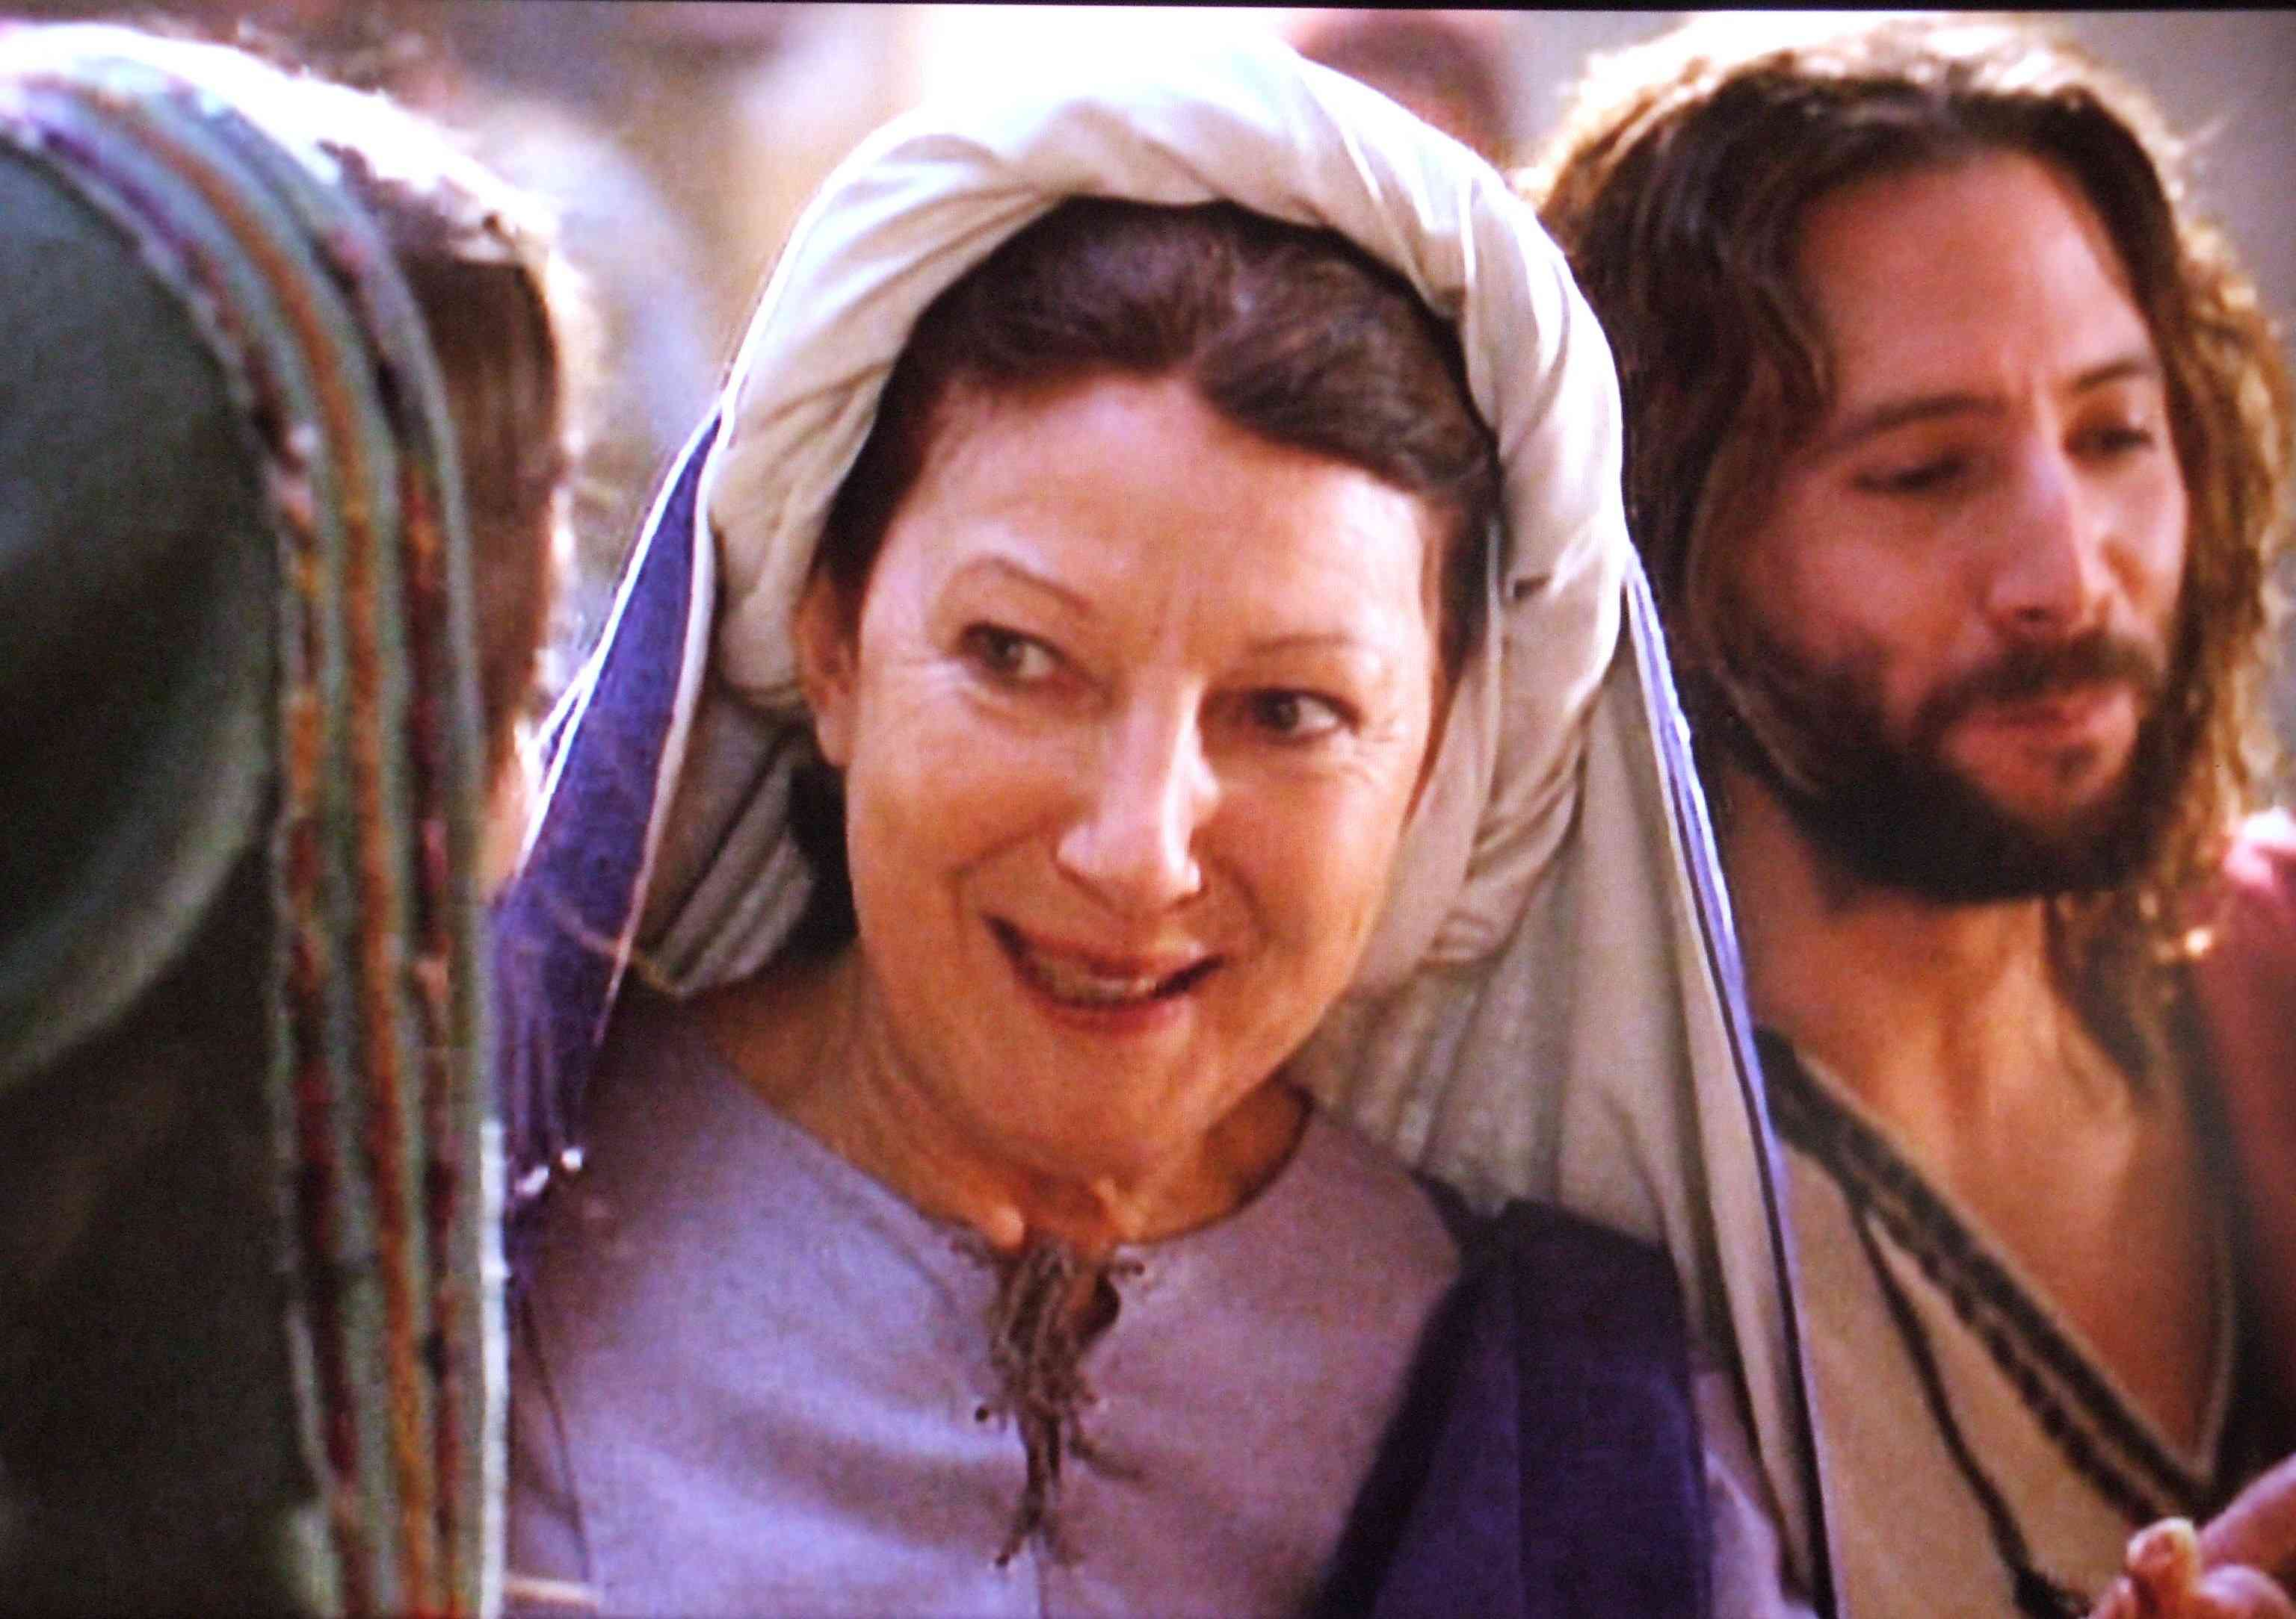
Wedding feast John 2:1-11
Enjoying the celebration..
Jesus’ mother seeks Jesus’ help..

Slide 6
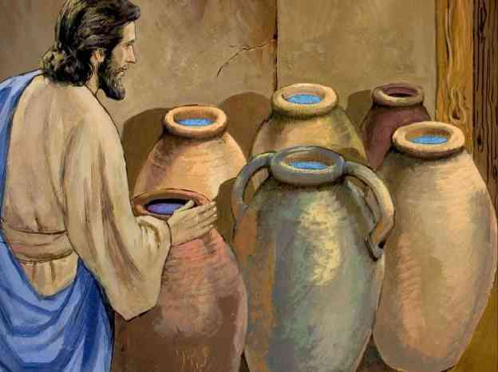
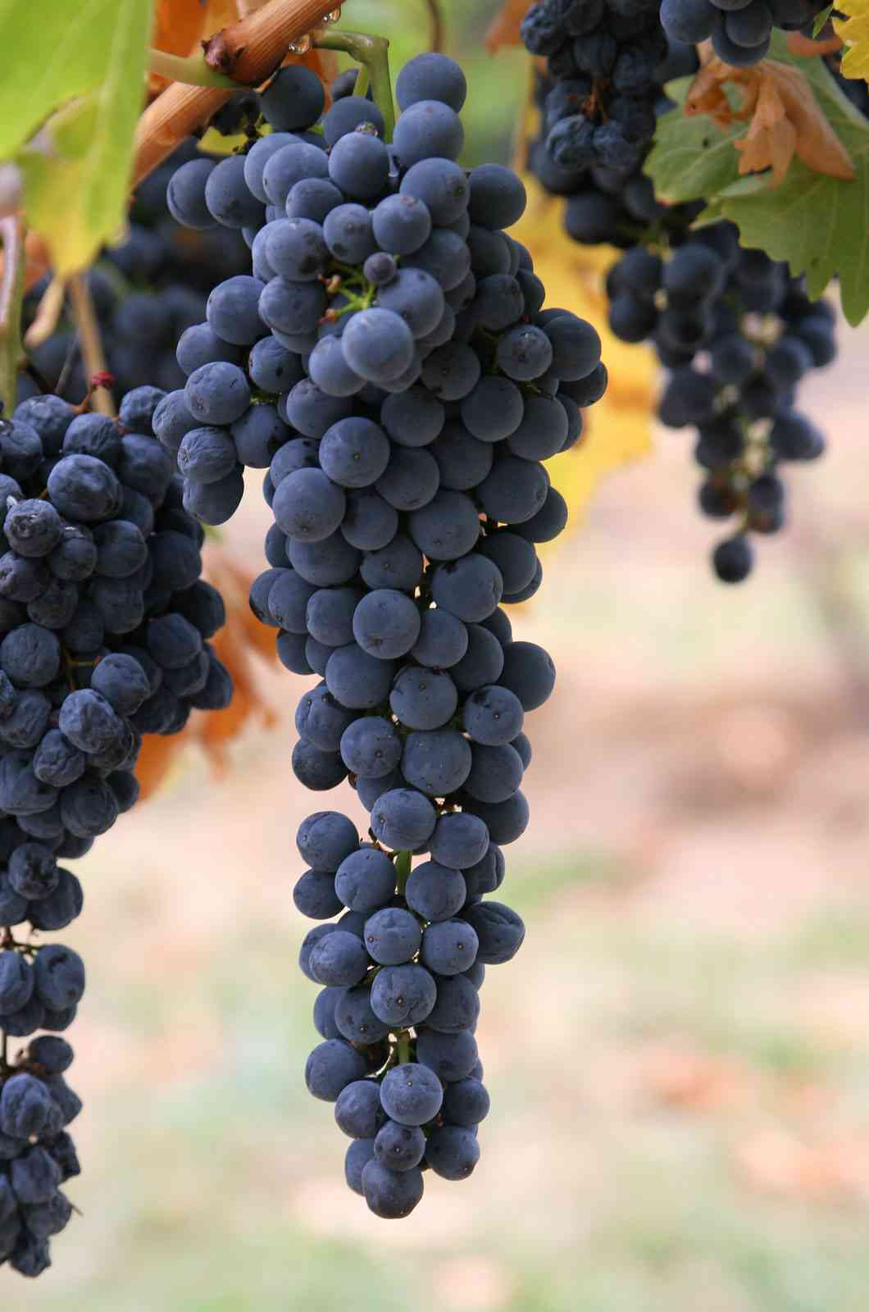
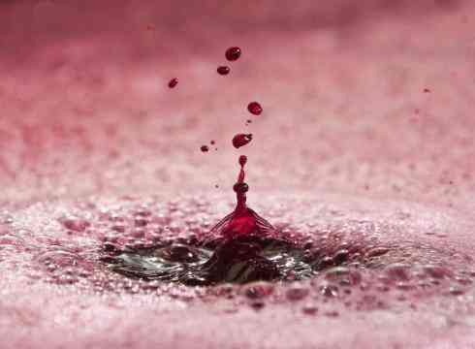
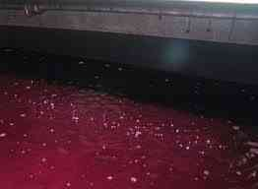
The miracle..water to wine
Bring happiness to those celebrating..
Prove He can intervene in your life..

Slide 7
Jesus understands your situation best..
Ephesians 3:20 Now to Him who is able to do exceedingly abundantly above all that we ask or think, according to the power that works in us..

Slide 8
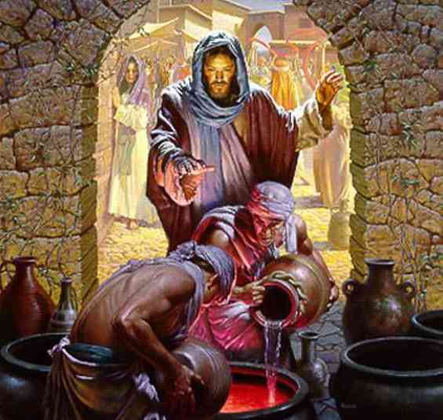
Fill the waterpots..
Jesus will do His part, but we also have our part …

Slide 9
God saves the best for last…
John 2:10 "Every man at the beginning sets out the good wine, and when the guests have well drunk, then the inferior. You have kept the good wine until now!"

Slide 10
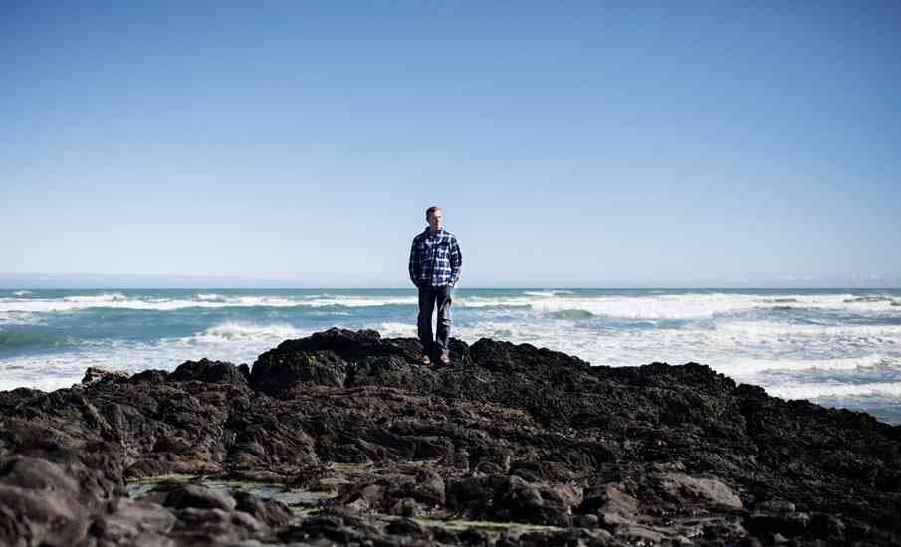
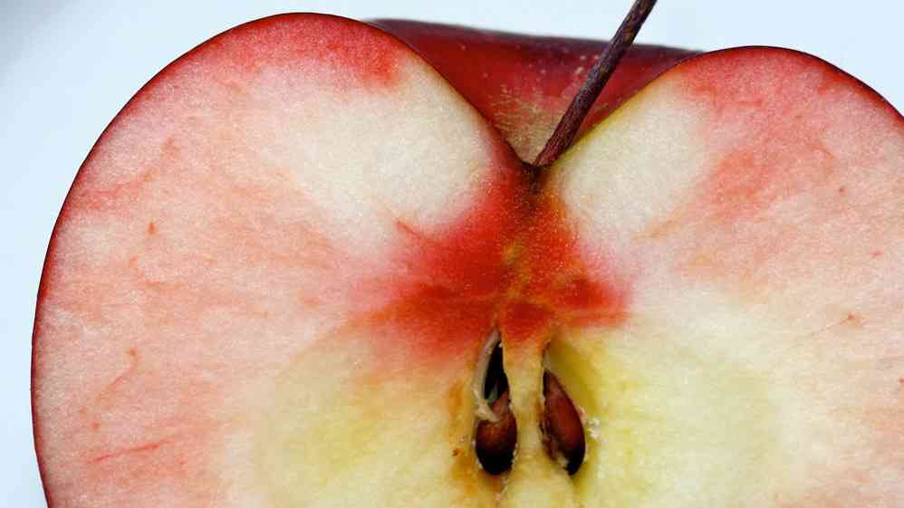
Satan’s lie..
Grab for the best right now..

Slide 11
The choice is yours..
Galatians 6:7-8 whatever a man sows, that he will also reap. 8 For he who sows to his flesh will of the flesh reap corruption, but he who sows to the Spirit will of the Spirit reap everlasting life.

Slide 12
The Best is Yet to Come
John 2:1-11

