Slide 1
Focusing on the Positive
Philippians 1:12-20

Slide 2
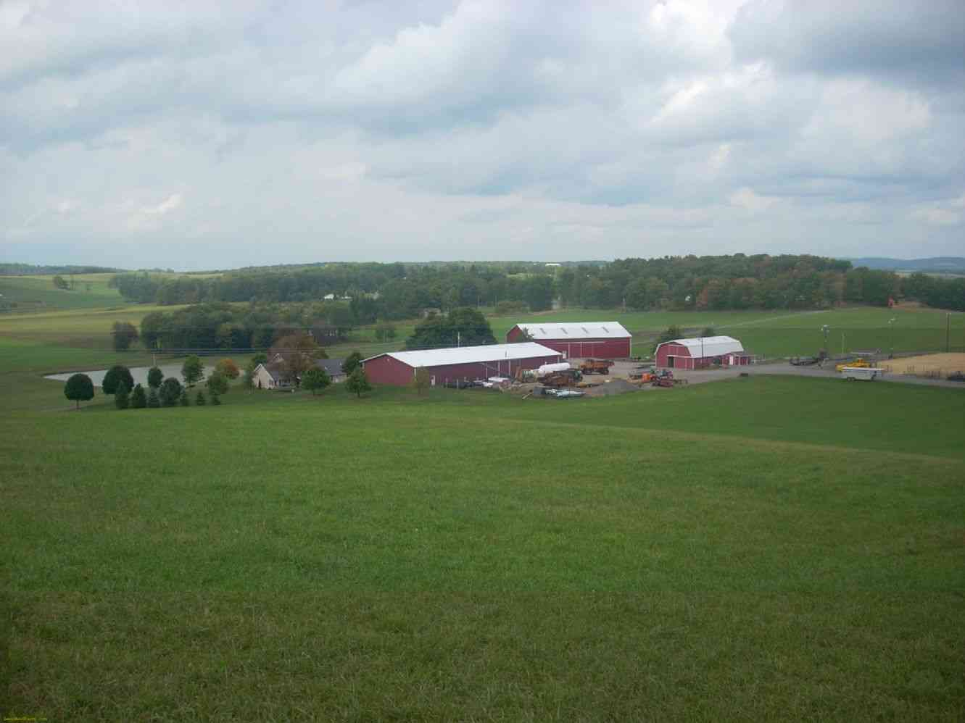
Farm for sale..
Good location, well kept house, sturdy barns, lush pastures, beautiful pond, fertile soil, great view…

Slide 3
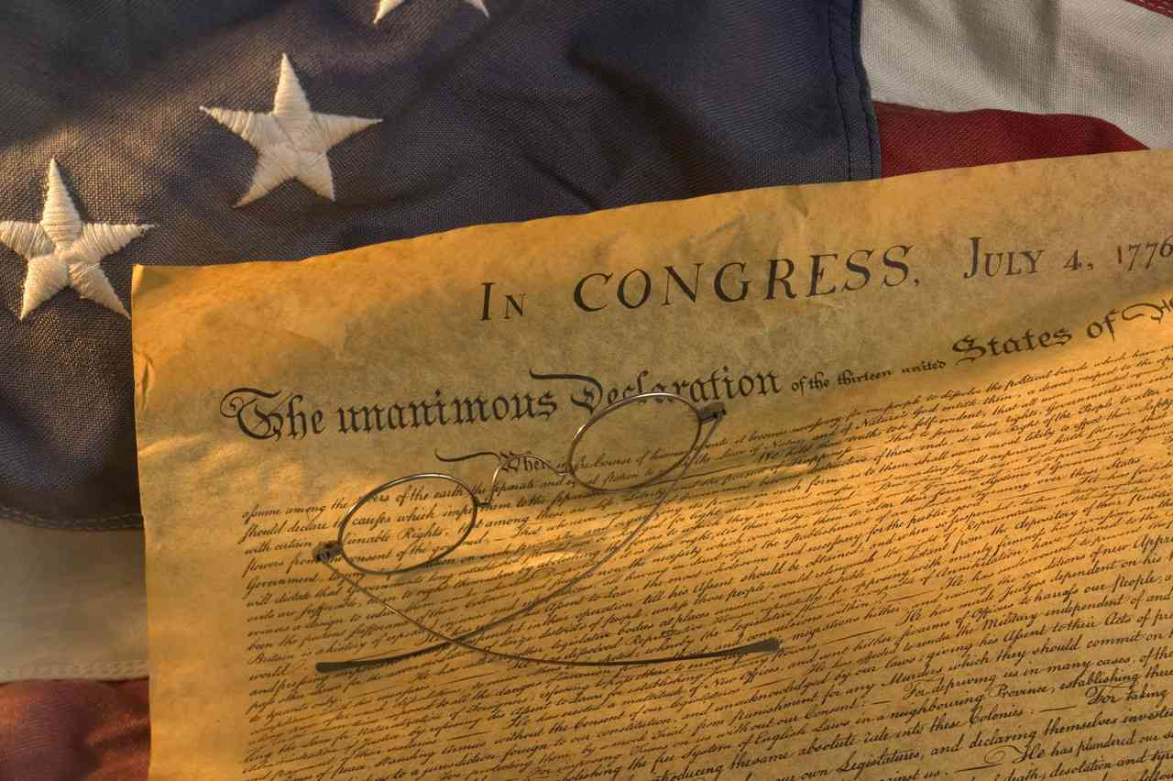
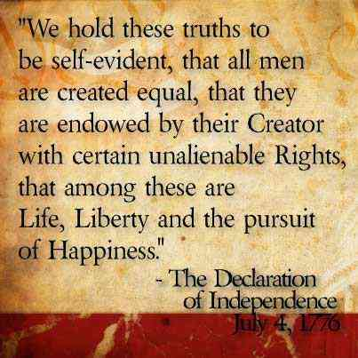
The pursuit of happiness..

Slide 4
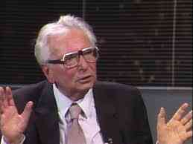
Victor Frankl, holocaust survivor..
“Everything can be taken from a man but one thing: the last of the human freedoms – to choose one’s attitude in any given set of circumstances…”

Slide 5
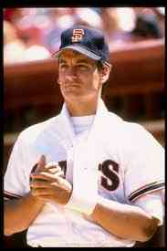
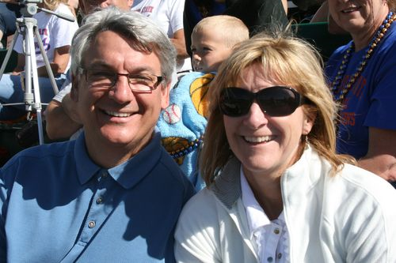
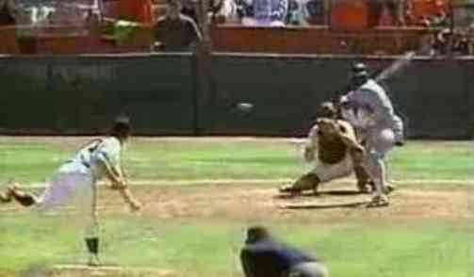
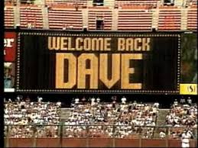
Pitcher Dave Dravecky..

Slide 6
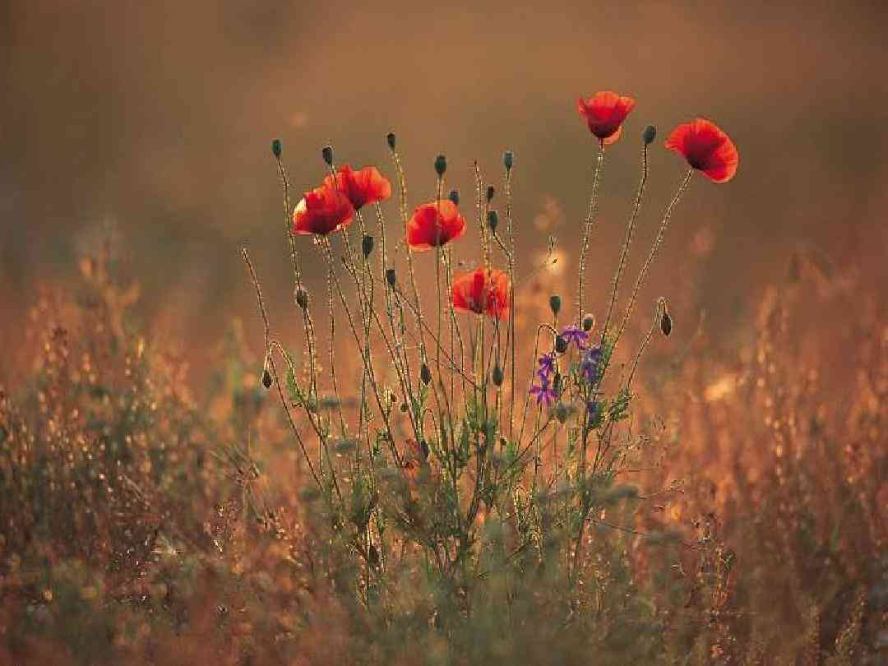
Have good thoughts..
Philippians 4:8 Finally, brethren, whatever things are true, whatever things are noble, whatever things are just, whatever things are pure, whatever things are lovely, whatever things are of good report, if there is any virtue and if there is anything praiseworthy — meditate on these things.

Slide 7
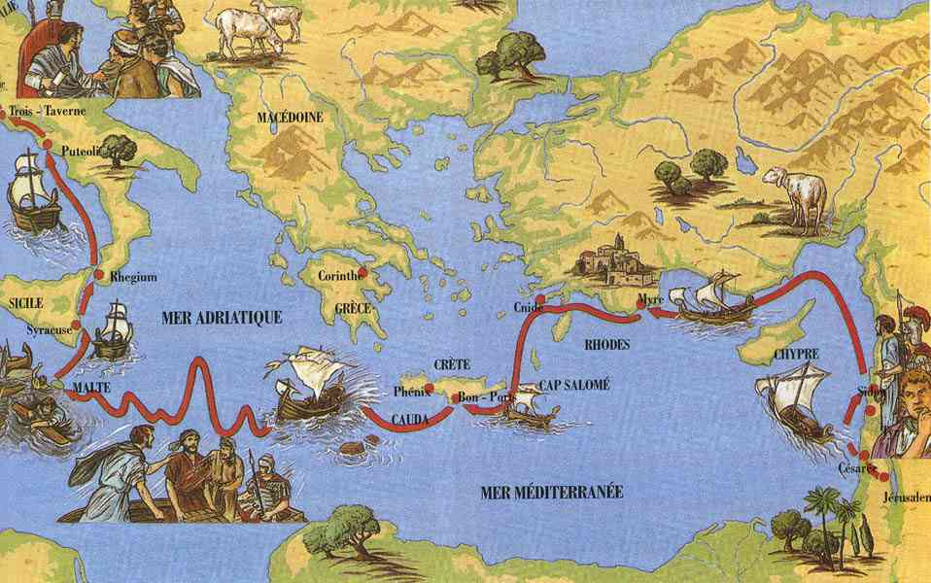
Paul’s attitude of joy..
Circumstances…
People…
Uncertain Future…

Slide 8
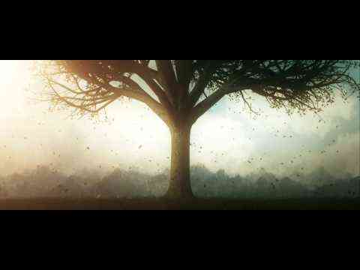
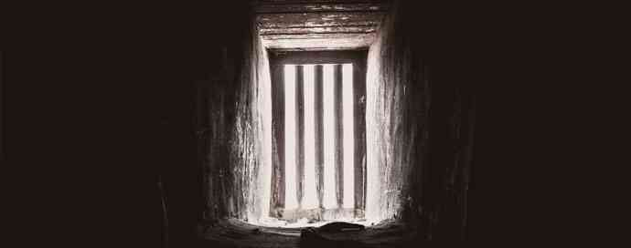
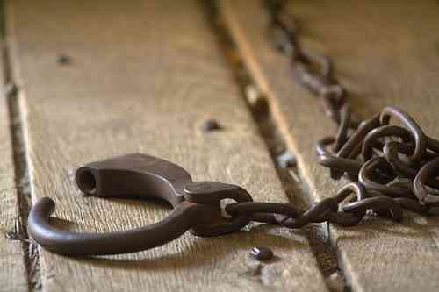
1 Circumstances..
Phil 1:12-14 But I want you to know, brethren, that the things which happened to me have actually turned out for the furtherance of the gospel, 13 so that it has become evident to the whole palace guard, and to all the rest, that my chains are in Christ; 14 and most of the brethren in the Lord, having become confident by my chains, are much more bold to speak the word without fear.

Slide 9
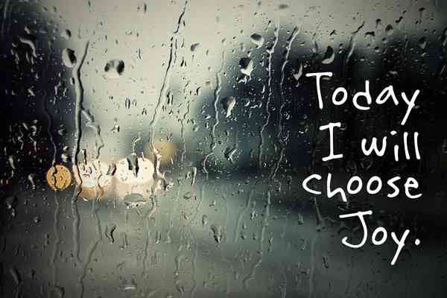
Positive results..
Progress of the gospel..
Witness before Roman guards..
Brethren became more bold..

Slide 10
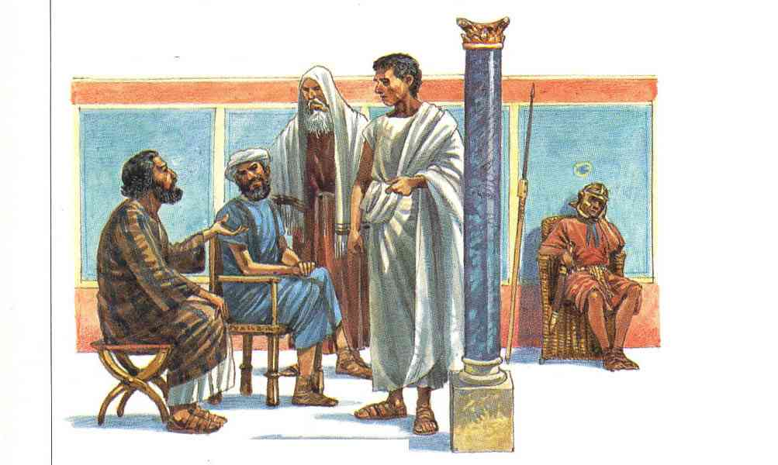
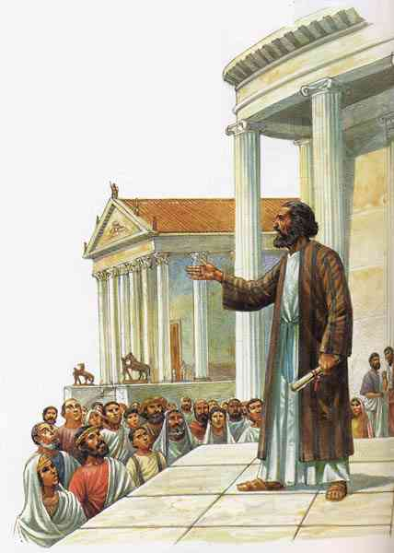
2 People..
Philippians 1:15-18 Some indeed preach Christ even from envy and strife, and some also from goodwill: 16 The former preach Christ from selfish ambition, not sincerely, supposing to add affliction to my chains; 17 but the latter out of love, knowing that I am appointed for the defense of the gospel.

Slide 11
2 People..
Philippians 1:18 What then? Only that in every way, whether in pretense or in truth, Christ is preached; and in this I rejoice, yes, and will rejoice.

Slide 12
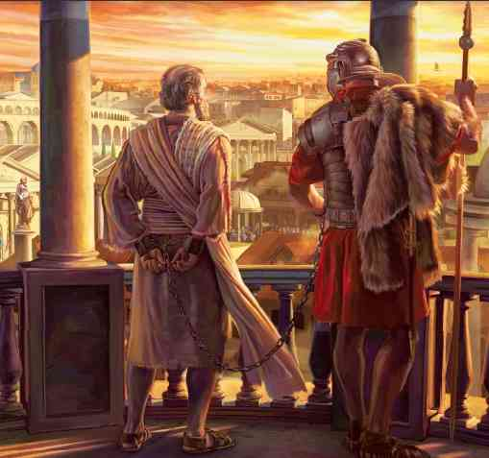
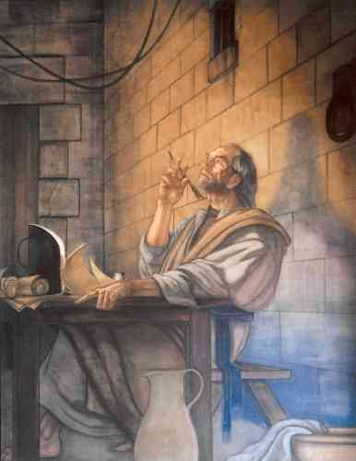
3 Uncertain future..
Philippians 1:19-20 For I know that this will turn out for my deliverance through your prayer and the supply of the Spirit of Jesus Christ, 20 according to my earnest expectation and hope that in nothing I shall be ashamed, but with all boldness, as always, so now also Christ will be magnified in my body, whether by life or by death.

Slide 13
3 Uncertain future..
Your prayers and help of the Spirit..
Not ashamed but have courage ..
Christ will be exalted..

Slide 14
3 Uncertain future..
Philippians 1:21 For to me, to live is Christ, and to die is gain..
“To live is money, to die is to leavee it all behind..
“To live is fame, to die is to be forgotten..
“To live is power, to die is to lose it all..
“To live is possessions, to die is to take none of it with me..

Slide 15
Focusing on the Positive
Philippians 1:12-20

