Slide 1
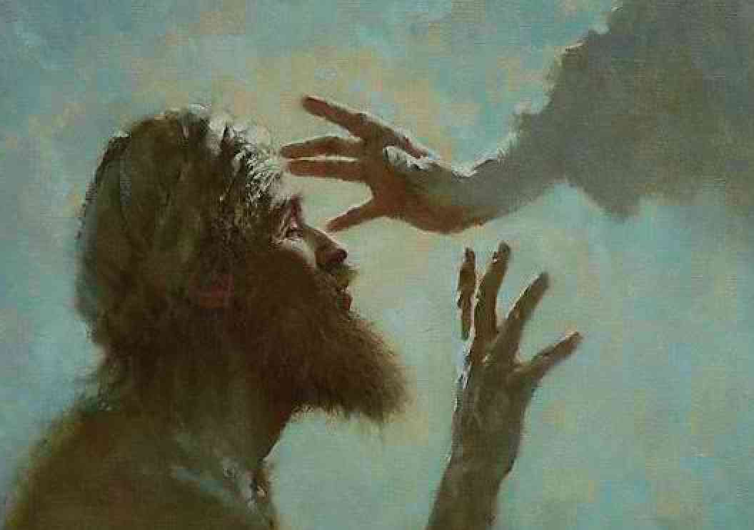
Giving Sight to the Blind
John 9:1-41

Slide 2
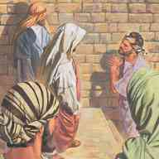
Jesus notices the blind..
John 9:1-3 Now as Jesus passed by, He saw a man who was blind from birth. 2 And His disciples asked Him, saying, "Rabbi, who sinned, this man or his parents, that he was born blind?"
3 Jesus answered, "Neither this man nor his parents sinned, but that the works of God should be revealed in him.

Slide 3
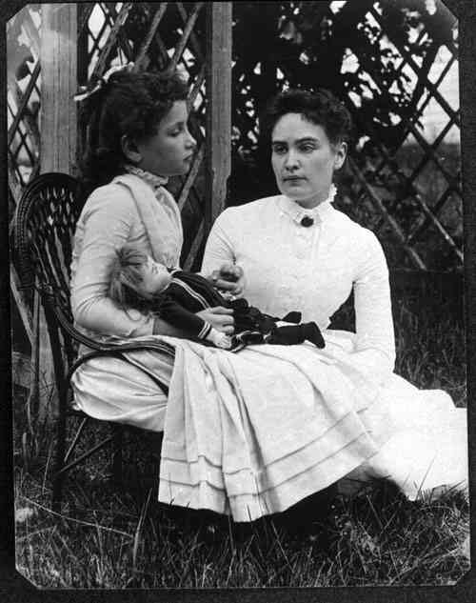
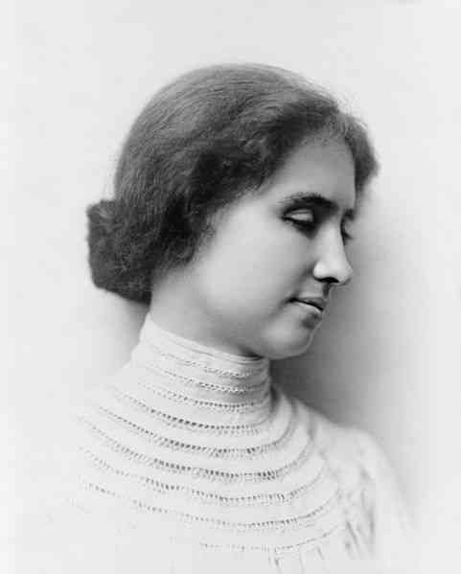
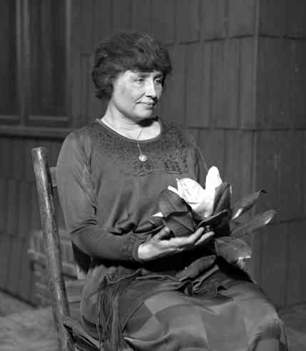
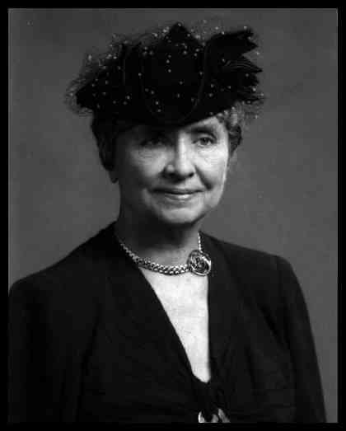
Helen Keller and her teacher..

Slide 4
The works of God..
John 9:4-7 I must work the works of Him who sent Me while it is day; the night is coming when no one can work. 5 As long as I am in the world, I am the light of the world."

Slide 5
A sign of the Messiah..
Isaiah 29:18 In that day the deaf shall hear the words of the book, and the eyes of the blind shall see out of obscurity and out of darkness...
Luke 4:16-18 "He has sent Me to heal the brokenhearted, to proclaim liberty to the captives and recovery of sight to the blind, to set at liberty those who are oppressed..

Slide 6
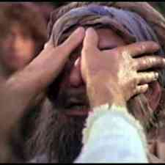
The power to heal..
John 9:6-7 When He had said these things, He spat on the ground and made clay with the saliva; and He anointed the eyes of the blind man with the clay. 7 And He said to him, "Go, wash in the pool of Siloam" (which is translated, Sent). So he went and washed, and came back seeing.

Slide 7
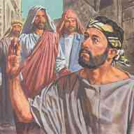
Power of a changed life..
John 9:8-12 Therefore the neighbors and those who previously had seen that he was blind said, "Is not this he who sat and begged?" 9 Some said, "This is he." Others said, "He is like him." He said, "I am he." 10 Therefore they said to him, "How were your eyes opened?" 11 He answered and said, "A Man called Jesus made clay and anointed my eyes and said to me, 'Go to the pool of Siloam and wash.' So I went and washed, and I received sight."

Slide 8
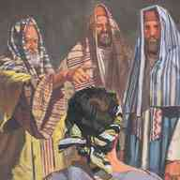
Unbelief of the Pharisees..
Setting false standards – 9:13-16
John 9:15-16 Therefore some of the Pharisees said, "This Man is not from God, because He does not keep the Sabbath." Others said, "How can a man who is a sinner do such signs?" And there was a division among them.

Slide 9
Unbelief of the Pharisees..
Bias and intimidation – 9:19-23
John 9:19-23 And they asked them, saying, "Is this your son, who you say was born blind? How then does he now see?" 20 His parents answered them.. He is of age; ask him. He will speak for himself." 22 His parents said these things because they feared the Jews, for the Jews had agreed already that if anyone confessed that He was Christ, he would be put out of the synagogue. 23 Therefore his parents said, "He is of age; ask him."

Slide 10
Unbelief of the Pharisees..
Rejecting the facts – 9:24-33
John 9:24-33 So they again called the man who was blind, and said to him, "Give God the glory! We know that this Man is a sinner." 25 He answered and said, "Whether He is a sinner or not I do not know. One thing I know: that though I was blind, now I see." 28 Then they reviled him and said, "You are His disciple, but we are Moses' disciples. 29 We know that God spoke to Moses; as for this fellow, we do not know where He is from."

Slide 11
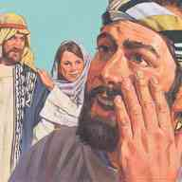
Learning to see spiritually..
A man called Jesus – vs 11
He is a prophet – vs 16-17
One thing I know, I was blind but now I see – vs 25
A worshipper of God.. if this man were not from God, he could do nothing vs 31-33

Slide 12
Jesus seeks him out..
John 9:35-38 Jesus heard that they had cast him out; and when He had found him, He said to him, "Do you believe in the Son of God?" 36 He answered and said, "Who is He, Lord, that I may believe in Him?" 37 And Jesus said to him, "You have both seen Him and it is He who is talking with you." 38 Then he said, "Lord, I believe!" And he worshiped Him.

Slide 13
Rejecting sight…
John 9:39-41 And Jesus said, "For judgment I have come into this world, that those who do not see may see, and that those who see may be made blind." 40 Then some of the Pharisees who were with Him heard these words, and said to Him, "Are we blind also?" 41 Jesus said to them, "If you were blind, you would have no sin; but now you say, 'We see.' Therefore your sin remains.

Slide 14
Seeing the light…
2 Corinthians 4:3-4 But even if our gospel is veiled, it is veiled to those who are perishing, 4 whose minds the god of this age has blinded, who do not believe, lest the light of the gospel of the glory of Christ, who is the image of God, should shine on them. 5 For we do not preach ourselves, but Christ Jesus the Lord, and ourselves your bondservants for Jesus' sake. 6 For it is the God who commanded light to shine out of darkness, who has shone in our hearts to give the light of the knowledge of the glory of God in the face of Jesus Christ.

Slide 15
Giving Sight to the Blind
John 9:1-41

