Slide 1
Learning to be Content
Philippians 4:10-23

Slide 2
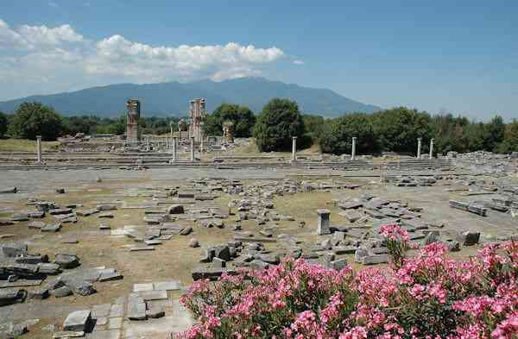
Paul’s gratitude..
10 But I rejoiced in the Lord greatly that now at last your care for me has flourished again; though you surely did care, but you lacked opportunity.

Slide 3
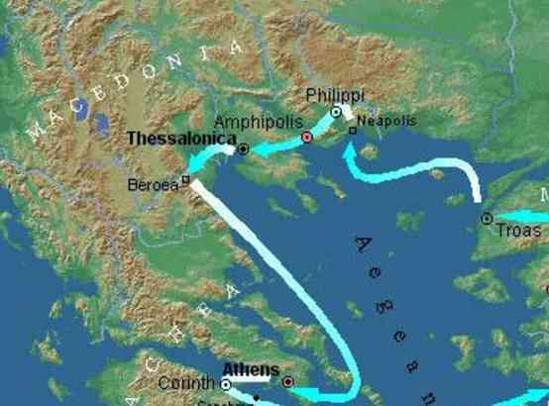
Background..
Acts 16 – founding of church (10 yrs ago)
15 Now you Philippians know also that in the beginning of the gospel, when I departed from Macedonia, no church shared with me concerning giving and receiving but you only. 16 For even in Thessalonica you sent aid once and again for my necessities.

Slide 4
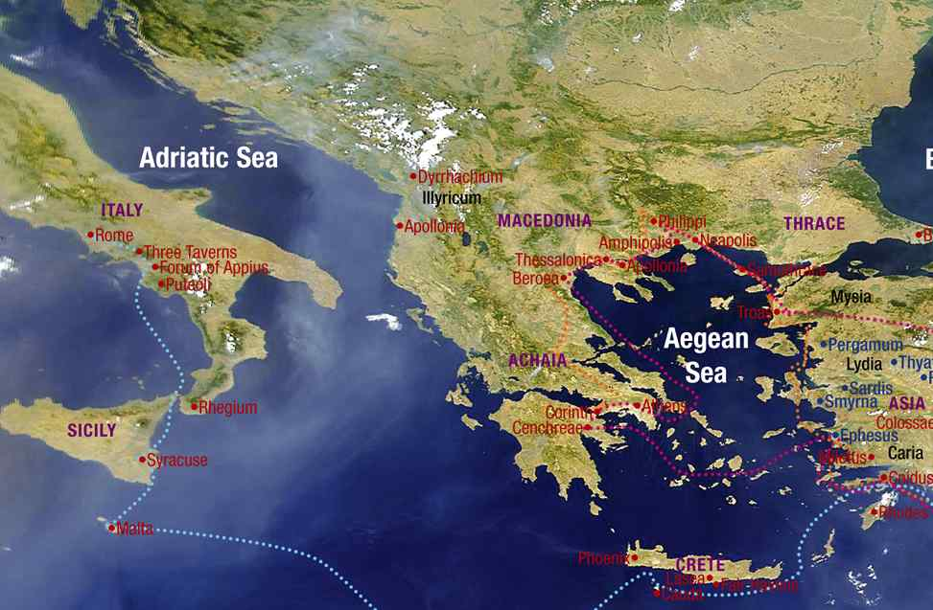
Their recent gift..
10 But I rejoiced in the Lord greatly that now at last your care for me has flourished again; though you surely did care, but you lacked opportunity.
18 Indeed I have all and abound. I am full, having received from Epaphroditus the things sent from you, a sweet-smelling aroma, an acceptable sacrifice, well pleasing to God.

Slide 5
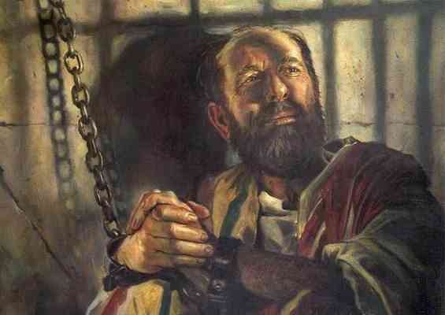
His contentment..
11 Not that I speak in regard to need, for I have learned in whatever state I am, to be content: 12 I know how to be abased, and I know how to abound. Everywhere and in all things I have learned both to be full and to be hungry, both to abound and to suffer need. 13 I can do all things through Christ who strengthens me.

Slide 6
“Content” (autarkes)
To be sufficent, satisfied, adequate..
2 Corinthians 12:8-9 Concerning this thing I pleaded with the Lord three times that it might depart from me. 9 And He said to me, "My grace is sufficient for you, for My strength is made perfect in weakness."

Slide 7
Contentment where God has placed you..
11 for I have learned in whatever state I am, to be content: 12 I know how to be abased, and I know how to abound.

Slide 8
Learning contentment..
1 Timothy 6:6-10 Now godliness with contentment is great gain. 7 For we brought nothing into this world, and it is certain we can carry nothing out. 8 And having food and clothing, with these we shall be content.

Slide 9
Learning contentment..
1 Timothy 6:9 But those who desire to be rich fall into temptation and a snare, and into many foolish and harmful lusts which drown men in destruction and perdition. 10 For the love of money is a root of all kinds of evil, for which some have strayed from the faith in their greediness, and pierced themselves through with many sorrows.

Slide 10
Four basic necessities..
What we put on us – clothes
What we put in us – food
What we put over us – house to live in
What we put aside – money for future

Slide 11
Content with the power of Christ within us..
13 I can do all things through Christ who strengthens me.
Not “I can do all things through education, money, power”

Slide 12
Content because of people who care…
10 But I rejoiced in the Lord greatly that now at last your care for me has flourished again; though you surely did care, but you lacked opportunity.
17 Not that I seek the gift, but I seek the fruit that abounds to your account. 18 Indeed I have all and abound. I am full, having received from Epaphroditus the things sent from you, a sweet-smelling aroma, an acceptable sacrifice, well pleasing to God. 19 And my God shall supply all your need according to His riches in glory by Christ Jesus.

Slide 13
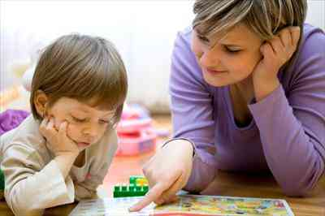
Be grateful..
Appreciate people and the gifts they want to give us…
Brings blessing to the one who receives the gift
Brings blessing to the one who gives the gift
Brings blessing to God

Slide 14
Contentment with God who sustains us…
19 And my God shall supply all your need according to His riches in glory by Christ Jesus.

Slide 15
- Personal ..
- Positive ..
- Pointed ..
- Plentiful ..
- Powerful ..

Slide 16
Final greeting…
20 Now to our God and Father be glory forever and ever. Amen. 21 Greet every saint in Christ Jesus. The brethren who are with me greet you. 22 All the saints greet you, but especially those who are of Caesar's household. 23 The grace of our Lord Jesus Christ be with you all. Amen.

Slide 18
Learning to be Content
Philippians 4:10-23

