Slide 1
Something is Missing
The World is Lying to Us
Psalm 8:3-5

Slide 2
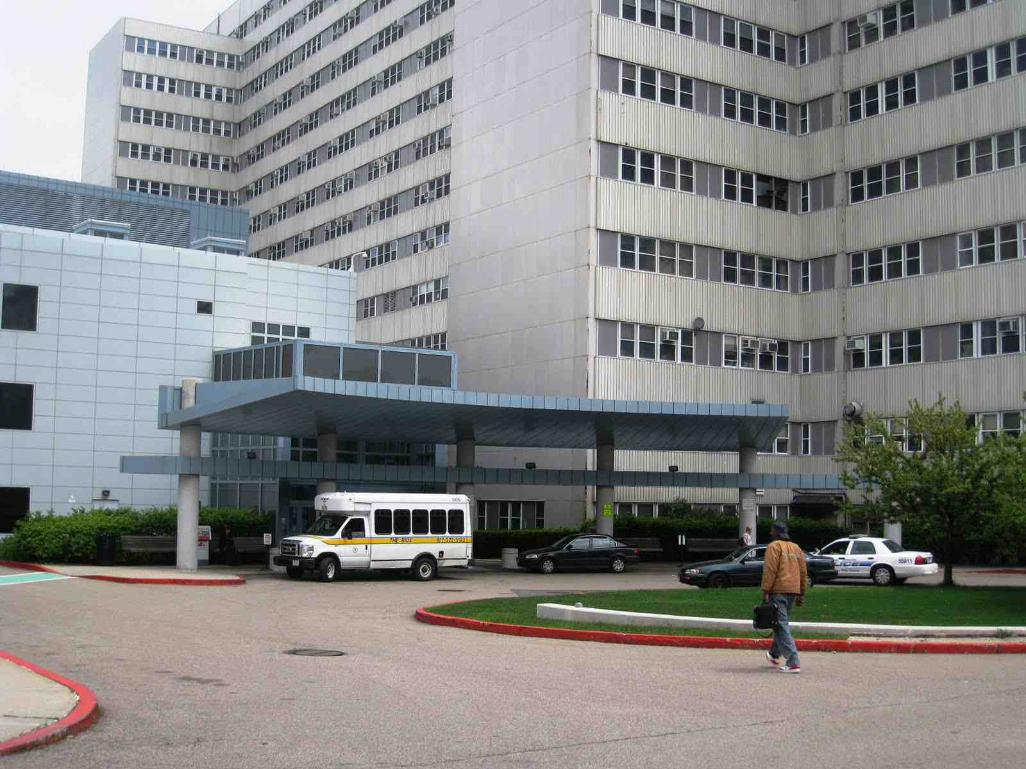
We live in unique times..
Advancement in medicine, science, inventions, education…

Slide 3
More Information…
Internet, cell phones, ipads, email, texting…

Slide 4
Larger homes…
More wealth per capita, higher standard of living…

Slide 5
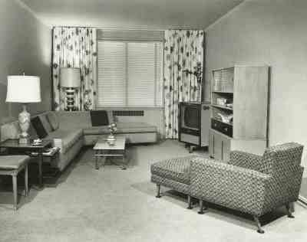
Advance in home furnishing…

Slide 6
We’ve been lied to..
“Get all the stuff you can or you’ll miss out on life”…

Slide 7
Still something missing..
Basic questions …
Where did I come from?
Why am I here?
Where am I going?
No satisfaction until we answer these…

Slide 8
New toys to occupy ourselves…

Slide 9
New toys to occupy ourselves…

Slide 10
New toys to occupy ourselves…

Slide 11
Where do we go for Answers…
The Evolutionist..
Where did I come from?
Why am I here?
Where am I going?

Slide 12
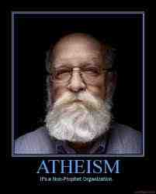
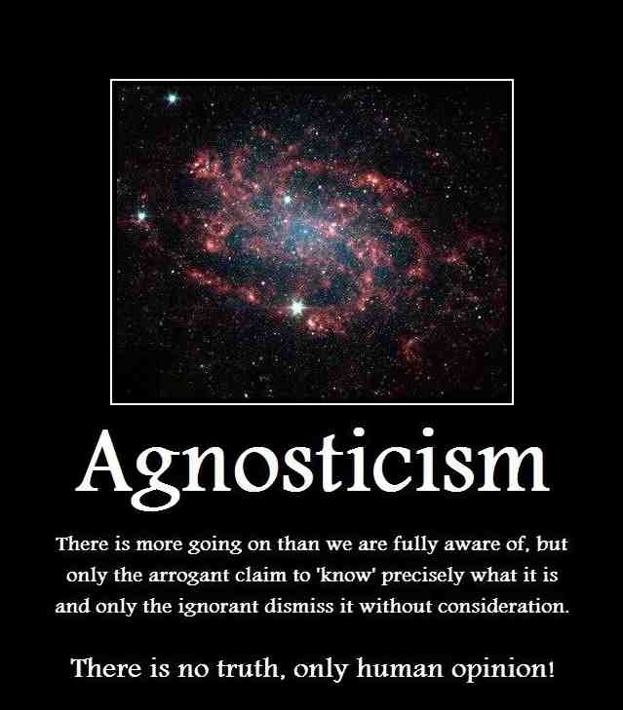
Where do we go for Answers…
The Atheist/Agnostic..
Where did I come from?
Why am I here?
Where am I going?

Slide 13
Where do we go for Answers…
Where did I come from?
Why am I here?
Where am I going?

Slide 14
Where do we go for Answers…
Where did I come from?
Why am I here?
Where am I going?

Slide 15
Where do we go for Answers…
Where did I come from?
Why am I here?
Where am I going?

Slide 16
The only source..
Question of Origins…
Genesis 1:27 So God created man in His own image; in the image of God He created him; male and female He created them.
Genesis 2:7 the Lord God formed man of the dust of the ground, and breathed into his nostrils the breath of life; and man became a living being.

Slide 17
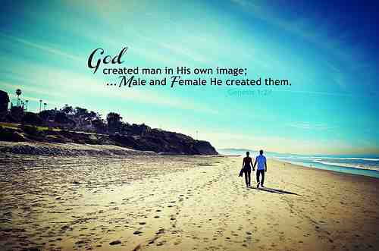
Psalms 8:3-5 When I consider Your heavens, the work of Your fingers, The moon and the stars, which You have ordained, 4 What is man that You are mindful of him, And the son of man that You visit him? 5 For You have made him a little lower than the angels, And You have crowned him with glory and honor.
You are special!

Slide 18
The only source..
Question of Purpose…
Ecclesiastes 12:13 Let us hear the conclusion of the whole matter: Fear God and keep His commandments, For this is man's all.

Slide 19
Love God…
Matthew 22:37-40 Jesus said to him, "'You shall love the Lord your God with all your heart, with all your soul, and with all your mind.' 38 This is the first and great commandment. 39 And the second is like it: 'You shall love your neighbor as yourself.' 40 On these two commandments hang all the Law and the Prophets."

Slide 20
Humanism…
“We can discover no divine purpose… no deity will save us.. We must save ourselves… (Humanist Manifesto II)

Slide 21
Free from God?...
Romans 1:26-28 For this reason God gave them up to vile passions. For even their women exchanged the natural use for what is against nature. 27 Likewise also the men, leaving the natural use of the woman, burned in their lust for one another, men with men committing what is shameful, and receiving in themselves the penalty of their error which was due. 28 And even as they did not like to retain God in their knowledge, God gave them over to a debased mind, to do those things which are not fitting..

Slide 22
The only source..
Question of Destiny…
1 Thessalonians 4:17 Then we who are alive and remain shall be caught up together with them in the clouds to meet the Lord in the air. And thus we shall always be with the Lord.

Slide 23
Our inheritance…
1 Peter 1:3-4 Blessed be the God and Father of our Lord Jesus Christ, who according to His abundant mercy has begotten us again to a living hope through the resurrection of Jesus Christ from the dead, 4 to an inheritance incorruptible and undefiled and that does not fade away, reserved in heaven for you…

Slide 24
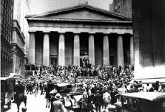
Stock market crash 1929
Many committed suicide because their god had died…

Slide 25
Something is Missing
The World is Lying to Us
Psalm 8:3-5

