Slide 1
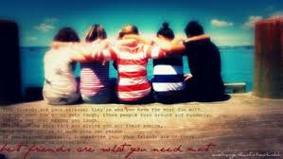
Amnon Had a Friend
2 Samuel 13:1-3

Slide 2
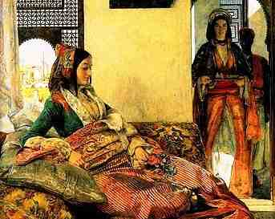
2 Samuel 13:1-2
After this Absalom the son of David had a lovely sister, whose name was Tamar; and Amnon the son of David loved her. 2 Amnon was so distressed over his sister Tamar that he became sick; for she was a virgin. And it was improper for Amnon to do anything to her.

Slide 3
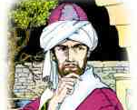
2 Samuel 13:3
But Amnon had a friend whose name was Jonadab ...

Slide 4
Good friends ..
King David had some good friends..
Abigail 1 Samuel 25
Nathan 2 Samuel 12
Naaman had good friends 2 Kings 5
Apollos Acts 18

Slide 5
What good friends do..
Keep you from doing wrong..
Encourage you to do right..
When you do wrong, point it out to you..
Teach you truth when you are in error..

Slide 6
Influence of bad friends ..
Job’s wife not a good friend Job 1-2
King Saul’s friend Doeg 2 Samuel 22
Man of God and older prophet 1 Kings 13
Ahab and Jezebel 1 Kings 21

Slide 7
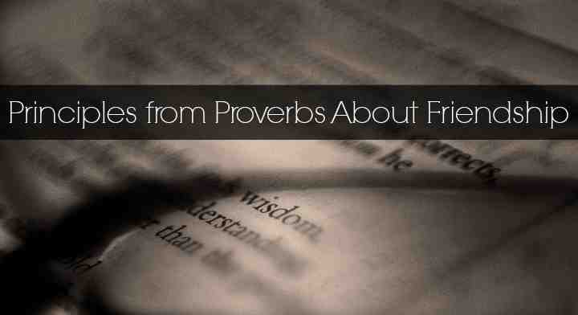
Proverbs 1:10-15
My son, if sinners entice you, Do not consent. 11 If they say, "Come with us, Let us lie in wait to shed blood; Let us lurk secretly for the innocent without cause; 12 Let us swallow them alive like Sheol, And whole, like those who go down to the Pit; 13 We shall find all kinds of precious possessions, We shall fill our houses with spoil; 14 Cast in your lot among us, Let us all have one purse" — 15 My son, do not walk in the way with them, Keep your foot from their path;

Slide 8
2 Samuel 13:3
But Amnon had a friend whose name was Jonadab the son of Shimeah, David's brother. Now Jonadab was a very crafty man.

Slide 9
2 Samuel 13:4-5
And he said to him, "Why are you, the king's son, becoming thinner day after day? Will you not tell me?"Amnon said to him, "I love Tamar, my brother Absalom's sister." 5 So Jonadab said to him, "Lie down on your bed and pretend to be ill. And when your father comes to see you, say to him, 'Please let my sister Tamar come and give me food, and prepare the food in my sight, that I may see it and eat it from her hand.'"

Slide 10
Rest of story..
13:15 Then Amnon hated her exceedingly..
13:22 Absalom hated Amnon, because he had forced his sister Tamar.
13:22-29 Two years later killed by Absalom..

Slide 11
2 Samuel 13:3
But Amnon had a friend whose name was Jonadab ...
Was Jonadab really a friend?

Slide 12
What is your story?
The rest of your life will depend a lot on the kind of friends you have..

Slide 13
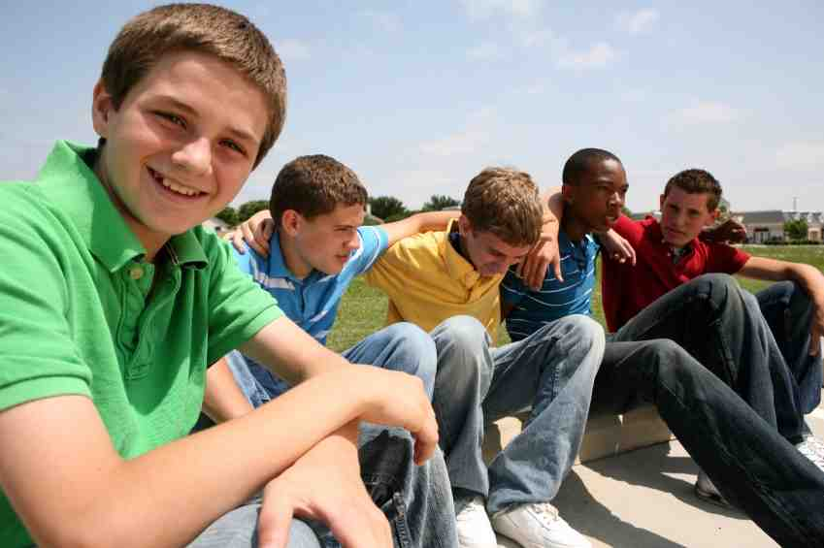
Elementary school..
High school..
College..
Moving away..

Slide 14
The one you marry..
The friend that is going to have more influence on you than anybody else ..
He/she is also going to influence your children..

Slide 15
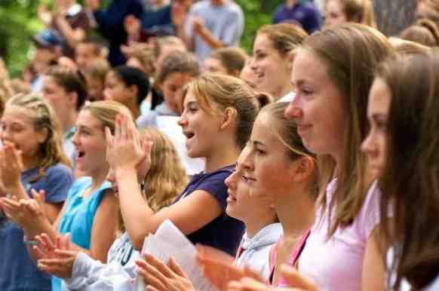
Finding good friends..
Look for them in the right places..
Where other young Christians are..

Slide 16
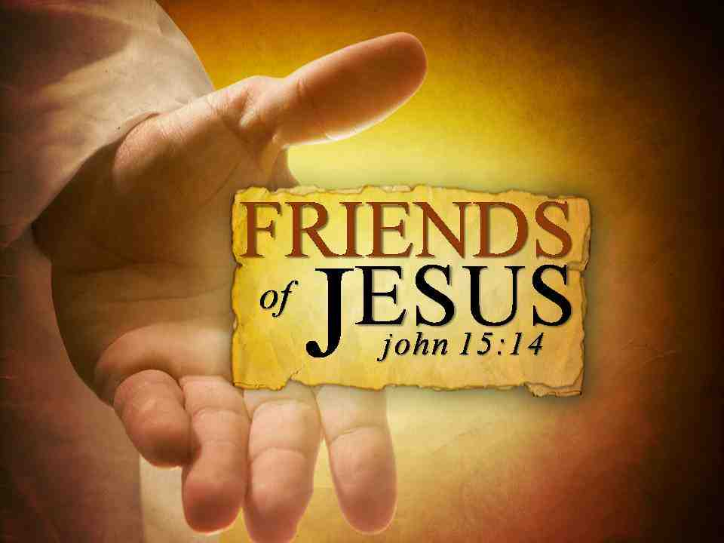
Jesus will be your friend..
John 15:13-14 Greater love has no one than this, than to lay down one's life for his friends. 14 You are My friends if you do whatever I command you

Slide 17
Jesus will be your friend..
2 Timothy 4:16-17 At my first defense no one stood with me, but all forsook me. 17 But the Lord stood with me and strengthened me..

Slide 18
Amnon Had a Friend
2 Samuel 13:1-3

