Slide 1
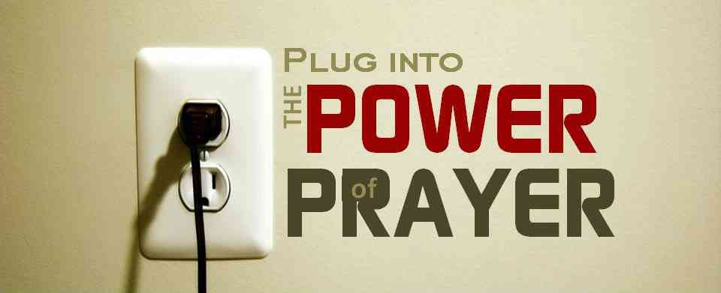
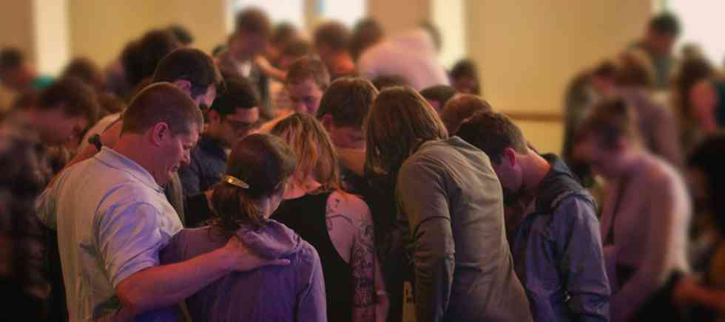
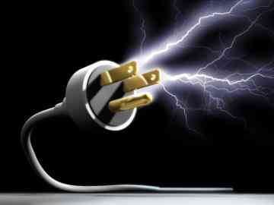
Plug into the Power
Luke 24:44-49

Slide 2
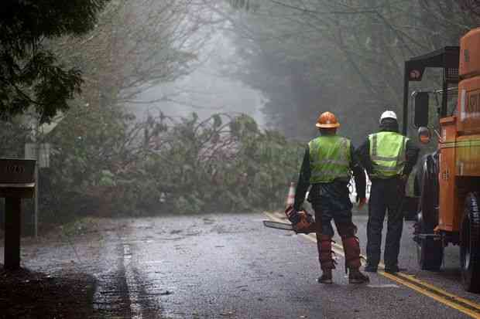
Power outage..
Maybe we’re not supposed to be so comfortable, easy and relaxed..

Slide 3
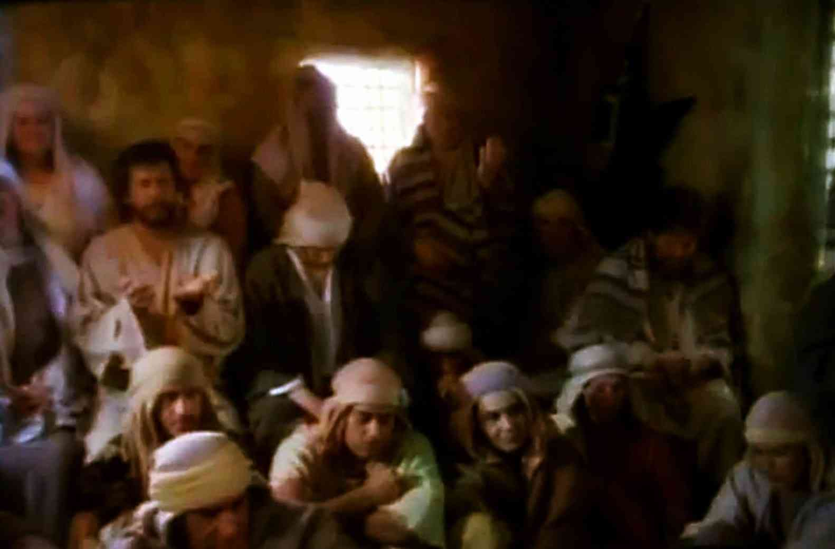
Promise of power..
Luke 24:49 Behold, I send the Promise of My Father upon you… tarry in the city of Jerusalem until you are endued with power from on high."
Acts 1:11-14 Then they returned to Jerusalem.. 14 These all continued with one accord in prayer and supplication, with the women and Mary the mother of Jesus, and with His brothers.

Slide 4
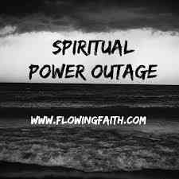
You say “Yes,” but then Live “No”..
You put off making decisions..
Your prayers don’t seem alive..
Church feels dry..
You’re moody and irritable..
You’re low on spiritual fruit...

Slide 5
Get connected..
Ephesians 3:20-21 Now to Him who is able to do exceedingly abundantly above all that we ask or think, according to the power that works in us, 21 to Him be glory in the church by Christ Jesus to all generations, forever and ever. Amen.

Slide 6
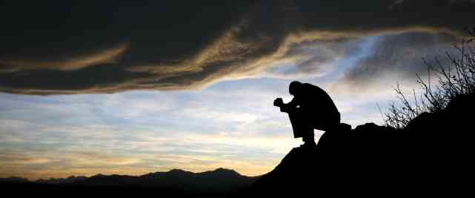
Humbly call on God…
Luke 18:9-14 "the tax collector, standing afar off, would not so much as raise his eyes to heaven, but beat his breast, saying, 'God, be merciful to me a sinner!' 14 I tell you, this man went down to his house justified rather than the other; for... he who humbles himself will be exalted."

Slide 7
Facing tough problems…
James 1:5-6 If any of you lacks wisdom, let him ask of God, who gives to all liberally and without reproach, and it will be given to him. 6 But let him ask in faith, with no doubting, for he who doubts is like a wave of the sea driven and tossed by the wind.
James 5:16-18 The effective, fervent prayer of a righteous man avails much. 17 Elijah was a man with a nature like ours, and he prayed earnestly that it would not rain; and it did not rain on the land for three years and six months. 18 And he prayed again, and the heaven gave rain, and the earth produced its fruit.

Slide 8
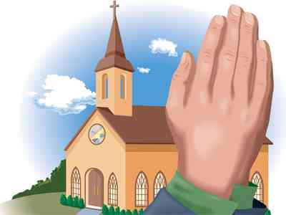
The praying church..
Prayer must be a priority..
Acts 2:42-46 And they continued steadfastly in the apostles' doctrine and fellowship, in the breaking of bread, and in prayers.. 46 So continuing daily with one accord in the temple, and breaking bread from house to house, they ate their food with gladness and simplicity of heart.

Slide 9
Leaders given to prayer..
A constant priority…
Acts 3:1 Now Peter and John went up together to the temple at the hour of prayer, the ninth hour.
Acts 6:2-4 "It is not desirable that we should leave the word of God and serve tables… 4 but we will give ourselves continually to prayer and to the ministry of the word."

Slide 10
Dependent on God..
We sense His blessing…
Acts 11:21-23 And the hand of the Lord was with them, and a great number believed and turned to the Lord... 23 When (Barnabas) came and had seen the grace of God, he was glad, and encouraged them all that with purpose of heart they should continue with the Lord.

Slide 11
Praying in homes..
Together as well as individually…
Acts 12:5 Peter was therefore kept in prison, but constant prayer was offered to God for him by the church. 12 he came to the house of Mary, the mother of John whose surname was Mark, where many were gathered together praying.

Slide 12
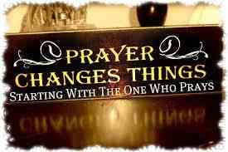
The Father will respond to our prayers…
Acts 2:47 the Lord added daily…
Acts 4:31 strength and boldness..
Acts 6:7 the word of God multiplied..
Acts 12:5 the Lord brought deliverance..

