Slide 1
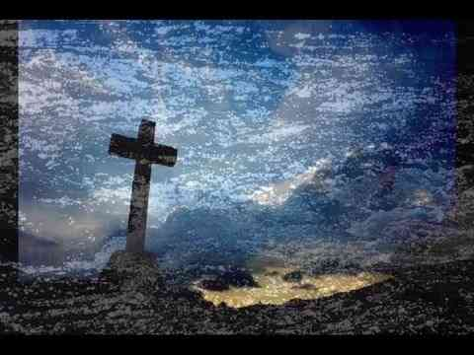
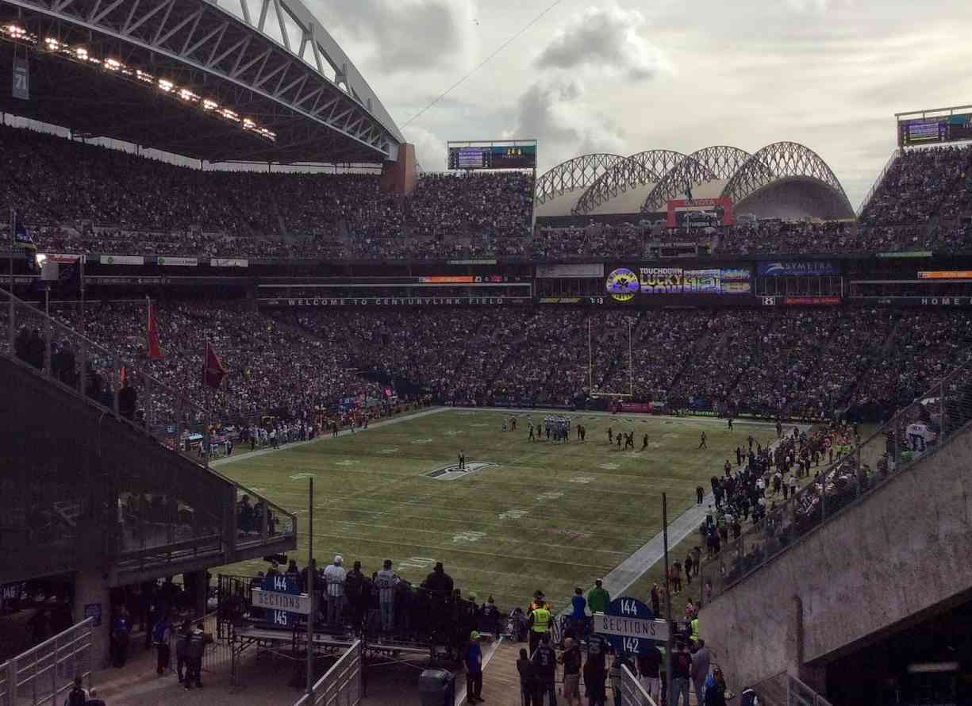
Enduring to the End
James 1:2-4,12

Slide 2
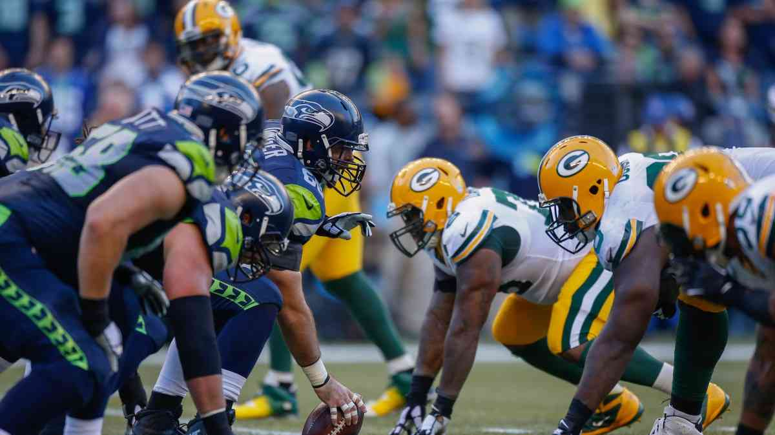
Great teams show what they are made of in the closing minutes…

Slide 3
James 1:12
Blessed is the man who endures temptation; for when he has been approved, he will receive the crown of life which the Lord has promised to those who love Him.

Slide 4
James 1:12
Blessed is the man who remains steadfast under trial, for when he has stood the test he will receive the crown of life, which God has promised to those who love him. (ESV)

Slide 5
James 1:2-4
My brethren, count it all joy when you fall into various trials, 3 knowing that the testing of your faith produces patience. 4 But let patience have its perfect work, that you may be perfect and complete, lacking nothing.

Slide 6
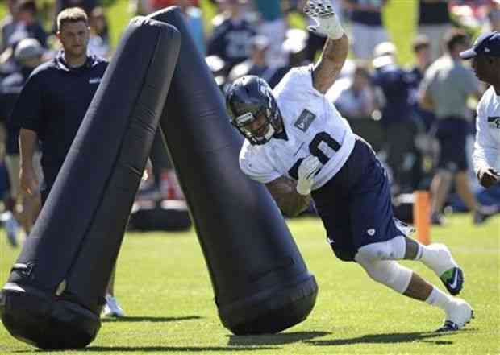
Trials help develop strength and prepare us to gain the victory…

Slide 7
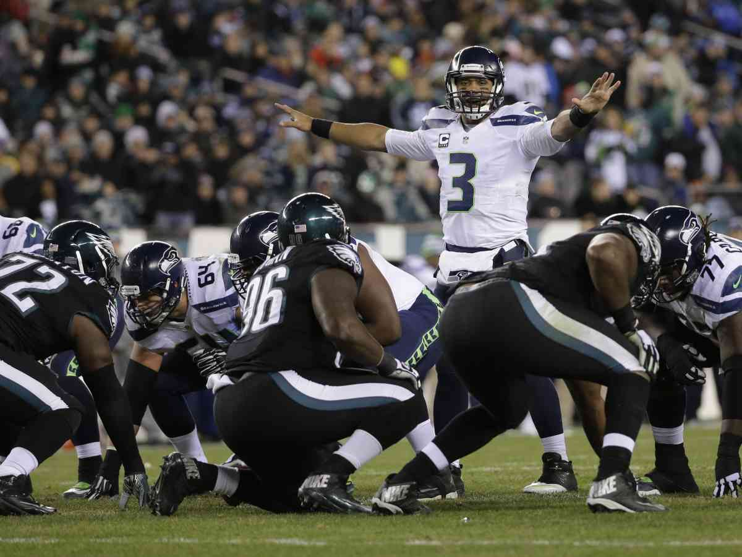
In the final drive, the team is confident they have the character to overcome…

Slide 8
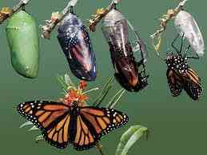
The butterfly’s struggle to escape the cocoon is necessary for survival…

Slide 9
Acts 11:21-23
News of these things came to the ears of the church in Jerusalem, and they sent out Barnabas to go as far as Antioch. 23 When he came and had seen the grace of God, he was glad, and encouraged them all that with purpose of heart they should continue with the Lord.

Slide 10
Hebrews 10:38-39
Now the just shall live by faith; But if anyone draws back, My soul has no pleasure in him." 39 But we are not of those who draw back to perdition, but of those who believe to the saving of the soul.

Slide 11
I Have Decided to Follow Jesus
I have decided to follow Jesus..
I have decided to follow Jesus..
No turning back! No turning back!

Slide 12
Acts 14:21-22
And when they had preached the gospel to that city and made many disciples, they returned to Lystra, Iconium, and Antioch, 22 strengthening the souls of the disciples, exhorting them to continue in the faith, and saying, "We must through many tribulations enter the kingdom of God."

Slide 13
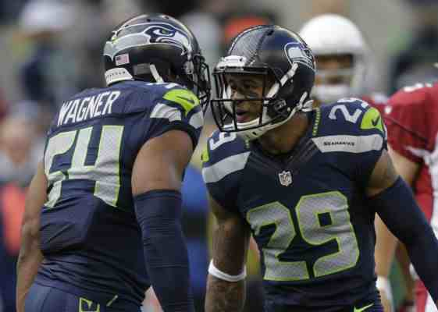
One player’s intensity can inspire others to their best…

Slide 14
2 Corinthians 11:24-28
From the Jews five times I received forty stripes minus one. 25 Three times I was beaten with rods; once I was stoned; three times I was shipwrecked; a night and a day I have been in the deep; 26 in journeys often, in perils of waters, in perils of robbers, in perils of my own countrymen, in perils of the Gentiles, in perils in the city, in perils in the wilderness, in perils in the sea, in perils among false brethren…

Slide 15
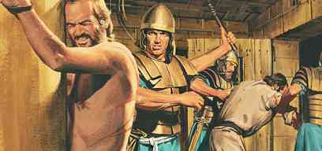
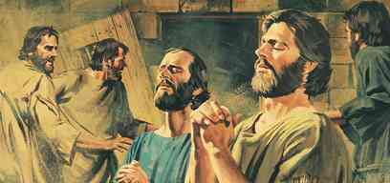
Acts 16:23-34
Acts 16:23-25 And when they had laid many stripes on them, they threw them into prison, commanding the jailer to keep them securely. 24 Having received such a charge, he put them into the inner prison and fastened their feet in the stocks. 25 But at midnight Paul and Silas were praying and singing hymns to God, and the prisoners were listening to them.

Slide 16
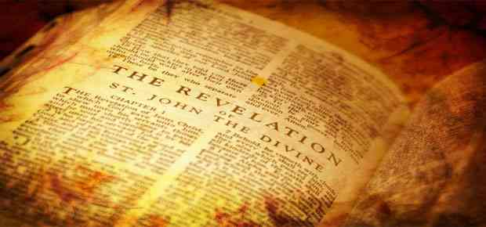
Rev 1:1-3 The Revelation of Jesus Christ, which God gave Him to show His servants — things which must shortly take place. And He sent and signified it by His angel to His servant John, 2 who bore witness to the word of God, and to the testimony of Jesus Christ, to all things that he saw. 3 Blessed is he who reads and those who hear the words of this prophecy, and keep those things which are written in it; for the time is near.

Slide 17
1. Ephesus “To him that overcometh” 2:7
2. Smyrna “He that overcometh” 2:11
3. Pergamos “To him that overcometh” 2:17
4. Thyratira “And he that overcometh” 2:26
5. Sardis “He that overcometh” 3:5
6. Philadelphia “Him that overcometh” 3:12
7. Laodicea “To him that overcometh” 3:21
8. “He that overcometh” 21:7

Slide 18
Revelation 2:10
Do not fear any of those things which you are about to suffer. Indeed, the devil is about to throw some of you into prison, that you may be tested, and you will have tribulation ten days. Be faithful until death, and I will give you the crown of life.

Slide 19
Revelation 17:14
These will make war with the Lamb, and the Lamb will overcome them, for He is Lord of lords and King of kings; and those who are with Him are called, chosen, and faithful."

Slide 20
Enduring to the End
James 1:2-4,12

