Slide 1
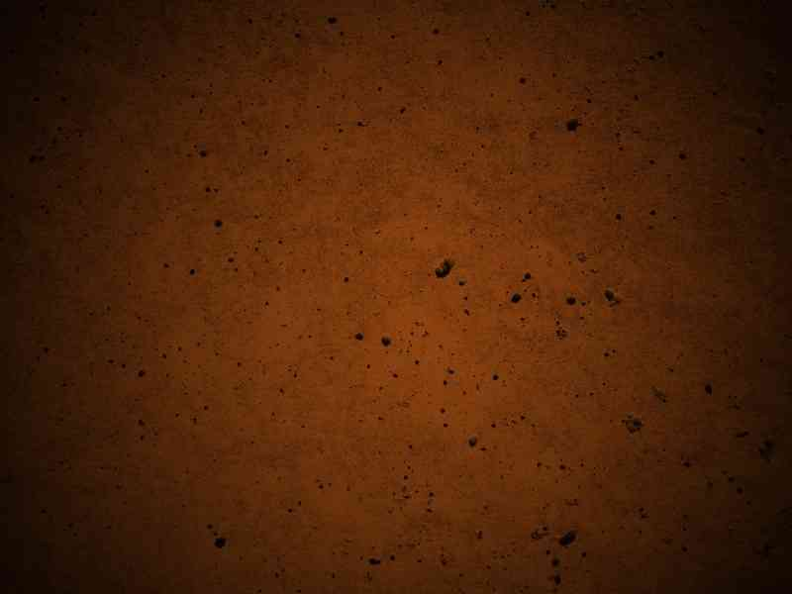
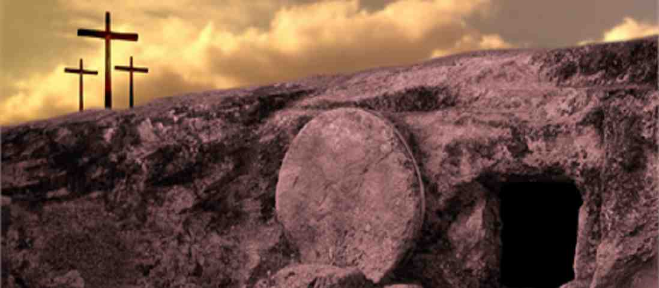
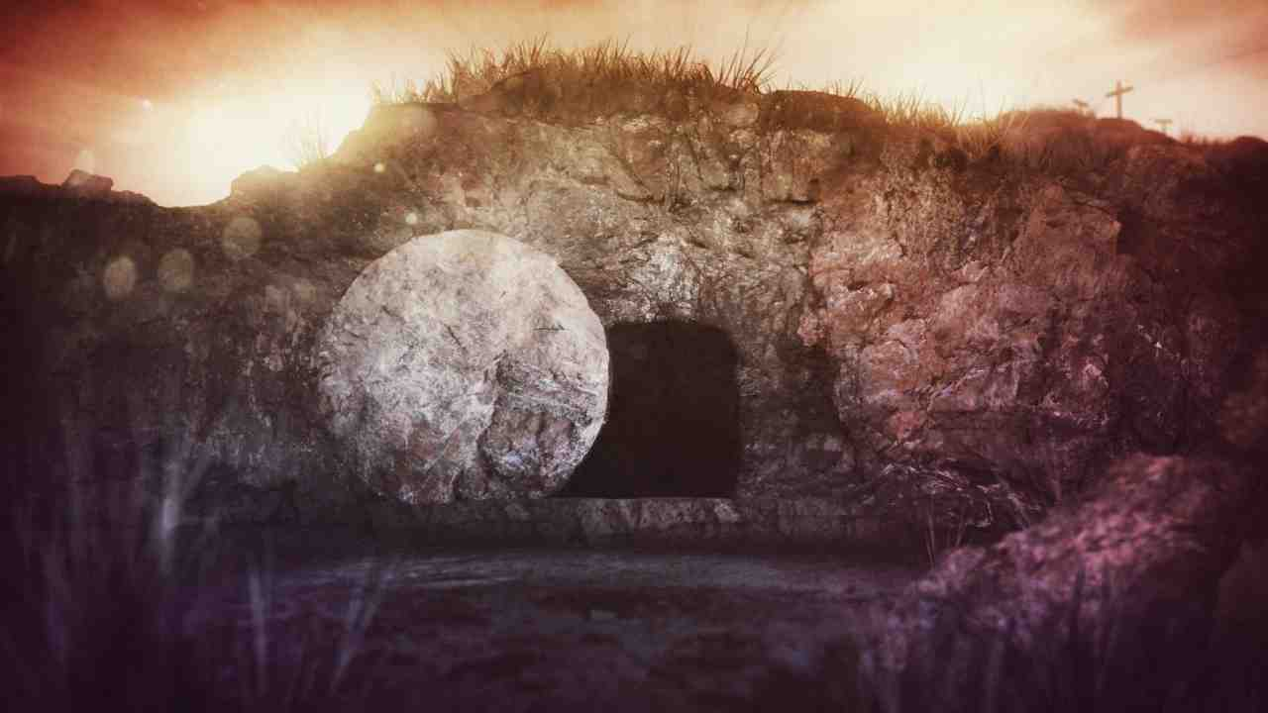
The Empty Tomb
Mark 16:1-8

Slide 2
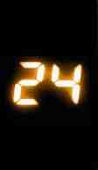
Hours…
That Changed the World
7 - 11 PM The Passover in Upper Room…
11 - 1 AM Garden of Gethsemane..
2 – 7 AM Trials and Condemned..
9 AM – 3 PM Jesus on the Cross..
3 – 6 PM Preparation and Burial..
1 Corinthians 15:1-4 I declare to you the gospel which I preached to you…3 For I delivered to you first of all that which I also received: that Christ died for our sins according to the Scriptures, 4 and that He was buried, and that He rose again the third day according to the Scriptures...

Slide 3
The Culminating Event…
1 Cor 15:14-20 And if Christ is not risen, then our preaching is empty and your faith is also empty...
17 And if Christ is not risen, your faith is futile; you are still in your sins! … 19 If in this life only we have hope in Christ, we are of all men the most pitiable.
20 but now Christ IS risen from the dead..

Slide 4
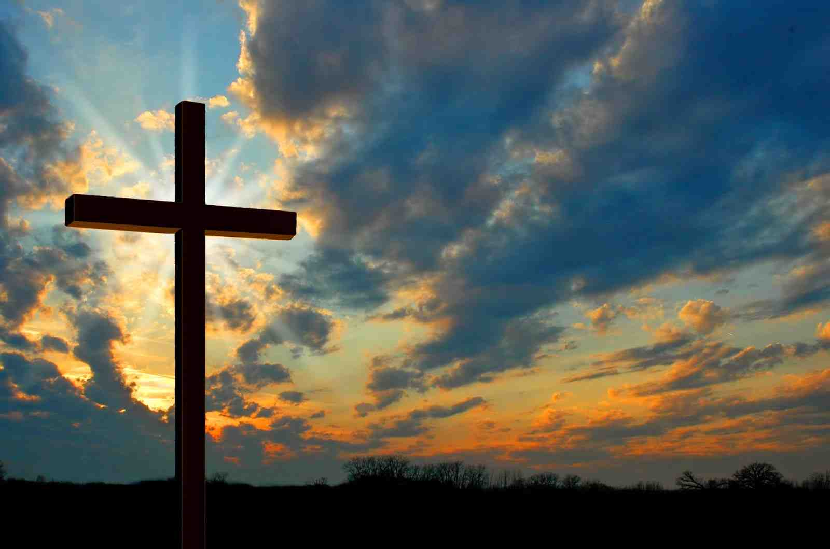
All four gospels...
Jesus’ Crucifixion
His Resurrection
Matthew
Mark
Luke
John
Matthew
Mark
Luke
John
One thing missing…
The resurrection itself..
No one was there when Jesus rose..
The disciples saw the empty tomb..

Slide 5
Mark 16:1-8…
1 Now when the Sabbath was past, Mary Magdalene, Mary the mother of James, and Salome bought spices, that they might come and anoint Him. 2 Very early in the morning, on the first day of the week, they came to the tomb when the sun had risen.
3 And they said among themselves, "Who will roll away the stone from the door of the tomb for us?" 4 But when they looked up, they saw that the stone had been rolled away — for it was very large.
5 And entering the tomb, they saw a young man clothed in a long white robe sitting on the right side; and they were alarmed.
They were not expecting the resurrection..

Slide 6
Jesus said he would rise…
John 2:19 "Destroy this temple, and in three days I will raise it up."
Mark 8:31 the Son of Man must suffer many things, and be killed, and after three days rise again.
Mark 9:31 "The Son of Man is being... And after He is killed, He will rise the third day."
Mark 10:33-34 the Son of Man will be betrayed .. and they will mock Him, and scourge Him, and spit on Him, and kill Him. And the third day He will rise again."

Slide 7
Testimony: The Empty Tomb…
Mark 16:1 Now when the Sabbath was past, Mary Magdalene, Mary the mother of James, and Salome bought spices, that they might come and anoint Him. 2 Very early in the morning, on the first day of the week, they came to the tomb when the sun had risen. 3 And they said among themselves, "Who will roll away the stone from the door of the tomb for us?" 4 But when they looked up, they saw that the stone had been rolled away — for it was very large.

Slide 8
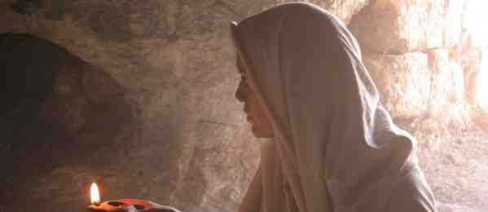
Testimony: The Empty Tomb…
John 20:1 Now the first day of the week Mary Magdalene went to the tomb early, while it was still dark, and saw that the stone had been taken away from the tomb. 2 Then she ran and came to Simon Peter, and to the other disciple, whom Jesus loved, and said to them, "They have taken away the Lord out of the tomb, and we do not know where they have laid Him."

Slide 9
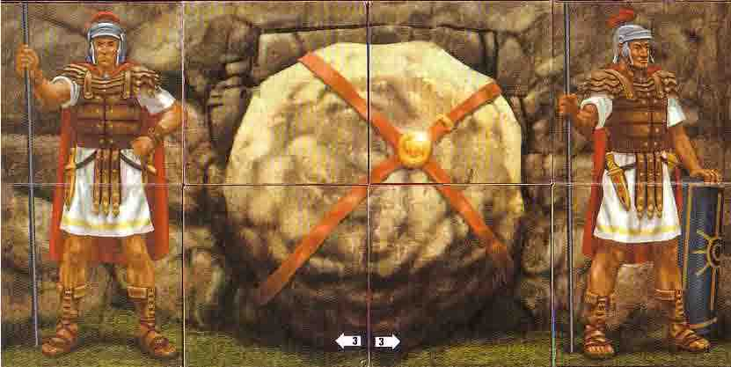
Testimony: The Empty Tomb…
Matthew 27:62-66 On the next day, which followed the Day of Preparation, the chief priests and Pharisees gathered together to Pilate, 63 saying, "Sir, we remember, while He was still alive, how that deceiver said, 'After three days I will rise.' 64 Therefore command that the tomb be made secure until the third day, lest His disciples come by night and steal Him away, and say to the people, 'He has risen from the dead….65 Pilate said to them, "You have a guard; go your way, make it as secure as you know how." 66 So they went and made the tomb secure, sealing the stone and setting the guard.

Slide 10
Testimony: The Empty Tomb…
Matthew 28:2-5 And behold, there was a great earthquake; for an angel of the Lord descended from heaven, and came and rolled back the stone from the door, and sat on it. 3 His countenance was like lightning, and his clothing as white as snow. 4 And the guards shook for fear of him, and became like dead men.

Slide 11
Testimony: The Empty Tomb…
Matthew 28:11-15 Now while they were going, behold, some of the guard came into the city and reported to the chief priests all the things that had happened. 12 When they had assembled with the elders and consulted together, they gave a large sum of money to the soldiers, 13 saying, "Tell them, 'His disciples came at night and stole Him away while we slept.' 14 And if this comes to the governor's ears, we will appease him and make you secure." 15 So they took the money and did as they were instructed; and this saying is commonly reported among the Jews until this day

Slide 12
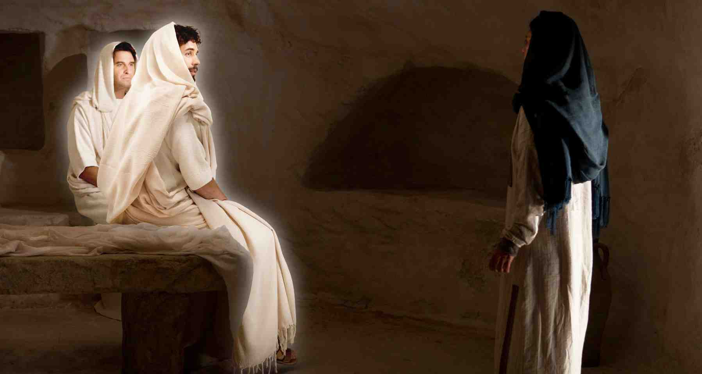
Testimony of the Angels…
Luke 24:4-8 And it happened, as they were greatly perplexed about this, that behold, two men stood by them in shining garments. 5 Then, as they were afraid and bowed their faces to the earth, they said to them, "Why do you seek the living among the dead? 6 He is not here, but is risen! Remember how He spoke to you when He was still in Galilee, 7 saying, 'The Son of Man must be delivered into the hands of sinful men, and be crucified, and the third day rise again.'" 8 And they remembered His words.

Slide 13
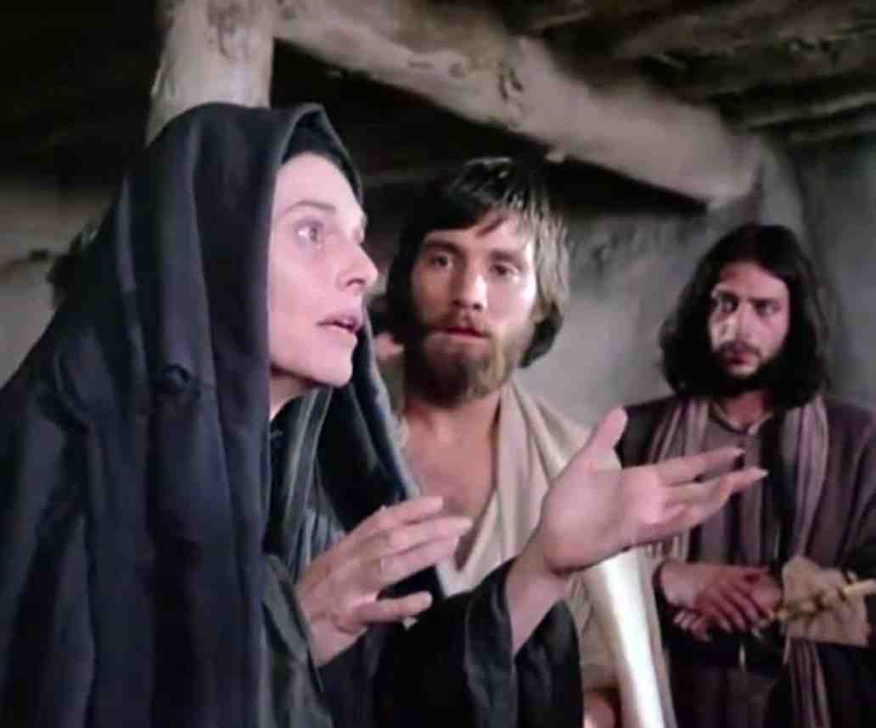
Testimony of Eyewitnesses…
Mark 16:7 But go, tell His disciples — and Peter — that He is going before you into Galilee; there you will see Him, as He said to you."
8 So they went out quickly and fled from the tomb, for they trembled and were amazed. And they said nothing to anyone, for they were afraid.

Slide 14
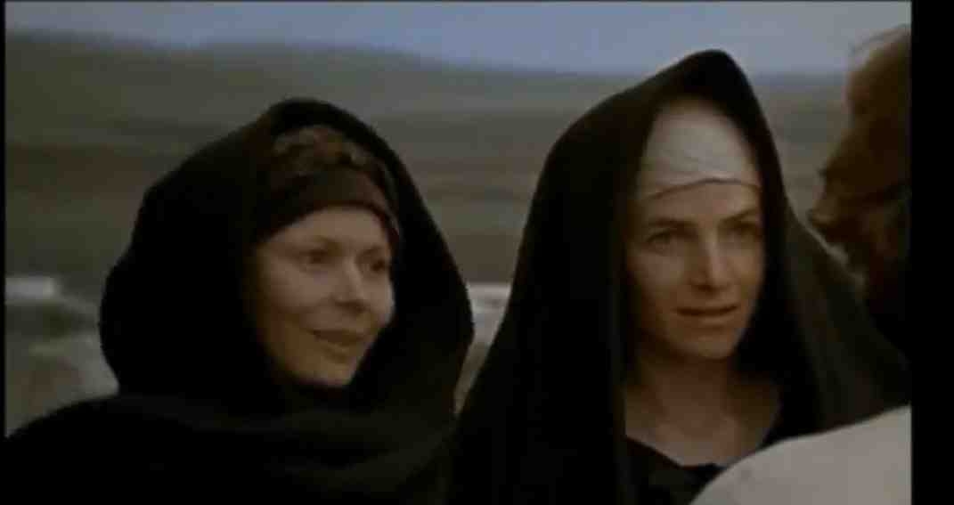
Testimony of Eyewitnesses…
Matthew 28:8-10 So they went out quickly from the tomb with fear and great joy, and ran to bring His disciples word. 9 And as they went to tell His disciples, behold, Jesus met them, saying, "Rejoice!" So they came and held Him by the feet and worshiped Him. 10 Then Jesus said to them, "Do not be afraid. Go and tell My brethren to go to Galilee, and there they will see Me."

Slide 15
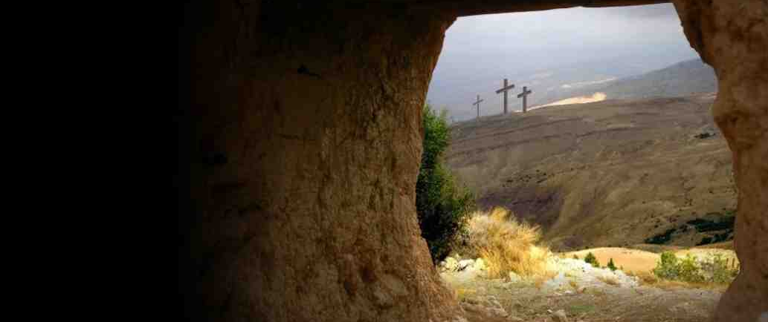
Testimony of Eyewitnesses…
1 Cor 15:4-7 and that He was buried, and that He rose again the third day according to the Scriptures, 5 and that He was seen by Cephas, then by the twelve. 6 After that He was seen by over five hundred brethren at once, of whom the greater part remain to the present, but some have fallen asleep. 7 After that He was seen by James, then by all the apostles.

Slide 16
The Evidence…
The Tomb was Empty…
Testimony of the Angels..
Testimony of Personal Eyewitnesses..

Slide 17
The Empty Tomb
Mark 16:1-8

