Slide 1
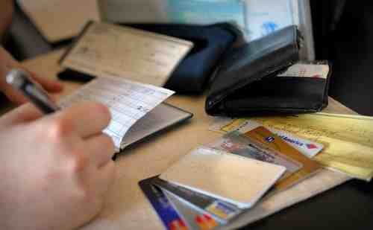
Your Most Valuable Asset
Matthew 16:24-28

Slide 2
All Your Possessions..
Which is most valuable?..
How long do you plan to keep it?..
Your spiritual soul is eternal..

Slide 3
Matthew 16:24-26
"If anyone desires to come after Me, let him deny himself, and take up his cross, and follow Me. 25 For whoever desires to save his life will lose it, but whoever loses his life for My sake will find it. 26 For what profit is it to a man if he gains the whole world, and loses his own soul? Or what will a man give in exchange for his soul?

Slide 4
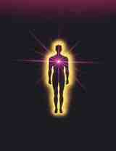
What is the Soul?..
The invisible part..
“Psuche”… “possessing life”
Matthew 16:26 “life” and “soul”..

Slide 5
What is the Soul?..
Can have several meanings..
The life of creatures … Gen 1:20
Life … Exod 21:23; Lev 4:2
Persons … Acts 2:41

Slide 6
What is the Soul?..
The inner God-given being..
Matthew 22:37 "'You shall love the Lord your God with all your heart, with all your soul, and with all your mind.'
Matthew 10:28 And do not fear those who kill the body but cannot kill the soul. But rather fear Him who is able to destroy both soul and body in hell.
Matthew 11:29 Take My yoke upon you and learn from Me, for I am gentle and lowly in heart, and you will find rest for your souls.

Slide 7
Implications of the Soul..
Its reality… 2 Cor 4:16-18
Consciousness..
Moral intuition..
Something leaves at death.. Eccl 3:11

Slide 8
Attributes of the Soul..
Intellect… thoughts, reason..
Emotions… joy, sorrow, happiness..
Will… power to choose right or wrong..
Attitude… the heart.. James 4:8
Philippians 3:15 Therefore let us, as many as are mature, have this mind; and if in anything you think otherwise, God will reveal even this to you.

Slide 9
Comes from God..
You belong to God…
Ezekiel 18:4 Behold, all souls are mine..
Your responsibility…
Ezekiel 18:20 The soul who sins shall die. The son shall not bear the guilt of the father, nor the father bear the guilt of the son. The righteousness of the righteous shall be upon himself, and the wickedness of the wicked shall be upon himself.

Slide 10
Saving your soul..
God wants you to be saved… 1 Tim 2:4
Entrust your soul to God.. 2 Tim 1:13
Matthew 16:25-26 For whoever desires to save his life will lose it, but whoever loses his life for My sake will find it. 26 For what profit is it to a man if he gains the whole world, and loses his own soul? Or what will a man give in exchange for his soul?
Acts 4:12 Nor is there salvation in any other, for there is no other name under heaven given among men by which we must be saved."
James 1:21 Therefore lay aside all filthiness and overflow of wickedness, and receive with meekness the implanted word, which is able to save your souls.

Slide 11
A Healthy Soul..
A soul right with God..
Unavoidable law… Gal. 6:7-8
God’s word restores the soul.. Psalm 19:7-11
All may seem well, yet lose soul.. Luke 12:12-20
Body may be ill, but soul well.. 3 John 2

Slide 12
Your Most Valuable Asset
Matthew 16:24-28

