Slide 1
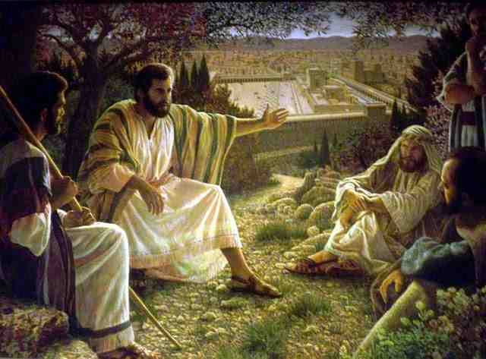
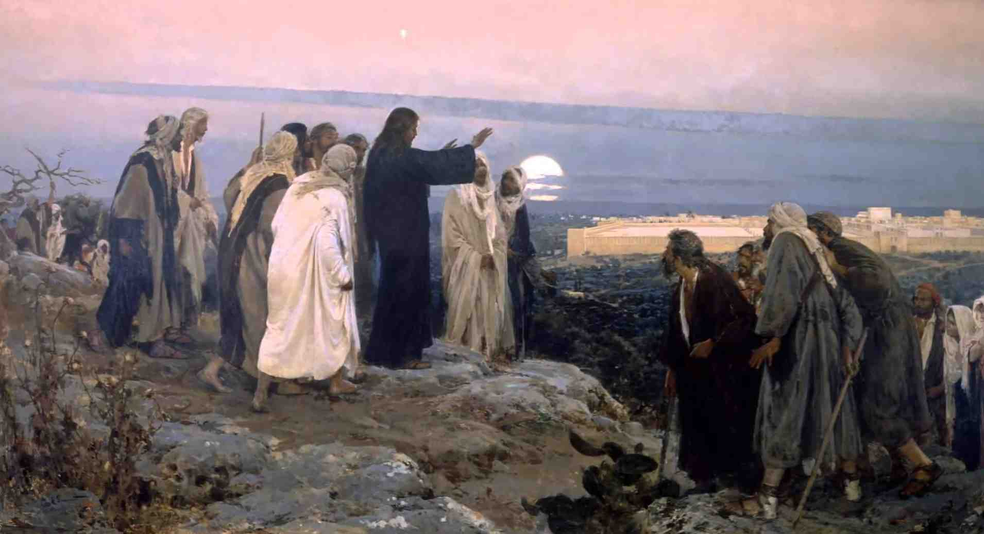
Is Jesus Coming Soon?
Matthew 24:1-36

Slide 2
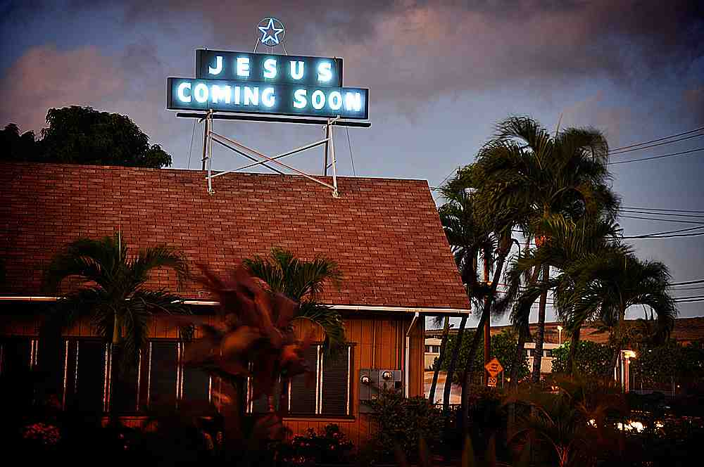
Do signs indicate the coming of Christ?
Does the Bible give signs when He will come
Do current events in the news fit these signs?
Are these signs in Jesus’ Olivet Discourse?

Slide 3
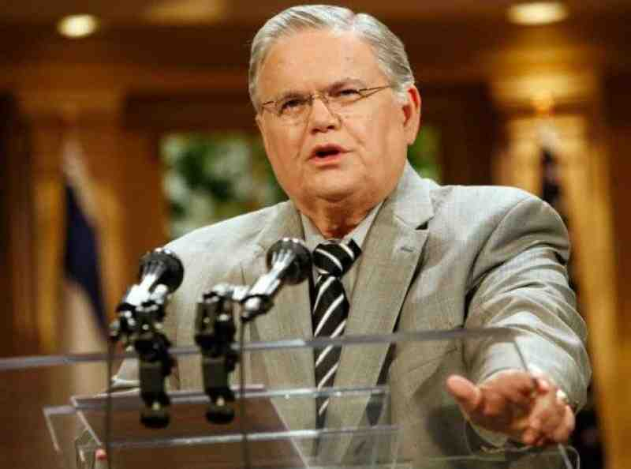
Eschatology..
Premillenial teachers apply prophecies to current events as indicating the imminent return of Christ..

Slide 4
The Olivet Discourse Matt 24 (Mark 13, Luke 21)
Jesus warnings to Israel ..
Luke 19:41-44 Enemies siege Jerusalem
Matt 21:21-46 Kingdom taken from Jews
Matt 22:1-10 King would burn their city
Matt 23:34-39 Their house left desolate
John 12:27-33 Now is judgment of world

Slide 5
Jesus and the Disciples..
Matthew 24:1-2 Then Jesus went out and departed from the temple, and His disciples came up to show Him the buildings of the temple. 2 And Jesus said to them, "Do you not see all these things? Assuredly, I say to you, not one stone shall be left here upon another, that shall not be thrown down."

Slide 6
Their questions..
Matthew 24:3 Now as He sat on the Mount of Olives, the disciples came to Him privately, saying, "Tell us, when will these things be? And what will be the sign of Your coming, and of the end of the age?"

Slide 7
Key Verse …
Matthew 24:34 Assuredly, I say to you, this generation will by no means pass away till all these things take place.
Vs 4-34 all to happen in that generation
Vs 36 "But of that day and hour no one knows, not even the angels of heaven, but My Father only.

Slide 8
Generation (genea)
Matthew 11:16 "But to what shall I liken this generation? It is like children sitting in the marketplaces and calling to their companions
Matthew 12:41-42 The men of Nineveh will rise up in the judgment with this generation and condemn it, because they repented at the preaching of Jonah.. a greater than Jonah is here.
Matthew 12:45 So shall it also be with this wicked generation."
Matthew 23:36 Assuredly, I say to you, all these things will come upon this generation.

Slide 9
Generation (genea)
Arndt and Gingrich: genea denotes “basically, the sum total of those born at the same time, expanded to include all those living at a given time generation, contemporaries” (153).
McClintock and Strong “this generation” in Matthew 24:34 denotes “the generation of persons then living contemporary with Christ” (776).
Herodotus, the Greek historian, said that “three generations” fill up a “century” (The Histories II.142). To him, a “generation” was a period of some thirty-three years.

Slide 10
Jerusalem’s destruction..
Early warnings (vs 4-14)..
False “messiahs” would arise.
There would be numerous military encounters.
Famines and earthquakes would occur.
Disciples would be persecuted.
Some would “stumble,” i.e., depart from the faith.
False prophets would be prevalent.
Decreasing spirituality on the part of some saints would be evident.
Those who endured would be delivered.
The gospel would be published far and wide during these four decades.

Slide 11
Jerusalem’s destruction..
Early warnings (vs 4-14)..
False “messiahs” would arise.
There would be numerous military encounters.
Famines and earthquakes would occur.
Disciples would be persecuted.
Some would “stumble,” i.e., depart from the faith.
False prophets would be prevalent.
Decreasing spirituality on the part of some saints would be evident.
Those who endured would be delivered.
The gospel would be published far and wide during these four decades.

Slide 12
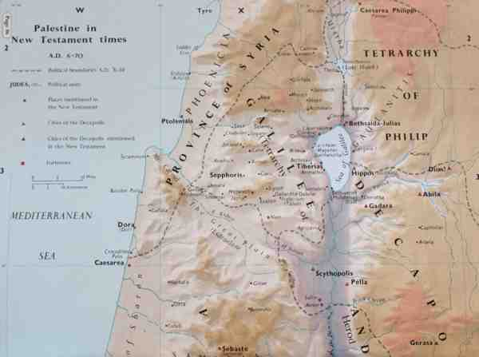
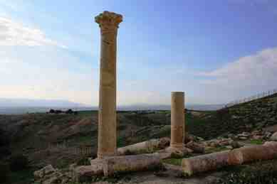

Slide 13
Signs in heaven (29-34)..
After the tribulation (29-31) Mark 13:24-27; Luke 21:25-27).
a) Like other prophets, Jesus uses figurative language to depict the city’s fall.
(1) Babylon (Isaiah 13:6-13).
(2) Egypt (Isaiah 19:1-2; Ezekiel 32:2, 7-9).
(3) Tyre (Isaiah 23:1; 24:21-23).
(4) Edom (Isaiah 34:4-6).
(5) Nineveh (Nahum 1:1-5).
(6) Israel and Judah (Amos 8:9; Jeremiah 4:23-28).

Slide 14
Signs in heaven (29-34)..
The fig tree (Matthew 24:32-33; Mark 13:28-29; Luke 21:29-31).
a) When a fig tree blooms, it is an obvious sign that summer is near. Does anyone really need a calendar to tell when the seasons change?
b) Likewise, when these aforementioned signs occur, Christ’s disciples will know that they should leave Jerusalem (Matthew 24:16-20; Mark 13:15-18; Luke 21:21-23).

Slide 15
The End of the World (36-44)..
But.. Of that day and hour no one knows.. Only the Father
As the days of Noah .. Vs 37-39
The field and the mill .. Vs 40-41
The faithful householder.. 42-45
The wise servant.. 45-51
The ten virgins.. 25:1-13
The talents.. 25:14-30
Judgment of nations.. 25:31-46

Slide 16
Is Jesus Coming Soon?
Matthew 24:1-36

