Slide 1
Why is the Church Declining?
John 6:60-69

Slide 2
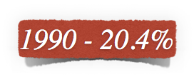
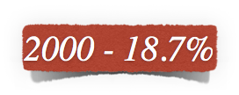
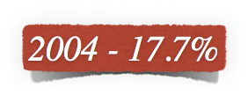
Number of Americans attending church…
U.S. population has grown 18.8%...
Younger generation shows decline in spiritual interest..

Slide 3
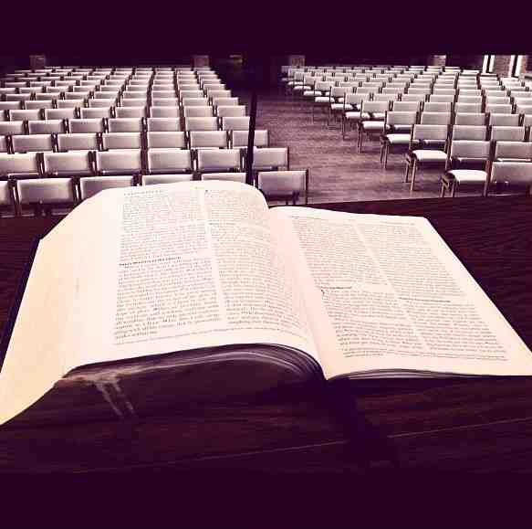
Changing with the times..
Compromising to sustain numbers..
Relaxed moral standards…
Grace and love, no demand to repent..
Mistaking emotionalism for spirituality..

Slide 4
The church in an experience driven culture...
“A Left-Brained Fellowship in a Right-Brained World” by James Nored

Slide 5
1 We cannot compromise the message -
John 6:60-69

Slide 6
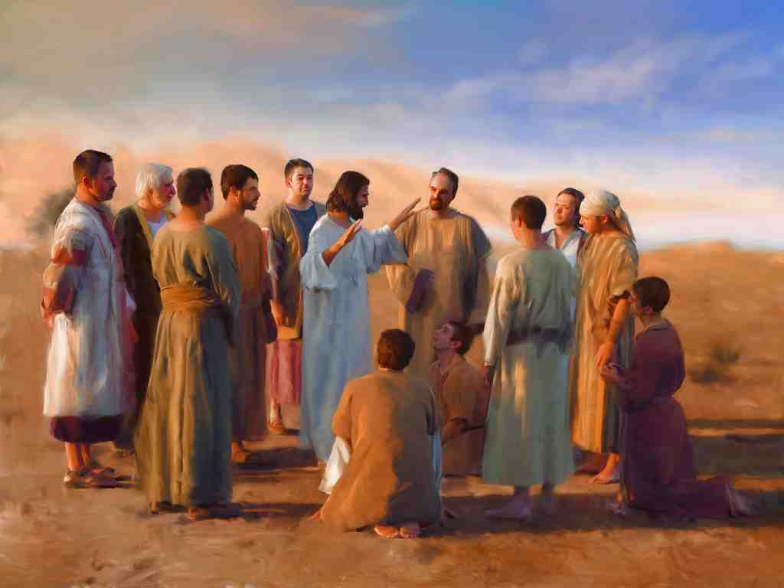
What did Jesus do..
John 6:60–69
⁶⁰ Therefore many of His disciples, when they heard this, said, “This is a hard saying; who can understand it?” ⁶¹ When Jesus knew in Himself that His disciples complained about this, He said to them, “Does this offend you?

Slide 7
What did Jesus do..
John 6:60–69
⁶² What then if you should see the Son of Man ascend where He was before? ⁶³ It is the Spirit who gives life; the flesh profits nothing. The words that I speak to you are spirit, and they are life.

Slide 8
What did Jesus do..
John 6:60–69
⁶⁴ But there are some of you who do not believe.” For Jesus knew from the beginning who they were who did not believe, and who would betray Him. ⁶⁵ And He said, “Therefore I have said to you that no one can come to Me unless it has been granted to him by My Father.”

Slide 9
What did Jesus do..
John 6:60–69
⁶⁶ From that time many of His disciples went back and walked with Him no more. ⁶⁷ Then Jesus said to the twelve, “Do you also want to go away?” ⁶⁸ But Simon Peter answered Him, “Lord, to whom shall we go? You have the words of eternal life. ⁶⁹ Also we have come to believe and know that You are the Christ, the Son of the living God.”

Slide 10
1 We cannot compromise the message -
John 6:60-69
2 We cannot conform to the world -
Romans 12:1-2

Slide 11
Paul’s earnest plea..
Romans 12:1–2
¹ I beseech you therefore, brethren, by the mercies of God, that you present your bodies a living sacrifice, holy, acceptable to God, which is your reasonable service.
² And do not be conformed to this world, but be transformed by the renewing of your mind, that you may prove what is that good and acceptable and perfect will of God.

Slide 12
Changing with the times..
Provide what people want (tolerance, humor, entertainment)..
A social – non threatening atmosphere where unbelievers can feel comfortable

Slide 13
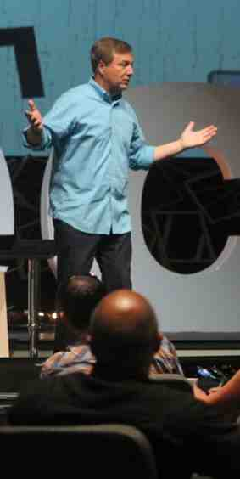
Find what works..
Church @ the Springs, Ocala Florida.. Ron Sylvia
“Worship style is as important as theology. … The entire worship experience must be evaluated through the eyes of your target.
“When you confidently determine who your target is—who you’re trying to reach—it makes crafting a worship experience for that person a lot easier. Through some trial and error you will learn what works and what does not work for your target group.” —

Slide 14
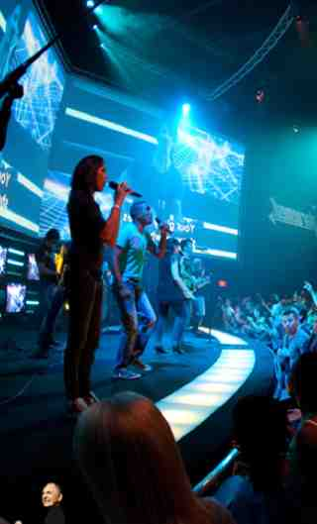
Market driven ministry..
Find out what they want and give it to them..
Special music.. rock band, rap music..
Gimmicks for attraction.. body builders, comedians, actors, dancers..

Slide 15
1 We cannot compromise the message -
John 6:60-69
2 We cannot conform to the world -
Romans 12:1-2
3 We should not feed carnal appetites -
2 Timothy 4:1-4

Slide 16
Charge to Timothy..
2 Timothy 4:1-4
¹ I charge you therefore before God and the Lord Jesus Christ, who will judge the living and the dead at His appearing and His kingdom:
² Preach the word! Be ready in season and out of season. Convince, rebuke, exhort, with all longsuffering and teaching.

Slide 17
Charge to Timothy..
2 Timothy 4:1-4
³ For the time will come when they will not endure sound doctrine, but according to their own desires, because they have itching ears, they will heap up for themselves teachers;
⁴ and they will turn their ears away from the truth, and be turned aside unto fables.

Slide 18
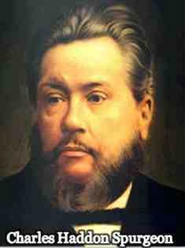
Has the word of God lost its power?..
The fact is, that many would like to unite church and stage, cards and prayer, dancing and sacraments. If we are powerless to stem this torrent, we can at least warn men of its existence, and entreat them to keep out of it.
When the old faith is gone, and enthusiasm for the gospel is extinct, it is no wonder that people seek something else in the way of delight. Lacking bread, they feed on ashes; rejecting the way of the Lord, they run greedily in the path of folly.”
The Sword and The Trowel (Aug. 1887)

Slide 19
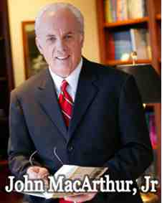
Wrong appeal…
We have a society filled with people who want what they want when they want it. They are into their own lifestyle, recreation, and entertainment. They want comfort, happiness, and success. When churches appeal to those selfish desires, they only fuel fires that hinder true godliness.”
Ashamed of The Gospel, When The Church Becomes Like The World, pg 85)

Slide 20
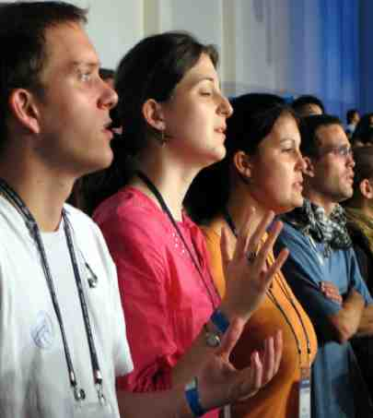
A Deeper Problem revealed..
Many do not know what it means to worship God.. confuse emotionalism with spirituality..
Seeking what they want instead of what pleases God…

Slide 21
1 We cannot compromise the message -
John 6:60-69
2 We cannot conform to the world -
Romans 12:1-2
3 We should not feed carnal appetites -
2 Timothy 4:1-4
4 We cannot deny reality -
Our numbers are declining

Slide 22
We should be pursuing..
Converting the lost .. 2 Cor 5:17
Edification of the saved – Eph 4:11-16
Obedience to God – Hebrews 5:8-9
Holiness – Hebrews 12:14
Spiritual maturity – Col 1:28
Teaching our children – Eph 6:4
Putting the Lord first – Matt 6:33

Slide 23
Self examination…
“If you get bored in church, may I suggest to you that it’s not a commentary on the sermon – it’s a commentary on your heart! Even if the sermon isn’t particularly worth listening to, the chance to pick up some truths about God that come through, should be the most exhilarating time of your life.
If you’re uninterested or indifferent, it’s not a commentary on the sermon, it’s a commentary on you.”
(True Worship, pg 89)

Slide 24
Why is the Church Declining?
John 6:60-69

