Slide 1
In the Kingdom.. For Such a Time as This
Esther 4:11-16

Slide 2
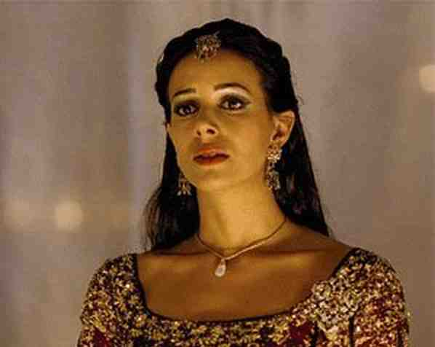
Esther at a critical time..
Esther 4:14 For if you remain completely silent at this time, relief and deliverance will arise for the Jews from another place, but you and your father's house will perish. Yet who knows whether you have come to the kingdom for such a time as this?"

Slide 3
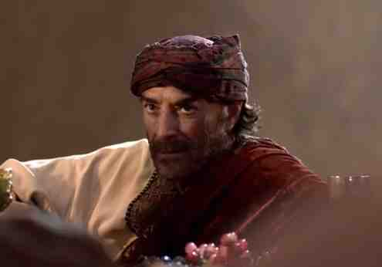
4:1-9 Mordecai learned of Haman’s plan to eradicate the Jews.. called for Esther

Slide 4
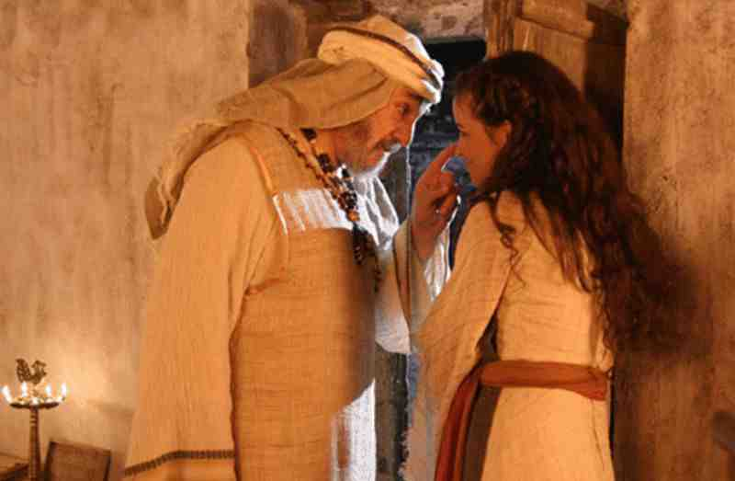
4:11-14 Mordecai reminds Esther that if she does not act at this time they will all perish

Slide 5
Esther 4:15-17 She told Mordecai she would go after three days of fasting..
Esther 5:1-4 Esther braved the law and entered the king’s room and found favor..

Slide 6
What about us today?
What if we are in the kingdom of Christ with our abilities for such a time as this?

Slide 7
To be an Encourager..
Acts 4:36-37 And Joses, who was also named Barnabas by the apostles (which is translated Son of Encouragement), a Levite of the country of Cyprus, 37 having land, sold it, and brought the money and laid it at the apostles' feet.

Slide 8
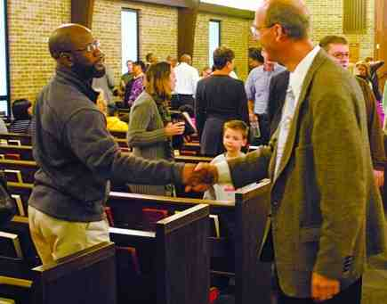
1 Thessalonians 5:11-14 Therefore comfort each other and edify one another, just as you also are doing. 14 Now we exhort you, brethren, warn those who are unruly, comfort the fainthearted, uphold the weak, be patient with all.

Slide 9
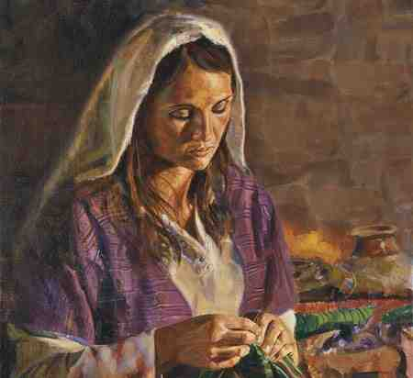
Heart of a servant..
Acts 9:36-43 At Joppa there was a certain disciple named Tabitha, which is translated Dorcas. This woman was full of good works and charitable deeds which she did.. And all the widows stood by him weeping, showing the tunics and garments which Dorcas had made while she was with them.

Slide 10
Teacher to save the lost..
Acts 9:15-16 But the Lord said to him, "Go, for he is a chosen vessel of Mine to bear My name before Gentiles, kings, and the children of Israel. 16 For I will show him how many things he must suffer for My name's sake."

Slide 11
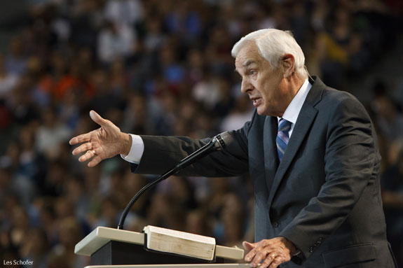
Teacher to defend the faith..
1 Timothy 4:1-6 Now the Spirit expressly says that in latter times some will depart from the faith, giving heed to deceiving spirits and doctrines of demons...6 If you instruct the brethren in these things, you will be a good minister of Jesus Christ, nourished in the words of faith and of the good doctrine which you have carefully followed.

Slide 12
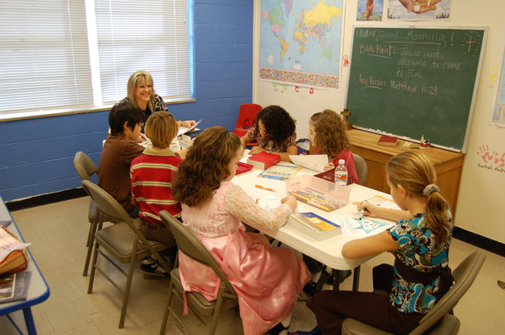
Using talents as members ..
Ephesians 4:14-16 speaking the truth in love, may grow up in all things into Him who is the head — Christ — 16 from whom the whole body, joined and knit together by what every joint supplies, according to the effective working by which every part does its share, causes growth of the body for the edifying of itself in love.

Slide 13
2 Timothy 1:3-5 I thank God, whom I serve with a pure conscience, as my forefathers did, as without ceasing I remember you in my prayers night and day, 5 when I call to remembrance the genuine faith that is in you, which dwelt first in your grandmother Lois and your mother Eunice, and I am persuaded is in you also.

Slide 14
In the Kingdom.. For Such a Time as This
Esther 4:11-16

