Slide 1
Honor Your Mother
Ephesians 6:1-3

Slide 2
Ephesians 6:1-3
Children, obey your parents in the Lord, for this is right. 2 "Honor your father and mother," which is the first commandment with promise: 3 "that it may be well with you and you may live long on the earth."
God’s Promise
If you honor your father and mother, you will live a long life, full of blessing

Slide 3
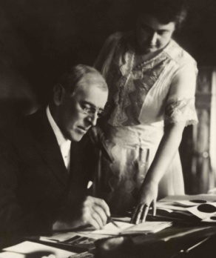
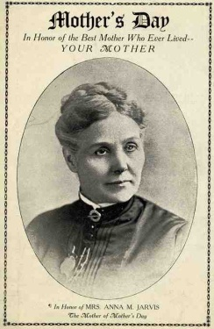

Slide 4
Why did God command this?
Every parent is imperfect..
Luke 11:13 If you then, being evil, know how to give good gifts to your children, how much more will your heavenly Father give the Holy Spirit to those who ask Him!“

Slide 5
Why did God command this?
I would not exist without them..
God chose their DNA to form me..
Psalms 139:13-16 For You formed my inward parts; You covered me in my mother's womb. 14 I will praise You, for I am fearfully and wonderfully made; Marvelous are Your works, And that my soul knows very well. 15 My frame was not hidden from You, When I was made in secret, And skillfully wrought in the lowest parts of the earth. 16 Your eyes saw my substance, being yet unformed. And in Your book they all were written, The days fashioned for me, When as yet there were none of them.

Slide 6
Honoring mothers today
Birth moms..
Adopted moms..
Foster moms..
Step moms..

Slide 7
How do I honor my mother?
As a child, by obeying her..
Ephesians 6:1 Children, obey your parents in the Lord, for this is right.
Proverbs 1:8 My son, hear the instruction of your father, And do not forsake the law of your mother..
Proverbs 13:24 He who spares his rod hates his son, But he who loves him disciplines him promptly.

Slide 8
How do I honor my mother?
As a young adult by respecting her..
Leviticus 19:3 'Every one of you shall revere his mother and his father, and keep My Sabbaths: I am the Lord your God.
Hebrews 12:9 Furthermore, we have had human fathers who corrected us, and we paid them respect. Shall we not much more readily be in subjection to the Father of spirits and live?

Slide 9
How do I honor my mother?
By listening to her..
Proverbs 13:1 A wise son heeds his father's instruction, But a scoffer does not listen to rebuke.
Proverbs 23:22 Listen to your father who begot you, And do not despise your mother when she is old.
Proverbs 6:20-23 My son, keep your father's command, And do not forsake the law of your mother. 21 Bind them continually upon your heart; Tie them around your neck. 22 When you roam, they will lead you; When you sleep, they will keep you; And when you awake, they will speak with you. 23 For the commandment is a lamp, And the law a light; Reproofs of instruction are the way of life..

Slide 10
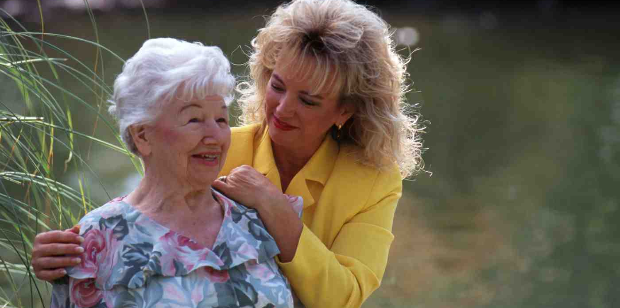
How do I honor my mother?
As an adult by showing your appreciation
Proverbs 23:22 Listen to your father who begot you, And do not despise your mother when she is old.
Proverbs 23:25 Let your father and your mother be glad, And let her who bore you rejoice.
Proverbs 31:28 Her children rise up and call her blessed; Her husband also, and he praises her:

Slide 11
How do I honor my mother?
As an adult by caring for them..
1 Timothy 5:1-2 Do not rebuke an older man, but exhort him as a father, younger men as brothers, 2 older women as mothers, younger women as sisters, with all purity.
1 Timothy 5:8 But if anyone does not provide for his own, and especially for those of his household, he has denied the faith and is worse than an unbeliever.

Slide 12
“I’ll love you forever, I’ll like you always..
As long as I’m living, my baby you’ll be.”

Slide 13
Honor Your Mother
Ephesians 6:1-3

