Slide 1
The Times of Our Life
Proverbs 2:1-11

Slide 2
A Solid foundation..
Psalm 27:4-6 One thing I have desired of the Lord, that will I seek: that I may dwell in the house of the Lord all the days of my life, to behold the beauty of the Lord, And to inquire in His temple.

Slide 3
Wisdom for life..
Proverbs 2:4-6 If you search for her as for hidden treasures; 5 Then you will understand the fear of the Lord, and find the knowledge of God. 6 For the Lord gives wisdom; from His mouth come knowledge and understanding..

Slide 4
Four times of ..
C H A N G E

Slide 5
The Teenage years..
Eccl 11:9-10 Rejoice, O young man, in your youth, and let your heart cheer you in the days of your youth; walk in the ways of your heart, and in the sight of your eyes; But know that for all these God will bring you into judgment.

Slide 6
Pressure to follow others..
Proverbs 1:7-8 The fear of the Lord is the beginning of knowledge, But fools despise wisdom and instruction. My son, hear the instruction of your father, And do not forsake the law of your mother;

Slide 7
The Invincibility Syndrome..
Galatians 6:7-8 Do not be deceived, God is not mocked; for whatever a man sows, that he will also reap. 8 For he who sows to his flesh will of the flesh reap corruption, but he who sows to the Spirit will of the Spirit reap everlasting life.

Slide 8
Putting it off till later..
1 Timothy 4:12 Let no one despise your youth, but be an example to the believers in word, in conduct, in love, in spirit, in faith, in purity.

Slide 9
Building a home..
Matthew 19:4-6 'For this reason a man shall leave his father and mother and be joined to his wife, and the two shall become one flesh'? 6 So then, they are no longer two but one flesh. Therefore what God has joined together, let not man separate."

Slide 10
Seeking the Lord..
Psa 127:1-2 Unless the Lord builds the house, They labor in vain who build it; Unless the Lord guards the city, The watchman stays awake in vain. 2 It is vain for you to rise up early, To sit up late, To eat the bread of sorrows; For so He gives His beloved sleep.

Slide 11
Keep eyes on the goal..

Slide 12
Don’t get caught up..
Ecclesiastes 1:17 And I set my heart to know wisdom and to know madness and folly. I perceived that this also is grasping for the wind.

Slide 13
Learning to grow old..
Philippians 3:12-14 13 Brethren, I do not count myself to have apprehended; but one thing I do, forgetting those things which are behind and reaching forward to those things which are ahead, 14 I press toward the goal for the prize of the upward call of God in Christ Jesus.

Slide 14
Know your treasure..
Matthew 6:19-21 "Do not lay up for yourselves treasures on earth, where moth and rust destroy and where thieves break in and steal; 20 but lay up for yourselves treasures in heaven, where neither moth nor rust destroys and where thieves do not break in and steal. 21 For where your treasure is, there your heart will be also.

Slide 15
Enjoy the golden years..
2 Peter 1:9-10 Therefore, brethren, be even more diligent to make your call and election sure, for if you do these things you will never stumble..

Slide 16
Keep bearing fruit..
Psa 92:12-14 The righteous shall flourish like a palm tree, He shall grow like a cedar in Lebanon. 13 Those who are planted in the house of the Lord Shall flourish in the courts of our God. 14 They shall still bear fruit in old age; They shall be fresh and flourishing.

Slide 17
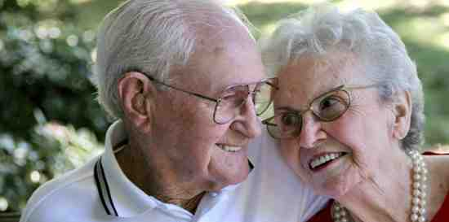
You have much to offer..
1 Pet 5:5 Likewise you younger people, submit yourselves to your elders. Yes, all of you be submissive to one another, and be clothed with humility, for "God resists the proud, But gives grace to the humble."

Slide 18
The Times of Our Life
Proverbs 2:1-11

