Slide 1
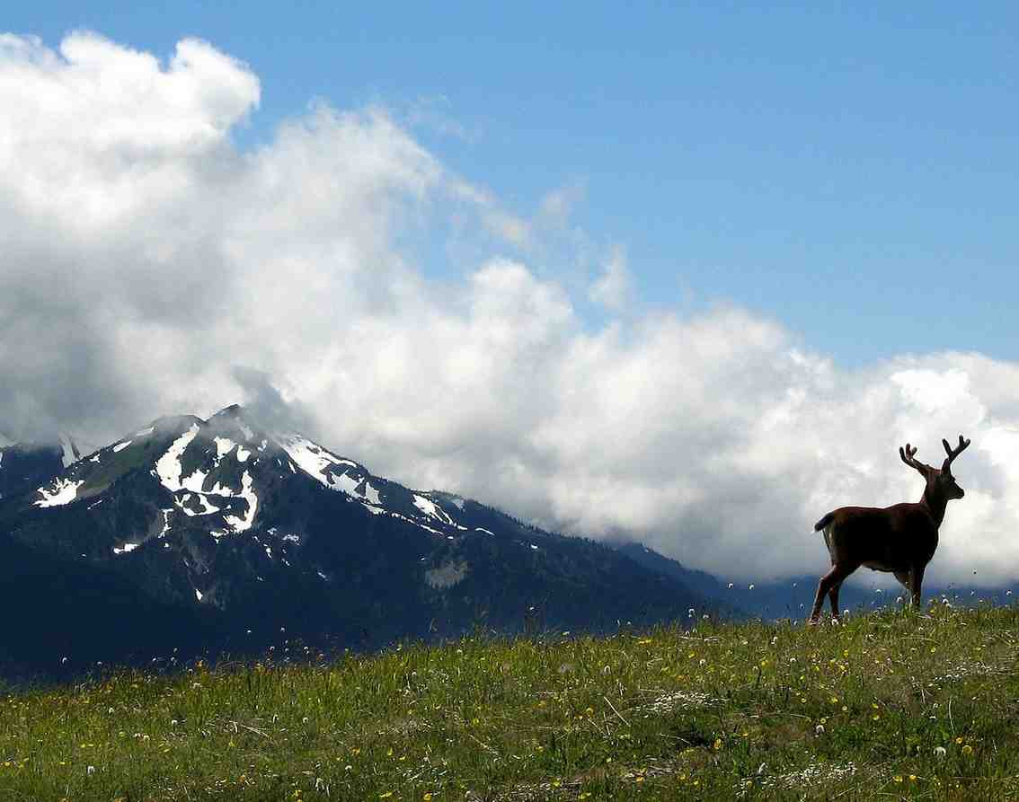
Strength to Stand Above
Habakkuk 3:17-19

Slide 2
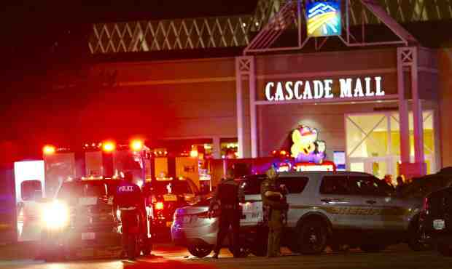
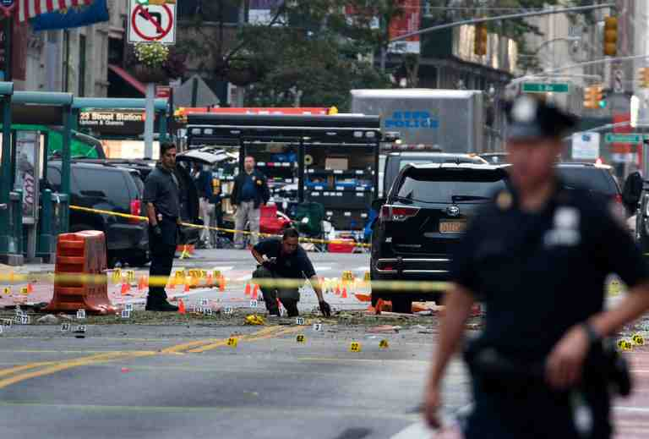
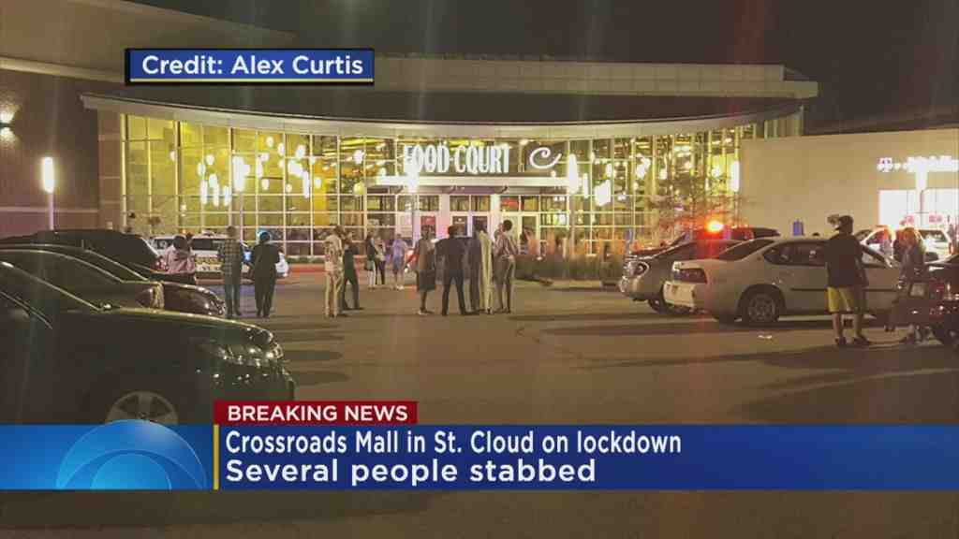
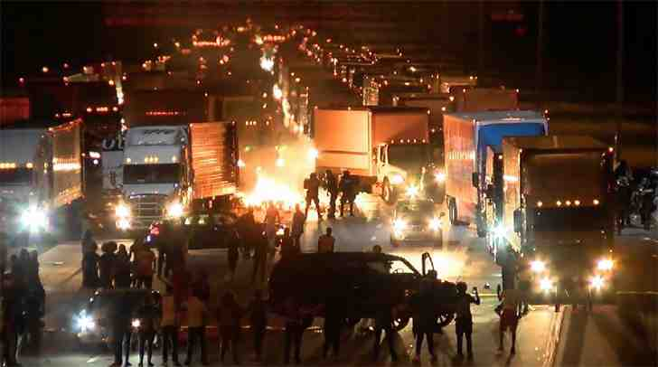
WHY, LORD?

Slide 3
We don’t understand faith until something goes wrong

Slide 4
Habakkuk
Ch 1-2 Habakkuk’s conversation w/God
Habakkuk expressed his complaint 1:2-4
The Lord gave His reply 1:5-11
Habakkuk’s further confusion 1:12-17
God’s fuller answer 2:2-20
Ch 3 Habakkuk’s hymn of praise
This process works in our problems..

Slide 5
Processing problems..
1:2-4 O Lord, how long shall I cry, And You will not hear? Even cry out to You, “Violence!”And You will not save.
³ Why do You show me iniquity, And cause me to see trouble? For plundering and violence are before me; There is strife, and contention arises.
⁴ Therefore the law is powerless, And justice never goes forth. For the wicked surround the righteous; Therefore perverse judgment proceeds.

Slide 6
The Lord responds..
1:5-7 “Look among the nations and watch—Be utterly astounded! For I will work a work in your days Which you would not believe, though it were told you.
⁶ For indeed I am raising up the Chaldeans, A bitter and hasty nation Which marches through the breadth of the earth, To possess dwelling places that are not theirs.⁷ They are terrible and dreadful; Their judgment and their dignity proceed from themselves.

Slide 7
Habakkuk’s confusion..
1:12-13 Are You not from everlasting, O Lord my God, my Holy One? We shall not die. O Lord, You have appointed them for judgment; O Rock, You have marked them for correction.
¹³ You are of purer eyes than to behold evil, And cannot look on wickedness. Why do You look on those who deal treacherously, And hold Your tongue when the wicked devours A person more righteous than he?

Slide 8
God’s fuller response..
2:2-4 “Write the vision And make it plain on tablets, That he may run who reads it. ³ For the vision is yet for an appointed time; But at the end it will speak, and it will not lie. Though it tarries, wait for it; Because it will surely come, It will not tarry.
⁴ “Behold the proud, His soul is not upright in him; But the just shall live by his faith.

Slide 9
God’s fuller response..
2:12-13 Behold, is it not of the Lord of hosts That the peoples labor to feed the fire, And nations weary themselves in vain? ¹⁴ For the earth will be filled With the knowledge of the glory of the Lord, As the waters cover the sea.
2:20 “But the Lord is in His holy temple. Let all the earth keep silence before Him.”

Slide 10
Habakkuk’s hymn of praise..
3:4 His brightness was like the light; He had rays flashing from His hand, And there His power was hidden.
3:12-13 You marched through the land in indignation; You trampled the nations in anger. 13 You went forth for the salvation of Your people, For salvation with Your Anointed. You struck the head from the house of the wicked, By laying bare from foundation to neck.

Slide 11
Habakkuk’s hymn of praise..
3:17-18 Though the fig tree may not blossom, Nor fruit be on the vines; Though the labor of the olive may fail, And the fields yield no food; Though the flock may be cut off from the fold, And there be no herd in the stalls—
¹⁸ Yet I will rejoice in the Lord, I will joy in the God of my salvation.

Slide 12
Habakkuk 3:19 The Lord God is my strength; He will make my feet like deer’s feet, and He will make me walk on my high hills.

Slide 13
Strength to Stand Above
Habakkuk 3:17-19

