Slide 1
Be Strengthened in
“He did not waver at the promise of God through unbelief, but was strengthened in faith, giving glory to God.” – Romans 4:20
Like Abraham

Slide 2
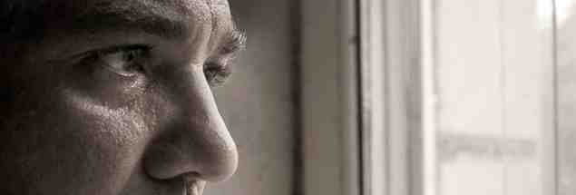
When life is discouraging..
Faith is keeping up our spirits when things aren’t going well..

Slide 3
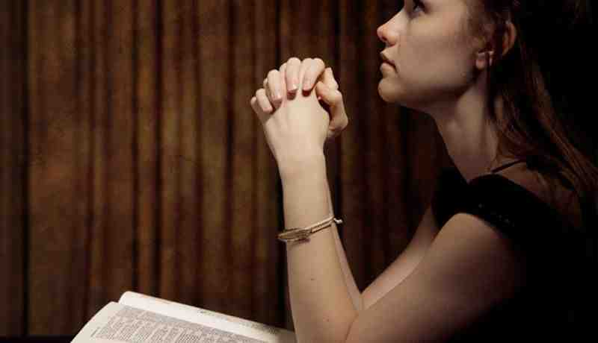
Holding on to truth..
Faith is taking God at His word, seeing every page of the Bible as TRUE ..

Slide 4
Substance of our hope..
Heb 11:1 Now faith is the substance of things hoped for, the evidence of things not seen.

Slide 5
Romans 4 Strong Faith illustrated..
Israel’s pride in Abraham..
Matt 3:8-9 Therefore bear fruits worthy of repentance, ⁹ and do not think to say to yourselves, ‘We have Abraham as our father.’ For I say to you that God is able to raise up children to Abraham from these stones.

Slide 6
Abraham not righteous within himself..
Rom 4:1-3 What then shall we say that Abraham our father has found according to the flesh? ² For if Abraham was justified by works, he has something to boast about, but not before God. ³ For what does the Scripture say? “Abraham believed God, and it was accounted to him for righteousness.” ⁴ Now to him who works, the wages are not counted as grace but as debt.

Slide 7
A forgiving God..
Rom 4:5-7 But to him who does not work but believes on Him who justifies the ungodly, his faith is accounted for righteousness, ⁶ just as David also describes the blessedness of the man to whom God imputes righteousness apart from works:
⁷ “Blessed are those whose lawless deeds are forgiven, And whose sins are covered; ⁸ Blessed is the man to whom the Lord shall not impute sin.”

Slide 8
Justified by faith..
How Abraham was justified..
Galatians 3:6-9 (connected with Gen 12:1-3)
Romans 4:1-5 (connected with Gen 15:1-6)
Romans 4:17-22 (connected with Gen 17:1-12)
James 2:21-24 (applied to Gen 22:1-14)

Slide 9
Justified by faith..
Four conclusions ..
Justification is not a single act or instance
Requires confessing and turning from sin
Requires continual trust in all circumstances
Involves obedience to God’s directions
Not faith only ..
Apart from works refers to works of merit which would give reason to boast ..
Results in blessedness in forgiveness..
Experienced before circumcised (vs 9-12)

Slide 10
Abraham’s hope in God..
Abraham’s faith in God’s promise..
¹³ For the promise that he would be the heir of the world was not to Abraham or to his seed through the law, but through the righteousness of faith. ¹⁴ For if those who are of the law are heirs, faith is made void and the promise made of no effect, ¹⁵ because the law brings about wrath; for where there is no law there is no transgression.
The promise of a nation, a son, and a Savior..
The promise of heaven (Heb 11:9-16)

Slide 11
It all depended on a son..
Sarah his wife was barren..
Human wisdom to have a son by Hagar (Gen 16)
13 years passed (Gen 16:16; 17:1)
17:1 When Abram was ninety-nine years old, the Lord appeared to Abram and said to him, “I am Almighty God; walk before Me and be blameless. ² And I will make My covenant between Me and you, and will multiply you exceedingly.”

Slide 12
Believing in hope.. Fully persuaded
¹⁹ And not being weak in faith, he did not consider his own body, already dead (since he was about a hundred years old), and the deadness of Sarah’s womb. ²⁰ He did not waver at the promise of God through unbelief, but was strengthened in faith, giving glory to God, ²¹ and being fully convinced that what He had promised He was also able to perform. ²² And therefore “it was accounted to him for righteousness.”

Slide 13
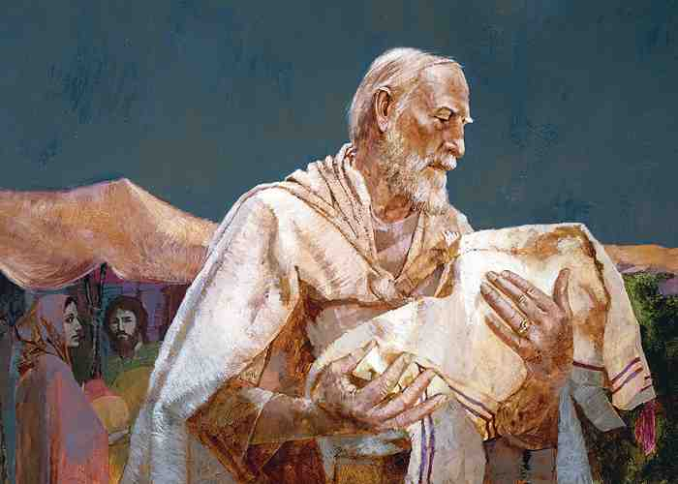
Gave glory to God..

