Slide 1
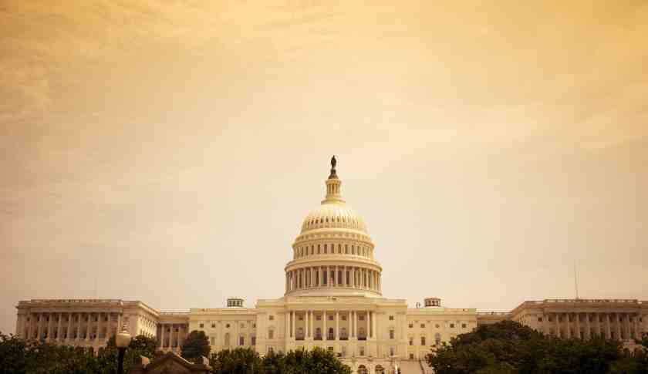
America at the Crossroads
Proverbs 14:26-34

Slide 2
Proverbs 14:34
Righteousness exalts a nation, But sin is a reproach to any people.

Slide 3
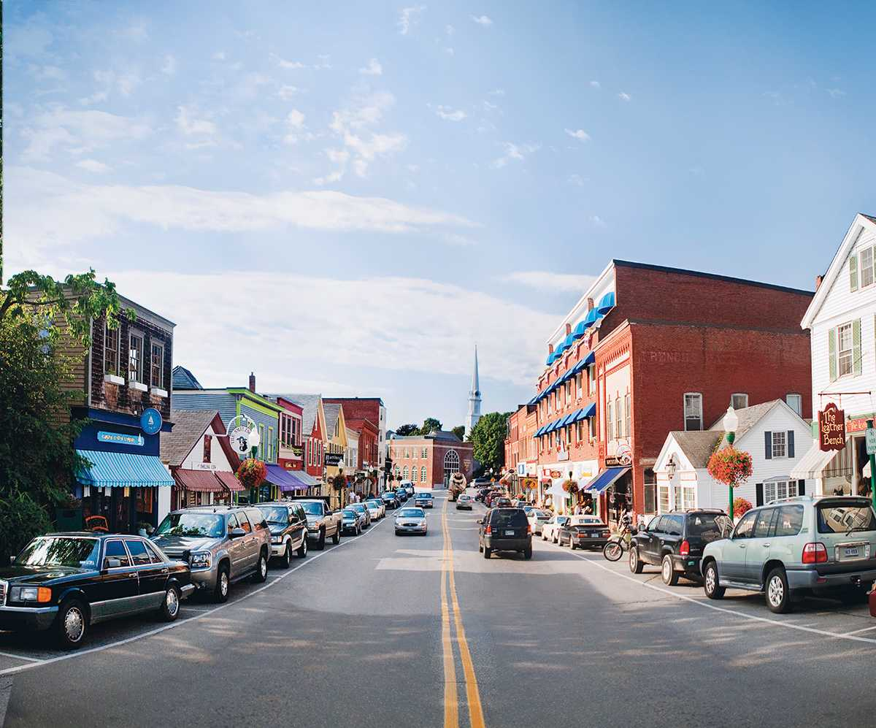
“America is great because America is good”.. Alexis DeToqueville (1828)

Slide 4
Psalm 20:7 Some trust in chariots, and some in horses; but we will remember the name
of the Lord our God.

Slide 5
Psalm 9:17 The wicked shall be turned into hell, And all the nations that forget God.

Slide 6
A Nation in Moral Decline
Turning points in America’s history

Slide 7
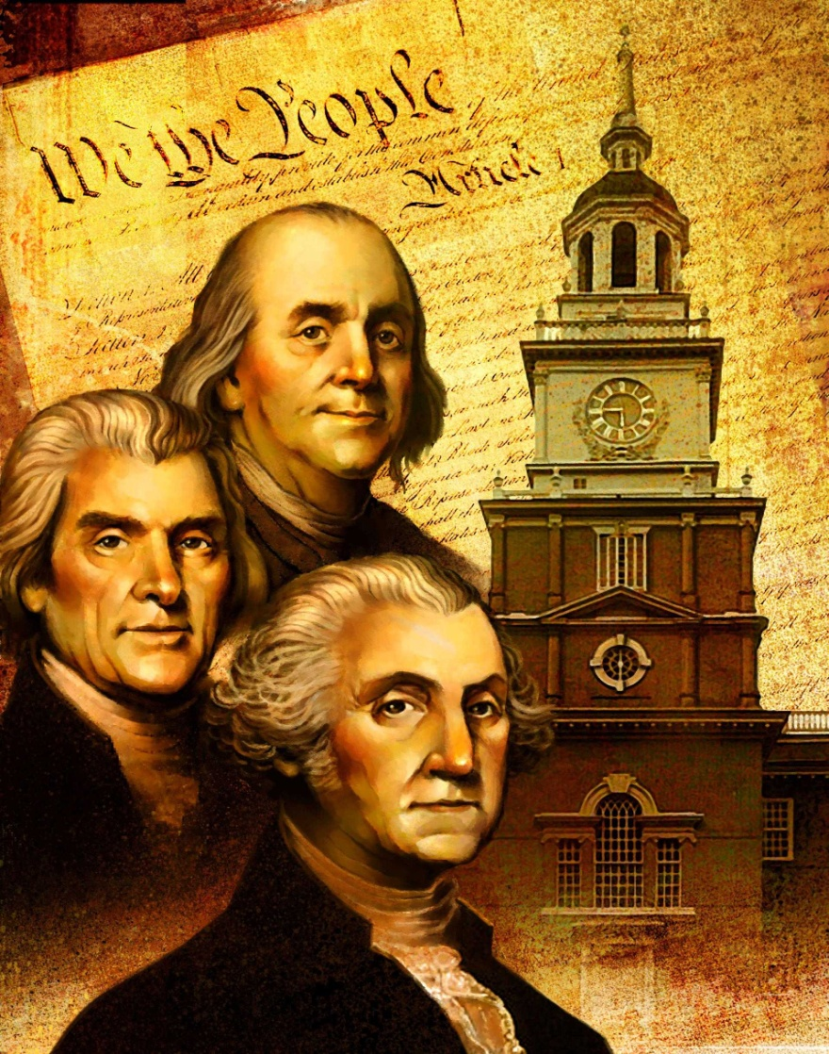
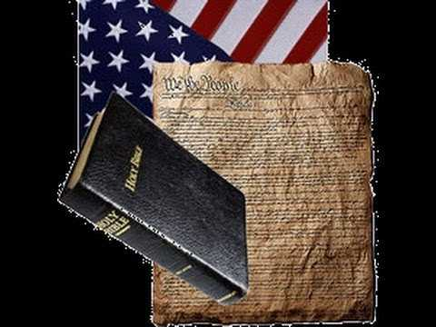
1776 In the beginning
G. Washington: “It is impossible to govern without God and the Bible”
John Adams: “Our Constitution was made only for a moral and religious people. It is wholly inadequate to the government of any other.”
B. Franklin: “God rules in the kingdoms of men”

Slide 8
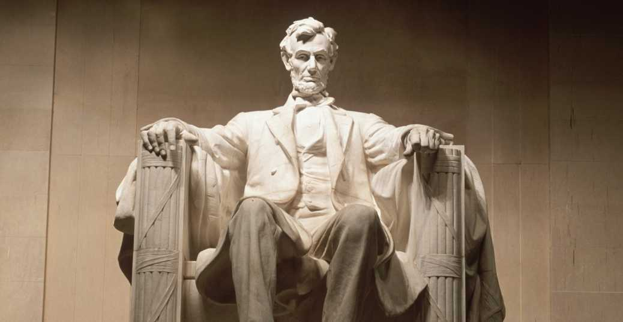
1860 War between states
“Testing whether that nation or any nation so conceived and so dedicated can long endure..”

Slide 9
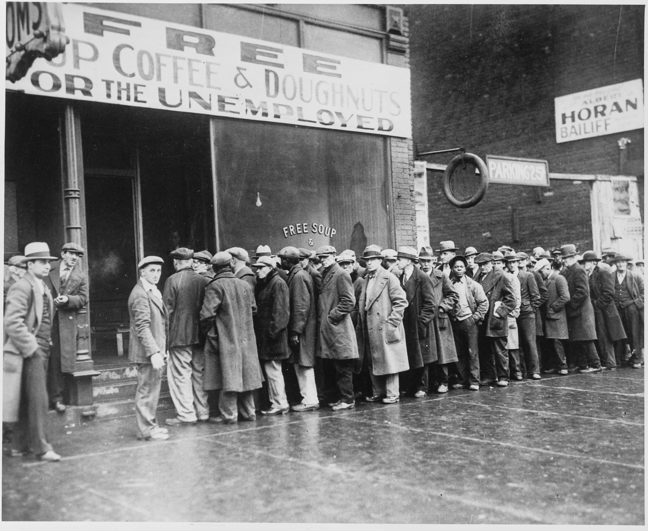
1929 Great Depression/ 1940-45 World War II
Test of survival as a nation..

Slide 10
1960s-70s Moral revolution
Free love.. Roe v Wade (1973)

Slide 11
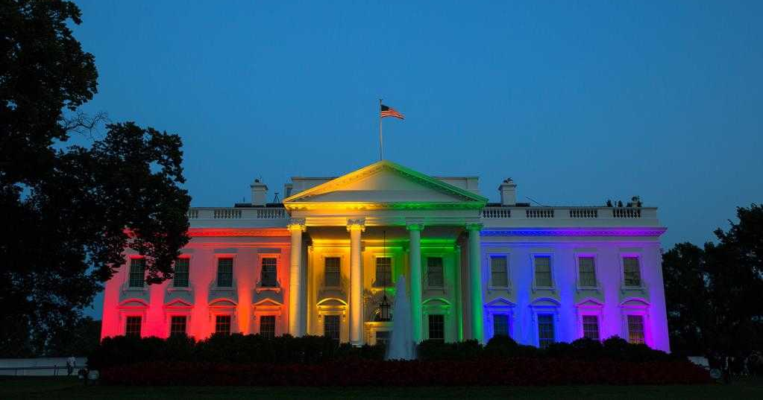
2000-16 Millenial era
Same sex marriage .. Etc ..

Slide 12
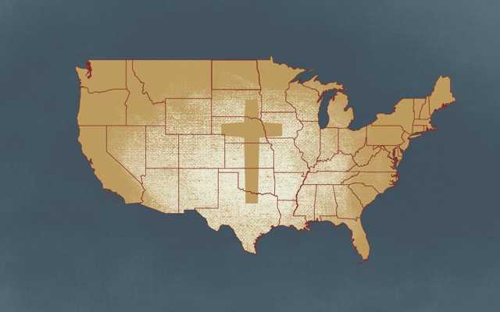
Forming of public opinion..
Erosion of moral consensus

Slide 13
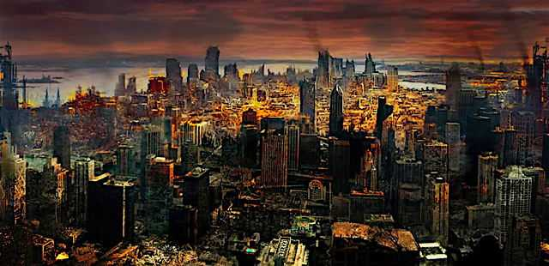
Satan’s plan to destroy America..
Undermine the family..
Relax, tear down sexual ethics..
Remove Christianity’s influence…
Fill the void with entertainment..
Use music, media to change minds..
Dumb down younger generations..

Slide 14
What can we do?
Live righteously.. Matt 5:13
Pray .. 1 Tim 2:1-2
Let the church be strong .. 1 Tim 3:15
Stand for righteousness.. Micah 6:8
Be good citizens.. Rom 13:1-7

Slide 15
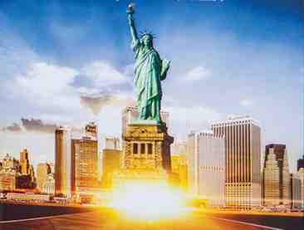
America at the Crossroads
Proverbs 14:26-34

