Slide 1
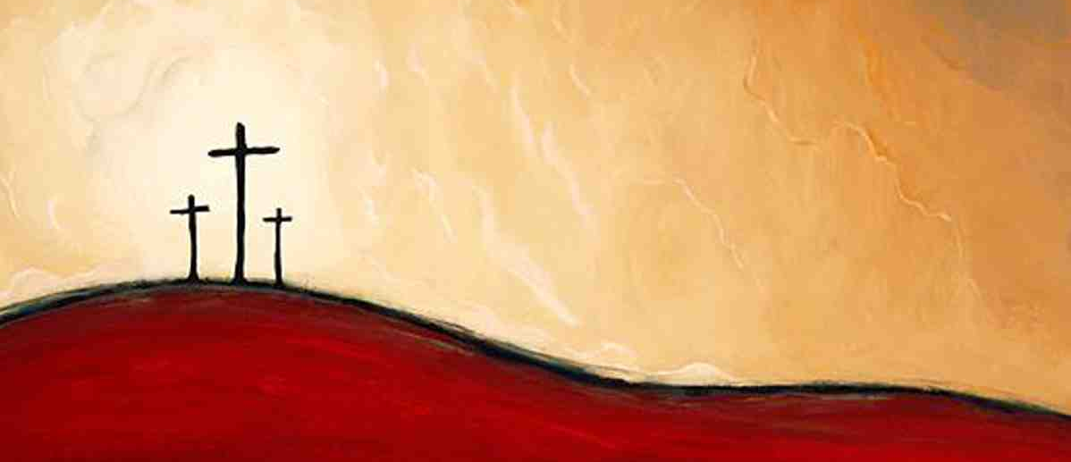
We Preach Christ Crucified
1 Corinthians 2:1-5

Slide 2
What works in today’s world?

Slide 3
The saving message
1 Cor 2:1-2 And I, brethren, when I came to you, did not come with excellence of speech or of wisdom declaring to you the testimony of God. ² For I determined not to know anything among you except Jesus Christ and Him crucified.

Slide 4
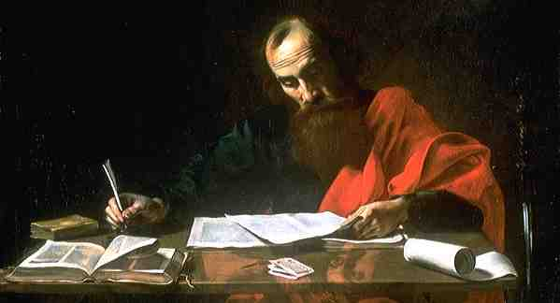
Paul writes the Corinthians..
Divisions
Arguments
Questions
1 Cor 1:9 God is faithful, by whom you were called into the fellowship of His Son, Jesus Christ our Lord.

Slide 5
Paul writes the Corinthians..
1:17 For Christ did not send me to baptize, but to preach the gospel, not with wisdom of words, lest the cross of Christ should be made of no effect.

Slide 6
God set aside the world’s wisdom by the cross..
1:18 For the message of the cross is foolish-ness to those who are perishing, but to us who are being saved it is the power of God.

Slide 7
God set aside the world’s wisdom by the cross..
1:19-21 For it is written: "I will destroy the wisdom of the wise, and bring to nothing the understanding of the prudent."
Where is the wise? Where is the scribe? Where is the disputer of this age? Has not God made foolish the wisdom of this world?
For since, in the wisdom of God, the world through wisdom did not know God, it pleased God through the foolishness of the message preached to save those who believe.

Slide 8
God set aside the world’s wisdom by the cross..
1:22-25 For Jews request a sign, and Greeks seek after wisdom; but we preach Christ crucified, to the Jews a stumbling block and to the Greeks foolishness, but to those who are called, both Jews and Greeks, Christ the power of God and the wisdom of God. Because the foolishness of God is wiser than men, and the weakness of God is stronger than men.

Slide 9
God set aside the world’s wisdom by the cross..
Isaiah 55:8-9 For My thoughts are not your thoughts, nor are your ways My ways, says the Lord. For as the heavens are higher than the earth, so are My ways higher than your ways, and My thoughts than your thoughts.

Slide 10
God did not choose us by the world’s standards..
1:26-29 For you see your calling, brethren, that not many wise according to the flesh, not many mighty, not many noble, are called.
27 But God has chosen the foolish things of the world to put to shame the wise, and God has chosen the weak things of the world to put to shame the things which are mighty; and the base things of the world and the things which are despised God has chosen, and the things which are not, to bring to nothing the things that are, that no flesh should glory in His presence.

Slide 11
God did not choose us by the world’s standards..
1:30-31 But of Him you are in Christ Jesus, who became for us wisdom from God; and righteousness and sanctification and redemption; that, as it is written, "He who glories, let him glory in the Lord."

Slide 12
God uses the weakness of preaching to us..
2:1-4 And I, brethren, when I came to you, did not come with excellence of speech or of wisdom declaring to you the testimony of God. For I determined not to know anything among you except Jesus Christ and Him crucified.
3 I was with you in weakness, in fear, and in much trembling. And my speech and my preaching were not with persuasive words of human wisdom, but in demonstration of the Spirit and of power.

Slide 13
God uses the weakness of preaching to us..
2:5 That your faith should not be in the wisdom of men but in the power of God.

Slide 14
What works in today’s world?

Slide 15
We Preach Christ Crucified
1 Corinthians 2:1-5

