Slide 1
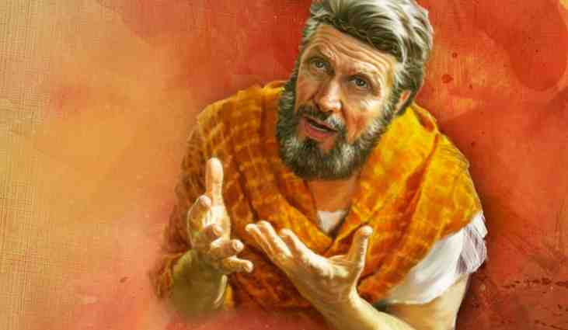
By Faith Noah
Hebrews 11:7

Slide 2
Hebrews 11:7..
By faith Noah, being divinely warned of things not yet seen, moved with godly fear, prepared an ark for the saving of his household, by which he condemned the world and became heir of the righteousness which is according to faith.

Slide 3
An example of the true meaning of faith (vs 1)
Heb 11:1 Now faith is the substance of things hoped for, the evidence of things not seen.
Two things Noah believed..
The great flood God promised
The salvation to come by the ark

Slide 4
Being Warned of God..
Genesis 6:13 And God said to Noah, "The end of all flesh has come before Me, for the earth is filled with violence through them; and behold, I will destroy them with the earth.

Slide 5
What brought this judgment from God?
Gen 6:5 Then the Lord saw that the wickedness of man was great in the earth, and that every intent of the thoughts of his heart was only evil continually.
6 And the Lord was sorry that He had made man on the earth, and He was grieved in His heart. 7 So the Lord said, "I will destroy man whom I have created from the face of the earth, both man and beast, creeping thing and birds of the air, for I am sorry that I have made them."

Slide 6
The wickedness of man..
Gen 6:11 The earth also was corrupt before God, and the earth was filled with violence. 12 So God looked upon the earth, and indeed it was corrupt; for all flesh had corrupted their way on the earth.

Slide 7
An Upright Man in a Corrupt Culture
Gen 6:8 But Noah found grace in the eyes of the Lord. 9 This is the genealogy of Noah. Noah was a just man, perfect in his generations. Noah walked with God. 10 And Noah begot three sons: Shem, Ham, and Japheth.
A righteous man
Blameless in his generation
Noah walks with God

Slide 8
Being Warned of God..
Genesis 6:13 And God said to Noah, "The end of all flesh has come before Me, for the earth is filled with violence through them; and behold, I will destroy them with the earth.
14 "Make yourself an ark of gopherwood; make rooms in the ark, and cover it inside and outside with pitch.

Slide 9
How to make the ark..
Genesis 6:15 And this is how you shall make it: The length of the ark shall be three hundred cubits, its width fifty cubits, and its height thirty cubits.

Slide 10
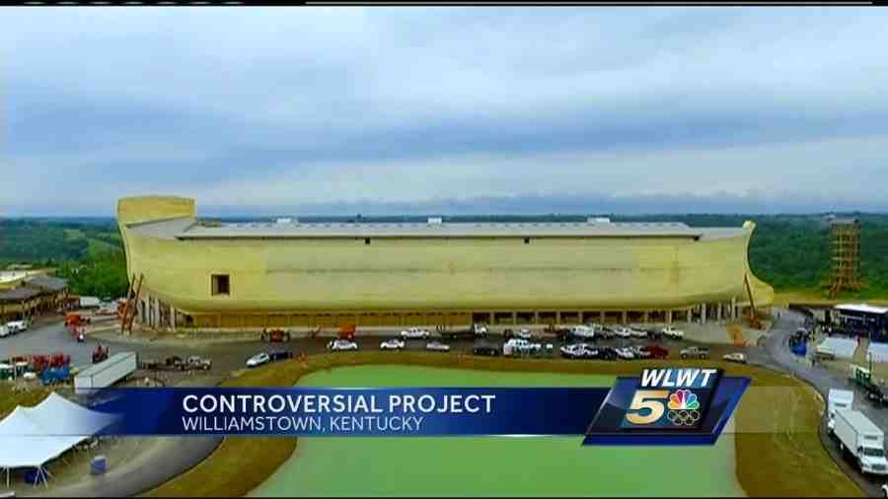
Size of the ark..
Creation Museum, Williamstown Kentucky

Slide 11
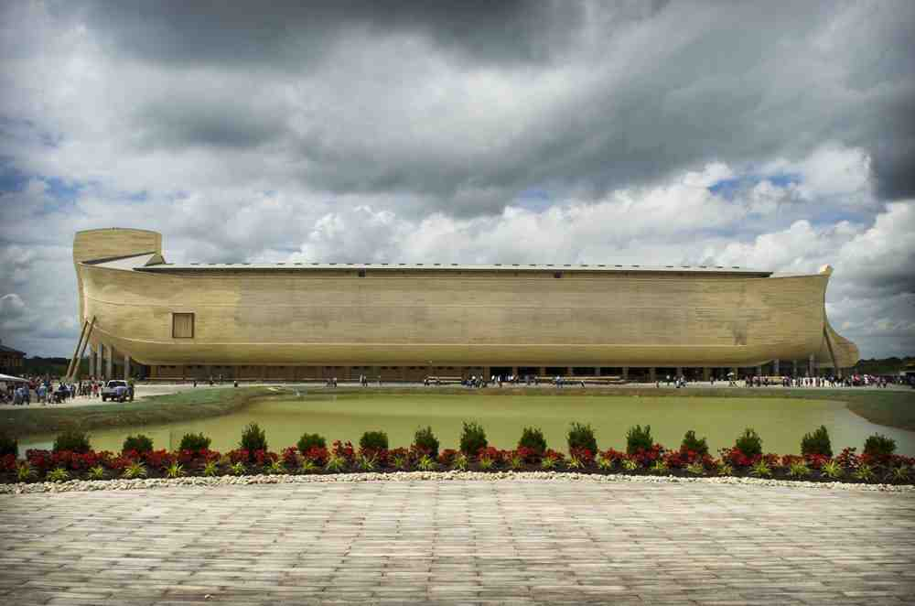

Slide 12
Detailed instructions..
Genesis 6:16 You shall make a window for the ark, and you shall finish it to a cubit from above; and set the door of the ark in its side. You shall make it with lower, second, and third decks. 17 And behold, I Myself am bringing floodwaters on the earth, to destroy from under heaven all flesh in which is the breath of life; everything that is on the earth shall die.
18 But I will establish My covenant with you; and you shall go into the ark--you, your sons, your wife, and your sons' wives with you.

Slide 13
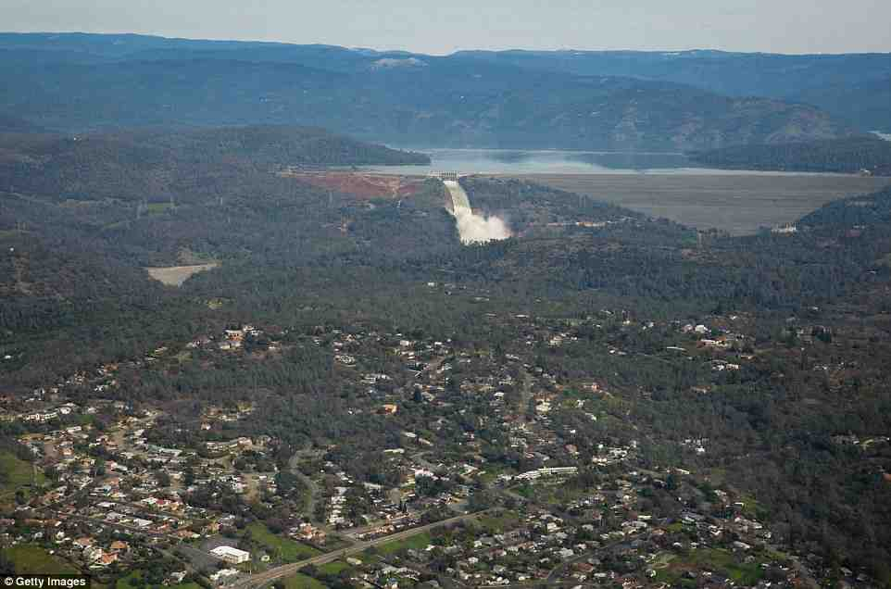
Oroville dam evacuation..

Slide 14
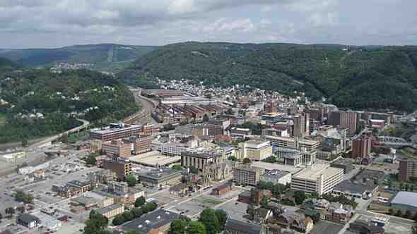
Johnstown Pennsylvania..

Slide 15
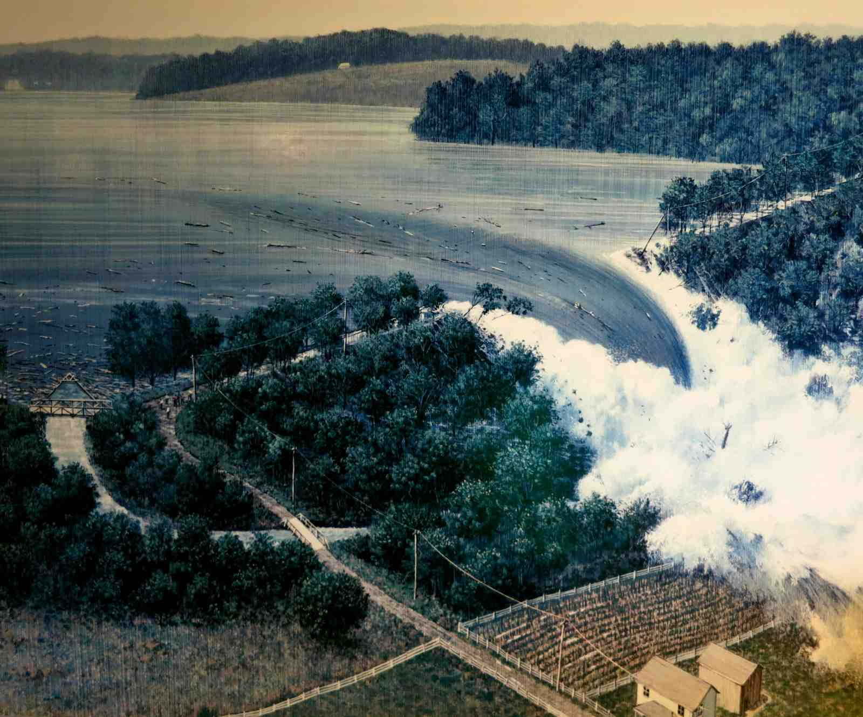
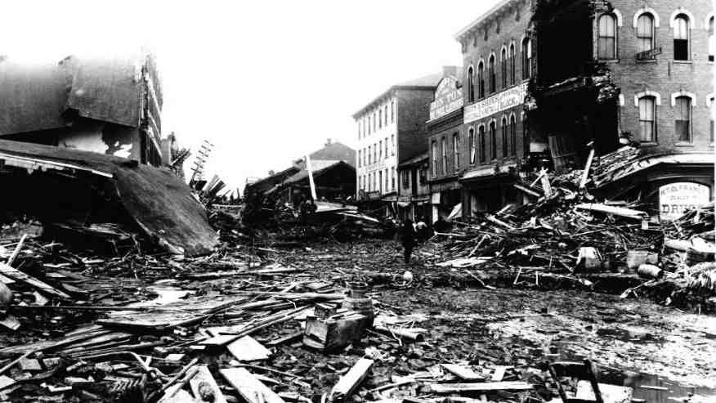
Johnstown Pennsylvania..

Slide 16
Johnstown Pennsylvania..

Slide 17
Noah obeyed..
Genesis 6:22 Thus Noah did; according to all that God commanded him, so he did.
Heb 11:7 By faith Noah, being divinely warned of things not yet seen, moved with godly fear, prepared an ark for the saving of his household, by which he condemned the world and became heir of the righteousness which is according to faith.

Slide 18
Noah’s faith..
He obeyed God’s word..
Built a massive ark because God told him to..
The world had never seen rain or a flood..
He warned of the coming judgment..
2 Pet 2:5 and did not spare the ancient world, but saved Noah, one of eight people, a preacher of righteousness, bringing in the flood on the world of the ungodly..

Slide 19
Noah’s faith..
He stood alone ..
Matt 24: 37 But as the days of Noah were, so also will the coming of the Son of Man be. 38 For as in the days before the flood, they were eating and drinking, marrying and giving in marriage, until the day that Noah entered the ark, 39 and did not know until the flood came and took them all away, so also will the coming of the Son of Man be.

Slide 20
Noah’s legacy..
Heb 11:7 By faith Noah, being divinely warned of things not yet seen, moved with godly fear, prepared an ark for the saving of his household, by which he condemned the world and became heir of the righteousness which is according to faith.
An heir of righteousness..
Effective with his family..

Slide 21
An heir of righteousness..
Gen 6:8 But Noah found grace in the eyes of the Lord. 9 This is the genealogy of Noah. Noah was a just man, perfect in his generations. Noah walked with God.
Gen 7:1 Then the Lord said to Noah, "Come into the ark, you and all your household, because I have seen that you are righteous before Me in this generation.
Genesis 6:22 Thus Noah did; according to all that God commanded him, so he did.

Slide 22
By Faith Noah
Hebrews 11:7

