Slide 1
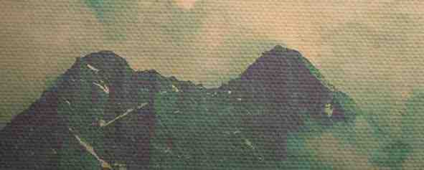
Come Before His Presence
Psalm 96:1-9

Slide 2
We are here to worship
8 Ascribe to the LORD the glory due his name; bring an offering, and come into his courts!
9 Worship the LORD in the splendor of holiness; tremble before him, all the earth!

Slide 3
He alone is worthy
Ps 99:9 Exalt the LORD our God, and worship at his holy mountain; for the LORD our God is holy!

Slide 4
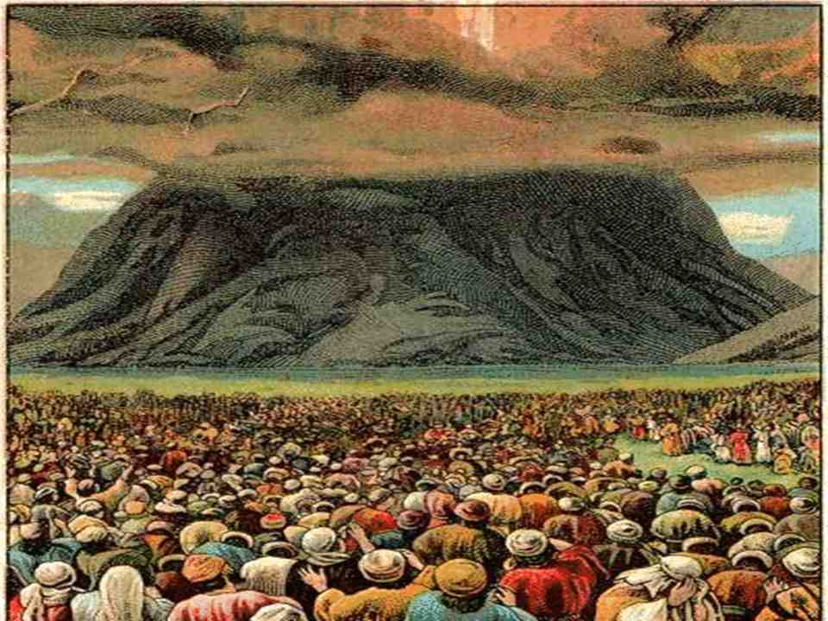
Worship under old law..
Ex 19:9 the LORD said to Moses, "Behold, I am coming to you in a thick cloud, that the people may hear when I speak with you, and may also believe you forever.
"When Moses told the words of the people to the LORD, 10 the LORD said to Moses, "Go to the people and consecrate them today and tomor-row, and let them wash their garments 11 and be ready for the third day. For on the third day the LORD will come down on Mount Sinai in the sight of all the people.

Slide 6
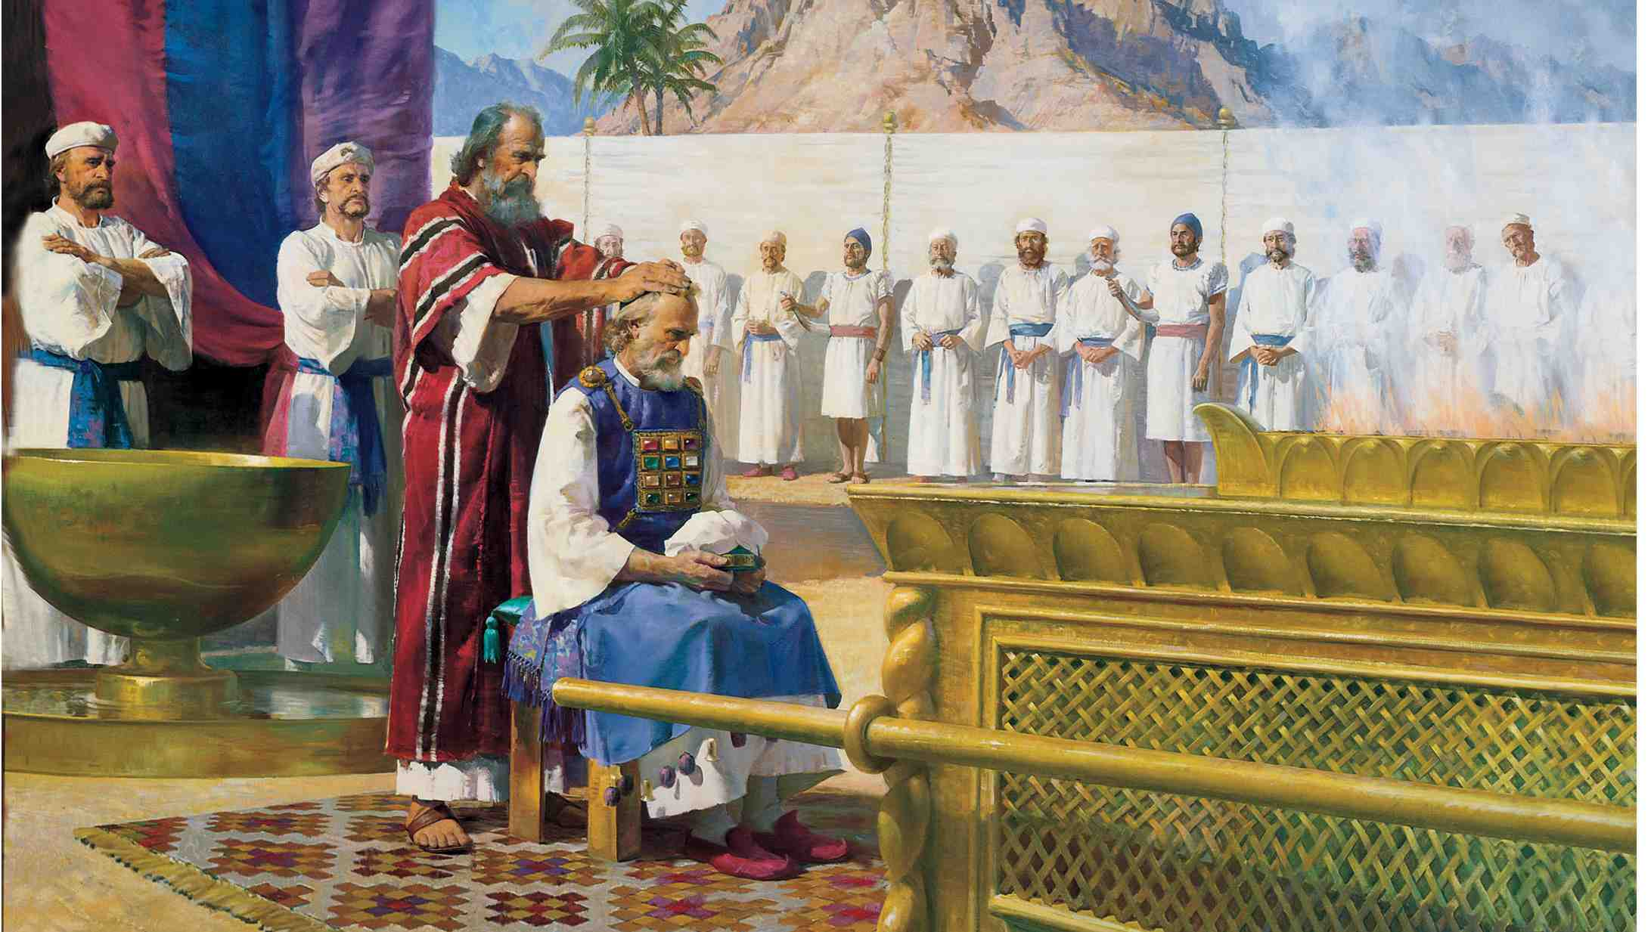
Consecrating the priests..
Ex 29:1"Now this is what you shall do to them to consecrate them, that they may serve me as priests.
4 You shall bring Aaron and his sons to the entrance of the tent of meeting and wash them with water. 5 Then you shall take the garments, and put on Aaron the coat and the robe of the ephod, and the ephod, and the breastpiece, and gird him with the skillfully woven band of the ephod.

Slide 7
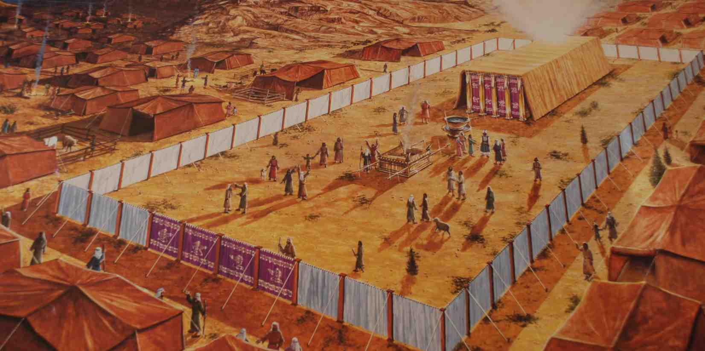
Day of Atonement..
Lev 16:1 The LORD spoke to Moses after the death of the two sons of Aaron, when they drew near before the LORD and died,
2 and the LORD said to Moses, "Tell Aaron your brother not to come at any time into the Holy Place inside the veil, before the mercy seat that is on the ark, so that he may not die. For I will appear in the cloud over the mercy seat.

Slide 8
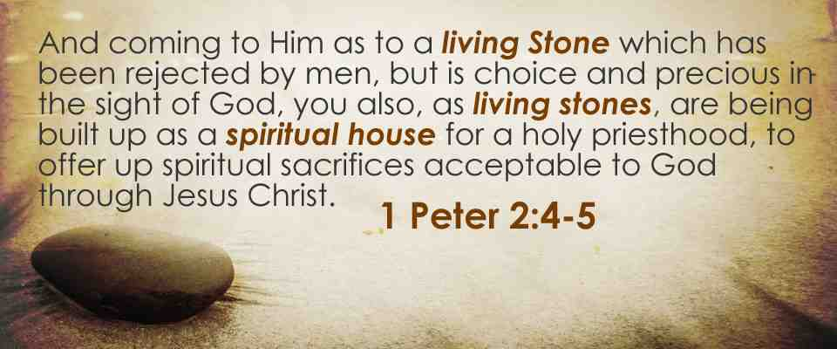
Priesthood in Christ..
1 Pet 2:4 As you come to him, a living stone rejected by men but in the sight of God chosen and precious, 5 you yourselves like living stones are being built up as a spiritual house, to be a holy priesthood, to offer spiritual sacrifices acceptable to God through Jesus Christ.
9 But you are a chosen race, a royal priesthood, a holy nation, a people for his own possession, that you may proclaim the excellencies of him who called you out of darkness into his marvelous light.

Slide 9
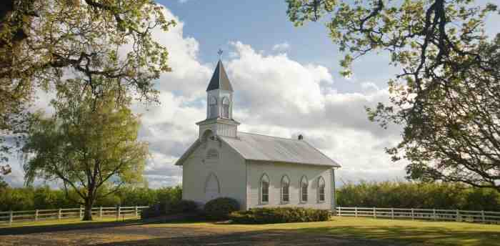
Our sacrifices as Christians..
Rom 12:1 I beseech you therefore, brethren, by the mercies of God, that you present your bodies a living sacrifice, holy, acceptable to God, which is your reasonable service.
Heb 13:15 Therefore by Him let us continually offer the sacrifice of praise to God, that is, the fruit of our lips, giving thanks to His name.
16 But do not forget to do good and to share, for with such sacrifices God is well pleased.

Slide 10
What God Expects..
Malachi 1:6-8 don’t offer God what is polluted..
1:12-13 bring your offering with sincerity and zeal
2:13-16 make sure your offering is from a righteous life

Slide 11
The book of remembrance
16 Then those who feared the LORD spoke with one another. The LORD paid attention and heard them, and a book of remembrance was written before him of those who feared the LORD and esteemed his name.
17 "They shall be mine, says the LORD of hosts, in the day when I make up my treasured possession, and I will spare them as a man spares his son who serves him.
18 Then once more you shall see the distinction between the righteous and the wicked, between one who serves God and one who does not serve him.

Slide 12
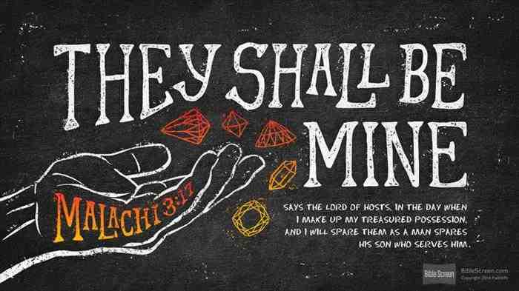
Those who fear the Lord and esteem His name..

Slide 13
Come Before His Presence
Psalm 96:1-9

