Slide 1
Because We Care
1 Peter 5:1-7

Slide 2
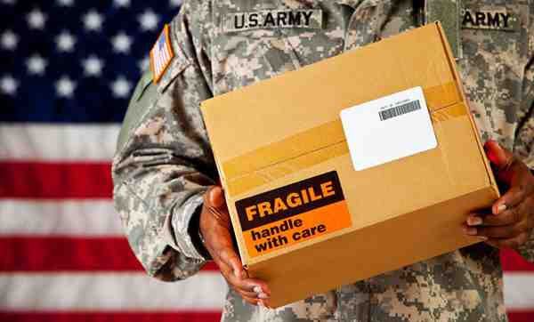
Sending care packages

Slide 3
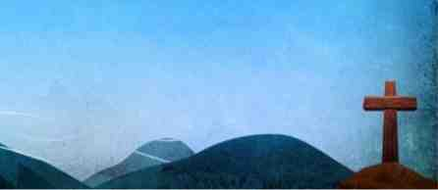
Cast your cares on Him
1 Peter 5:6-7 Therefore humble yourselves under the mighty hand of God, that He may exalt you in due time, ⁷ casting all your care upon Him, for He cares for you.

Slide 4
Having the same care ..
Romans 12:4-5 For as we have many members in one body.. so we, being many, are one body in Christ, and individually members of one another.
1 Cor 12:25 that there should be no schism in the body, but that the members should have the same care for one another.

Slide 5
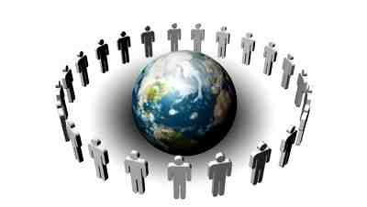
God uses us to show His care
Titus 3:8 these things I want you to affirm constantly, that those who have believed in God should be careful to maintain good works. These things are good and profitable to men.

Slide 6
We care, so we take the time to share ..

Slide 7
We share our time & love with our brethren..
Romans 12:9-13 Let love be without hypocrisy.. ¹⁰ Be kindly affectionate to one another with brotherly love, in honor giving preference to one another; ¹¹ not lagging in diligence, fervent in spirit, serving the Lord..¹³ distributing to the needs of the saints, given to hospitality.

Slide 8
We share our physical blessings with the needy..
Galatians 6:10 Therefore, as we have opportunity, let us do good to all, especially to those who are of the household of faith.
Luke 6:30-35 Give to everyone who asks of you. And from him who takes away your goods do not ask them back. ³¹ And just as you want men to do to you, you also do to them likewise.. do good, and lend, hoping for nothing in return; and your reward will be great.

Slide 9
We share the saving gospel with the lost..
John 1:43-46 Philip found Nathanael and said to him, “We have found Him of whom Moses in the law, and also the prophets, wrote—Jesus of Nazareth, the son of Joseph.”⁴⁶ And Nathanael said to him, “Can anything good come out of Nazareth?” Philip said to him, “Come and see.”
Proverbs 11:30 The fruit of the righteous is a tree of life, and he who wins souls is wise.

Slide 10
We care, so we approach God in prayer..

Slide 11
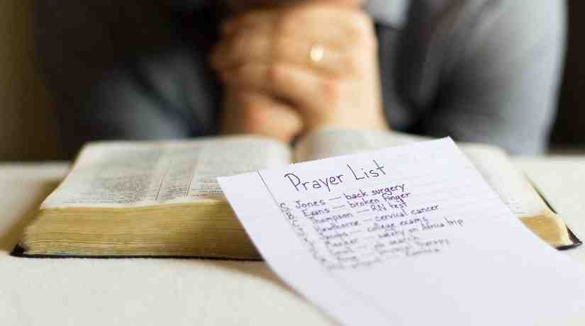
We pray for the physical needs of our brethren..
James 5:13-16 Is anyone among you suffering? Let him pray. Is anyone cheerful? Let him sing psalms. ¹⁴ Is anyone among you sick? Let him call for the elders of the church, and let them pray over him, anointing him with oil in the name of the Lord.
¹⁵ And the prayer of faith will save the sick, and the Lord will raise him up. And if he has committed sins, he will be forgiven. ¹⁶ Confess your trespasses to one another, and pray for one another, that you may be healed. The effective, fervent prayer of a righteous man avails much.

Slide 12
We pray for the spiritual strength of our brethren....
Colossians 1:9-12 For this reason we also, since the day we heard it, do not cease to pray for you, and to ask that you may be filled with the knowledge of His will in all wisdom and spiritual understanding;
¹⁰ that you may walk worthy of the Lord, fully pleasing Him, being fruitful in every good work and increasing in the knowledge of God; ¹¹ strengthened with all might, according to His glorious power, for all patience and longsuffering with joy; ¹² giving thanks to the Father who has qualified us to be partakers of the inheritance of the saints in the light.

Slide 13
We pray for open doors to share the gospel..
Colossians 4:2-4 Continue earnestly in prayer, being vigilant in it with thanksgiving; ³ meanwhile praying also for us, that God would open to us a door for the word, to speak the mystery of Christ, for which I am also in chains, ⁴ that I may make it manifest, as I ought to speak.

Slide 14
Because We Care
1 Peter 5:1-7

