Slide 1
Spiritual Signs of a Christian
John 13:31-38

Slide 2
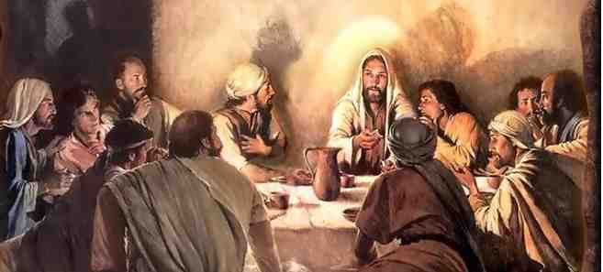
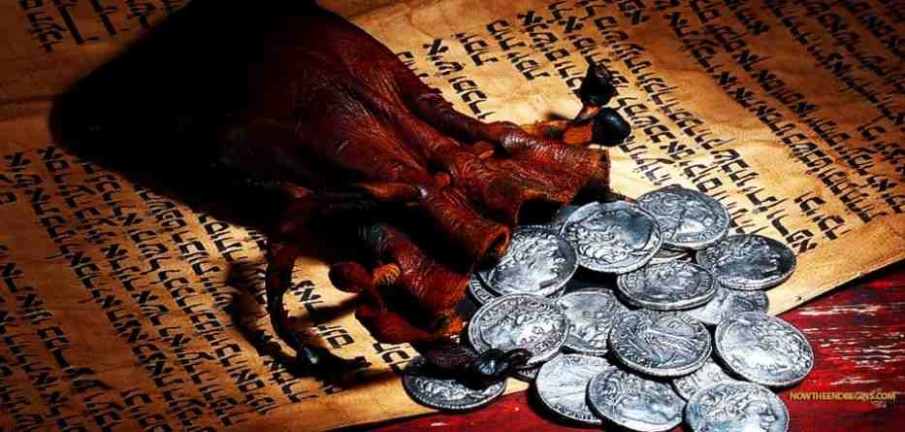
Jesus with eleven apostles
26-31 And having dipped the bread, He gave it to Judas Iscariot, the son of Simon. ²⁷ Now after the piece of bread, Satan entered him. Then Jesus said to him, “What you do, do quickly.”
³⁰ Having received the piece of bread, he then went out immediately. And it was night.
³¹ So, when he had gone out, Jesus said…

Slide 3
1 Focus on Glory of God 31-33
31 Jesus said, “Now the Son of Man is glorified, and God is glorified in Him. ³² If God is glorified in Him, God will also glorify Him in Himself, and glorify Him immediately.
³³ Little children, I shall be with you a little while longer. You will seek Me; and as I said to the Jews, ‘Where I am going, you cannot come,’ so now I say to you.

Slide 4
1 Focus on Glory of God 31-33
Now the Son of Man is glorified..
God is glorified in Him..
God will also glorify Him immediately..
The sign of a true Christian is God’s glory

Slide 5
2 Love for one another 34-35
34 A new commandment I give to you, that you love one another; as I have loved you, that you also love one another. ³⁵ By this all will know that you are My disciples, if you have love for one another.”

Slide 6
2 Love for one another 34-35
A high standard (.. As I have loved you)
The world will know you are my disciples
How can we manifest this love?..
Humility when we wrong others
Forgiving those who wrong us
The most visible, practical mark of a disciple

Slide 7
3 Loyalty to Jesus 36-38
36 Simon Peter said to Him, “Lord, where are You going?” Jesus answered him, “Where I am going you cannot follow Me now, but you shall follow Me afterward.”
³⁷ Peter said to Him, “Lord, why can I not follow You now? I will lay down my life for Your sake.”
³⁸ Jesus answered him, “Will you lay down your life for My sake? Most assuredly, I say to you, the rooster shall not crow till you have denied Me three times.

Slide 8
3 Loyalty to Jesus 36-38
More than promising loyalty..
Loyalty that holds up under pressure..
Your loyalty.. What have you promised Jesus?

Slide 9
Spiritual Signs of a Christian
John 13:31-38

