Slide 1
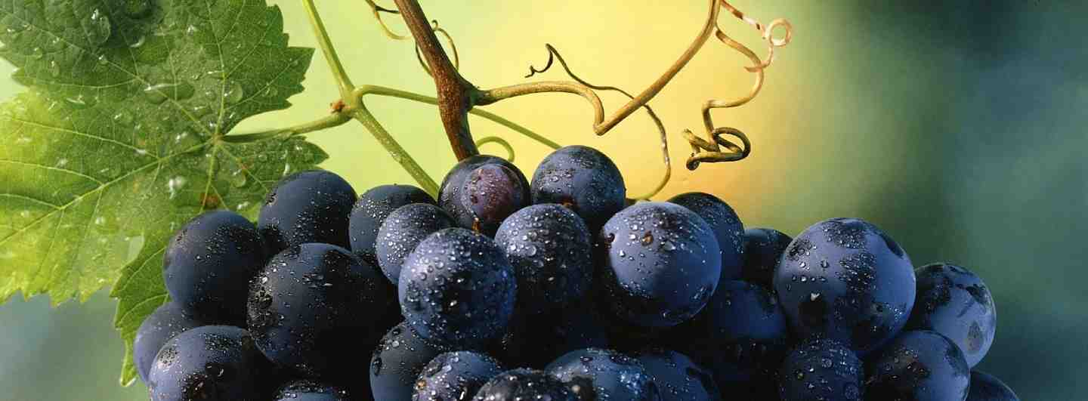
Benefits of Life in Christ
John 15:7-11

Slide 2
Bearing Fruit..
4 Abide in Me, and I in you. As the branch cannot bear fruit of itself, unless it abides in the vine, neither can you, unless you abide in Me.

Slide 3
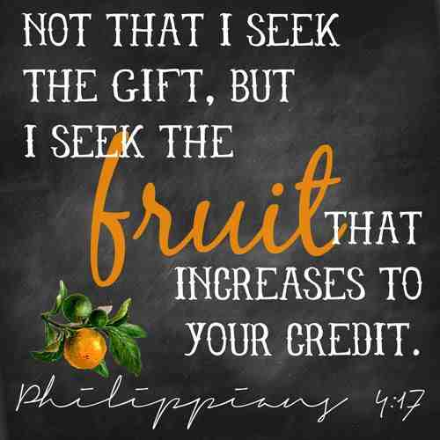
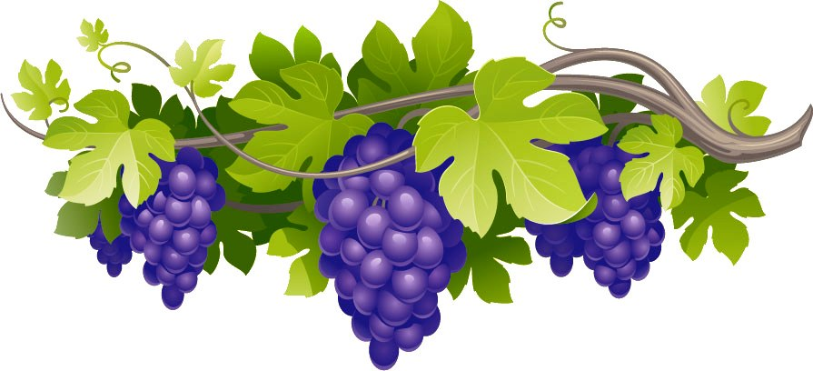
ABIDING IN THE VINE

Slide 4
Answered prayer..
7 If you abide in Me, and My words abide in you, you will ask what you desire, and it shall be done for you.
Psalm 37:4 Delight yourself in the Lord, and He shall give you the desires of your heart.

Slide 5
Full joy..
11 “These things I have spoken to you, that My joy may remain in you, and that your joy may be full.
Psalm 51:12 Restore to me the joy of Your salvation..

Slide 6
Assurance of salvation..
5-6 “I am the vine, you are the branches. He who abides in Me, and I in him, bears much fruit; for without Me you can do nothing. ⁶ If anyone does not abide in Me, he is cast out as a branch and is withered; and they gather them and throw them into the fire, and they are burned.
Romans 8:1 There is therefore now no condemnation to those who are in Christ Jesus, who do not walk according to the flesh, but according to the Spirit.

Slide 7
Benefits of Life in Christ
John 15:7-11

