Slide 1
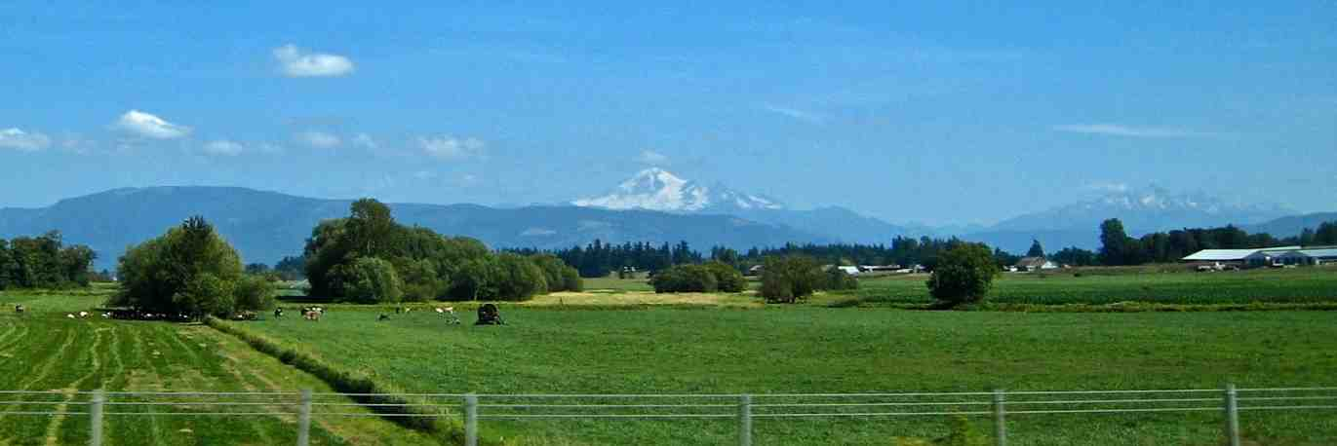
The Peace of Christ
John 14:27-31

Slide 2
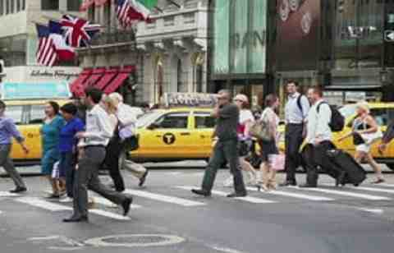
Modern view of peace..
Absence of trouble and stress..

Slide 3
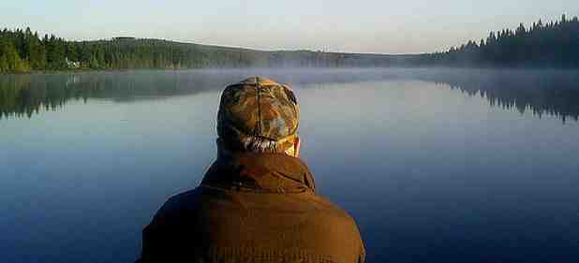
Biblical peace..
John 14:27 Peace I leave with you, My peace I give to you; not as the world gives do I give to you. Let not your heart be troubled, neither let it be afraid.
Not based on outward circumstances..

Slide 4
1 Nature of this peace..
Peace with God..
Rom 5:1-2 having been justified by faith, we have peace with God through our Lord Jesus Christ..
Col 1:20-22 to reconcile all things to Himself, by Him, whether things on earth or things in heaven, having made peace through the blood of His cross.

Slide 5
1 Nature of this peace..
The peace of God..
John 14:27 Peace I leave with you, My peace I give to you; not as the world gives do I give to you. Let not your heart be troubled, neither let it be afraid.
Phil 4:6-7 Be anxious for nothing..⁷ and the peace of God, which surpasses all understanding, will guard your hearts and minds through Christ Jesus.

Slide 6
2 Source of this peace
The peace of God..
Phil 4:9 The things which you learned and received and heard and saw in me, these do, and the God of peace will be with you.
Jesus is the Giver of peace..
John 14:27 My peace I give to you..
2 Thess 3:16 Now may the Lord of peace Himself give you peace always in every way. The Lord be with you all.

Slide 7
2 Source of this peace
The Holy Spirit dispenses peace to us..
Gal 5:22 The fruit of the Spirit is love, joy, peace..
John 16:14 He will glorify Me, for He will take of what is mine, and declare it to you..

Slide 8
3 Contrast with the World
John 14:27 My peace I give to you.. not as the world gives do I give to you..
Col 3:15 And let the peace of God rule in your hearts, to which also you were called in one body; and be thankful.

Slide 9
3 Contrast with the World
Isaiah 26:3 You will keep him in perfect peace, whose mind is stayed on You, because he trusts in You.
Psalm 119:165 Great peace have those who love Your law, And nothing causes them to stumble.

Slide 10
The Peace of Christ
John 14:27-31

