Slide 1
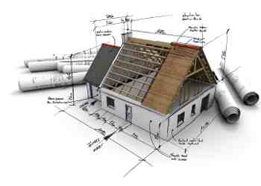
God’s Household Built Together
Ephesians 2:17-22

Slide 2
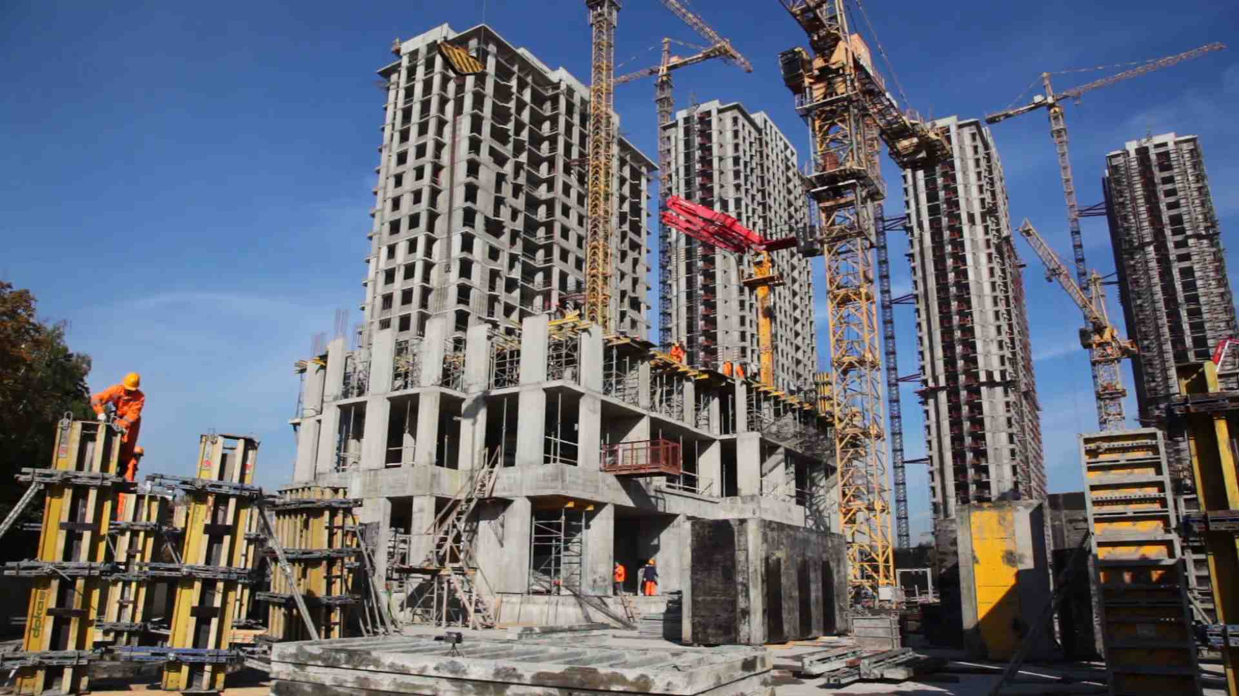
Stages of construction..

Slide 3
God’s three institutions..
The Family (Eden).. organic unity
Government (after flood).. societal citizenship
Church (Pentecost).. spiritual fellowship

Slide 4
God’s reconciliation work..
Ephesians 2…
The need for reconciliation .. 1-3
The process of personal reconciliation .. 4-10
The reconciliation of Jews/Gentiles.. 11-22

Slide 5
God’s magnificent idea
Create one new church (Jew & Gentile)
17-18 And He came and preached peace to you who were afar off and to those who were near. ¹⁸ For through Him we both have access by one Spirit to the Father.
Christ
Gospel/Peace
Gospel/Peace
Jews
Gentiles

Slide 6
A New Community..
Fellowcitizens .. community
19 Now, therefore, you are no longer strangers and foreigners, but fellow citizens with the saints..
Christians of Gentile background are full and equal citizens

Slide 7
A New Family
Members of same household.. unity
19 no longer strangers and foreigners, but fellow citizens with the saints and members of the household of God..
Every Brother and Sister in Christ shares same spiritual DNA

Slide 8
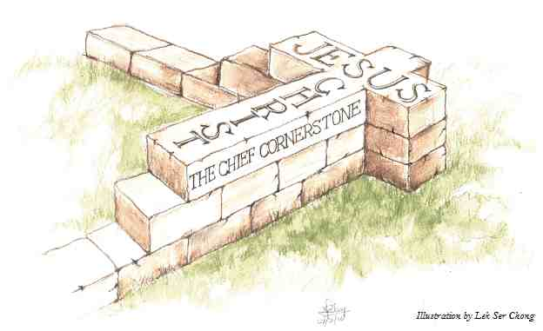
A New Holy Temple
The One Foundation.. stability
20 having been built on the foundation of the apostles and prophets, Jesus Christ Himself being the chief cornerstone..
Each stone must be aligned with the foundation and cornerstone

Slide 9
A dwelling place for God..
Living stones built together..
in whom the whole building, being fitted together, grows into a holy temple in the Lord, ²² in whom you also are being built together for a dwelling place of God in the Spirit.
Each one of us play an important part building up God’s spiritual house

Slide 10
God’s Household Built Together
Ephesians 2:17-22

