Slide 1
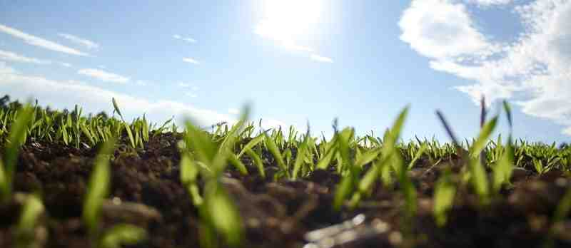
Growing Together in the Body
Ephesians 4:13-16

Slide 2
Walking in Unity..
Loving attitudes.. vs 1-3
Oneness of truth.. vs 4-6
Using our gifts.. vs 7-12

Slide 3
God’s Gifts to the Church
Apostles
Prophets
Evangelists
Pastors
Teachers
Equipping of the saints
For the work of service
For the building up of the body

Slide 4
1 Maturity
¹³ till we all come to the unity of the faith and of the knowledge of the Son of God, to a perfect man, to the measure of the stature of the fullness of Christ..
Unity of the faith
Christlike fullness

Slide 5
2 Stability
¹⁴ that we should no longer be children, tossed to and fro and carried about with every wind of doctrine, by the trickery of men, in the cunning craftiness of deceitful plotting..
Well grounded
Not easily deceived

Slide 6
3 Right Balance
¹⁵ but, speaking the truth in love, may grow up in all things into Him who is the head—Christ—
Passion for truth
Love for others

Slide 7
4 Cooperation
¹⁶ from whom the whole body, joined and knit together by what every joint supplies, according to the effective working by which every part does its share, causes growth of the body for the edifying of itself in love.
All parts operating properly
Living and working in harmony

Slide 8
God wants His church to enjoy unity..
Loving attitudes.. vs 1-3
Oneness of truth.. vs 4-6
Using our gifts.. vs 7-12
Maturing in growth.. vs 13-16

Slide 9
Growing Together in the Body
Ephesians 4:13-16

