Slide 1
Praying for Inner Strength
Ephesians 3:14-21

Slide 2
How do we pray for each other and for ourselves?
Eph 3:14-21.. Paul’s prayer for the Ephesians
Beautiful prayer for strength in the inner man
Which of us couldn’t benefit?
Inner strength must be developed and nurtured over time by the intake of truth and prayer..

Slide 3
Importance of inner strength
Outward man.. meeting expectations of society
Inward man.... meeting the challenges of life
2 Cor 4:16 Therefore we do not lose heart. Even though our outward man is perishing, yet the inward man is being renewed day by day.

Slide 4
Posture for this prayer..
Eph 3:14-15 For this reason I bow my knees to the Father of our Lord Jesus Christ, ¹⁵ from whom the whole family in heaven and earth is named..
Jewish men prayed standing ..
Picture of intensity and submission..

Slide 5
Petitions of this prayer
3:16 that He would grant you, according to the riches of His glory, to be strengthened with might through His Spirit in the inner man..

Slide 6
Petitions of this prayer..
1 Inner Strength

Slide 7
Blessings Christians enjoy..
Chosen by God (1:4)
Adopted into God’s family (1:5)
Acceptance before God (1:6)
Forgiveness of sins (1:7)
Insight into God’s will (1:9)
An eternal inheritance (1:12)
Sealed by the Spirit (1:13)
Wisdom and knowledge (1:17)
God’s divine power in us (1:18)
Christ the head of body (1:22)
Raised to spiritual life (2:1-5)
God’s mercy and love (2:4)
Seated with Christ (2:5-6)
Promise of eternal riches (2:7)
Saved by grace (2:8)
God’s workmanship (2:10)
Made near to God (2:11-13)
Unity/peace in His body (2:14)
Equal access to God (2:18)
Heavenly citizenship(2:19)

Slide 8
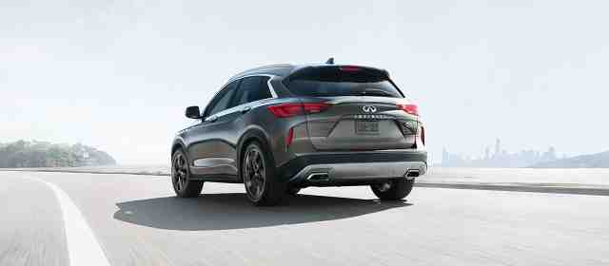
How do we use this power?
Ephesians 1-3.. All our blessings..
3:16-20.. How to turn on the ignition..
3:16 that He would grant you, according to the riches of His glory, to be strengthened with might through His Spirit in the inner man..

Slide 9
Petitions of this prayer..
3:17 that Christ may dwell in your hearts through faith..
2 Christ dwell in your heart
1 Inner Strength

Slide 10
Petitions of this prayer..
3:17-19 that you, being rooted and grounded in love, ¹⁸ may be able to comprehend with all the saints what is the width and length and depth and height— ¹⁹ to know the love of Christ which passes knowledge
3 Comprehend the love of Christ
2 Christ dwell in your heart
1 Inner Strength

Slide 11
Petitions of this prayer..
3:19 that you may be filled with all the fullness of God.
4 Filled with the fullness of God
3 Comprehend the love of Christ
2 Christ dwell in your heart
1 Inner Strength

Slide 12
Potential of this prayer..
Eph 3:20-21 Now to Him who is able to do exceedingly abundantly above all that we ask or think, according to the power that works in us, ²¹ to Him be glory in the church by Christ Jesus to all generations, forever and ever. Amen.

Slide 13
Reaching your spiritual goals?
Imagine achieving far beyond those goals..

Slide 14
Praying for Inner Strength
Ephesians 3:14-21

