Slide 1
Honoring God in Your Work
Ephesians 6:5-9

Slide 2
Be thankful for work..
See Christ in our work..
As a servant of Christ..
For His glory..

Slide 3
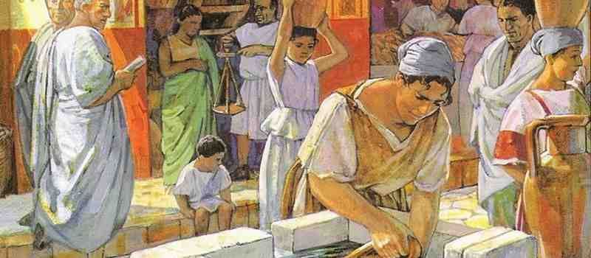
Slaves and Masters..
Context.. Slavery in Roman empire
1/3 of people of Ephesus
Did all types of work
Could earn their freedom

Slide 4
Does the Bible condone slavery?
Paul gives instructions for household relationships in a given society..
Exod 21:16 “He who kidnaps a man and sells him, or if he is found in his hand, shall surely be put to death.
1 Tim 1:10 the law is not made for a righteous person, but for the lawless and insubordinate, for the ungodly and for sinners.. for kidnappers..
Equality in Christ.. Gal 3:28; Col 3:11; 1 Cor 7:21

Slide 5
How Christ changed slavery..
Slaves and masters treat each other as they would Christ..
Masters.. “in the same way”
With respect, fear, as unto Christ

Slide 6
Instructions for slaves (5-8)
5 Be obedient to your masters .. as to Christ
6 Not with eyeservice..as bondservants of Christ
7 With goodwill doing service.. as to the Lord
8 Whatever good anyone does..receive the same from the Lord

Slide 7
Instructions for masters (9)
Treat your slaves the same way
Without threatening
Both their Master and yours is in heaven

Slide 8
Honoring God in Your Work
Ephesians 6:5-9

