Slide 1
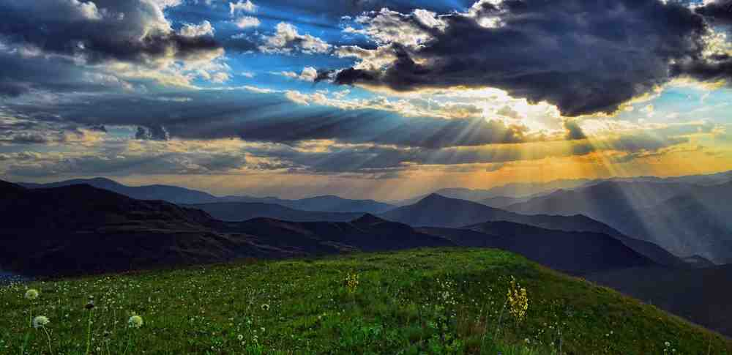
Citizens of God’s Kingdom
Philippians 3:20-21

Slide 2
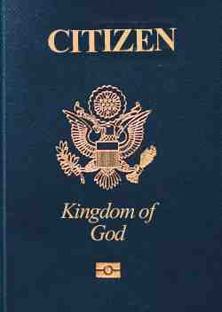
Citizens of heaven
Phil 3:20-21 For our citizenship is in heaven, from which we also eagerly wait for the Savior, the Lord Jesus Christ..
Eph 2:19-20 Now, therefore, you are no longer strangers and foreigners, but fellow citizens with the saints and members of the household of God..

Slide 3
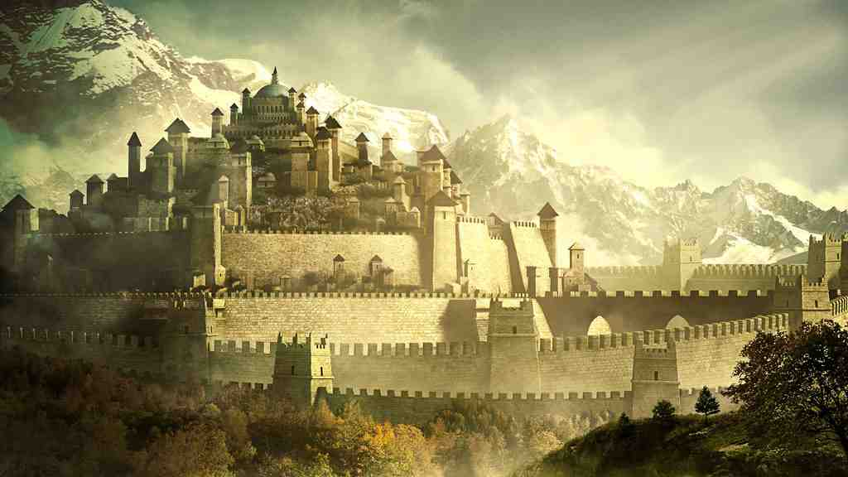
Four things true of a kingdom..
A king as leader..
There are borders..
Laws that govern behavior..
There are benefits for citizens..

Slide 4
A Kingdom has a King..
Same in God’s kingdom .. 1 Tim 6:13-16
Our God is a great king.. Malachi 1:14
God expects to be honored.. 1 Sam 8:4-7

Slide 5
A Kingdom has borders..
Identify who is inside..
True of God’s kingdom.. Mark 10:23-25
Must follow procedure.. John 3:3-7
Must enter through gates.. Rev 22:14-15

Slide 6
The Kingdom has laws..
God has laws we must obey.. 1 Cor 6:9-10
Laws are set by the King.. 1 John 2:3, 5:3
There is enforcement of the laws.. 1 John 3:4

Slide 7
Great benefits in the Kingdom
Unlimited forgiveness.. 1 John 1:7-10
Direct relationship with King.. Heb 10:19-22
Fellowship with citizens.. Acts 2:42
Retirement plan.. 1 Pet 1:3-5
Resurrection from death
Eternal life..

Slide 8
Citizens of God’s Kingdom
Philippians 3:20-21

