Slide 1
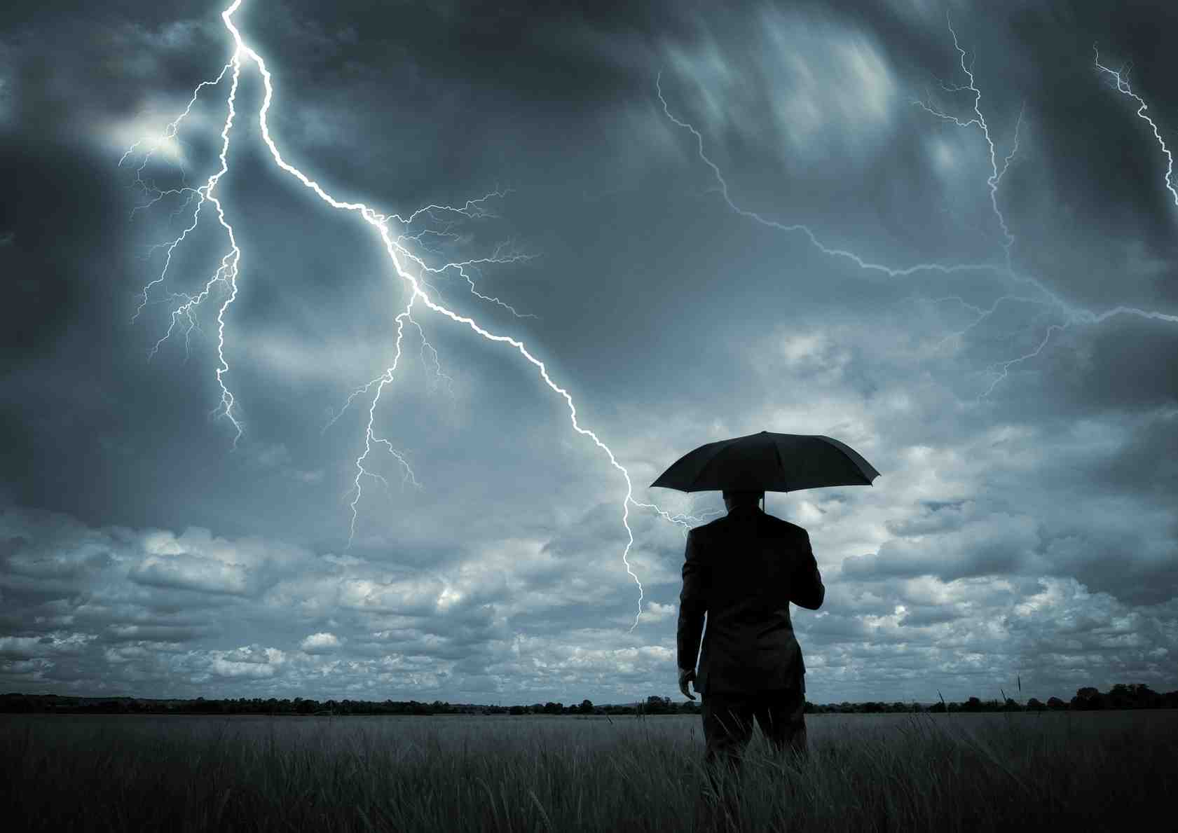
God’s Presence in the Storms
Mark 4:35-40

Slide 2
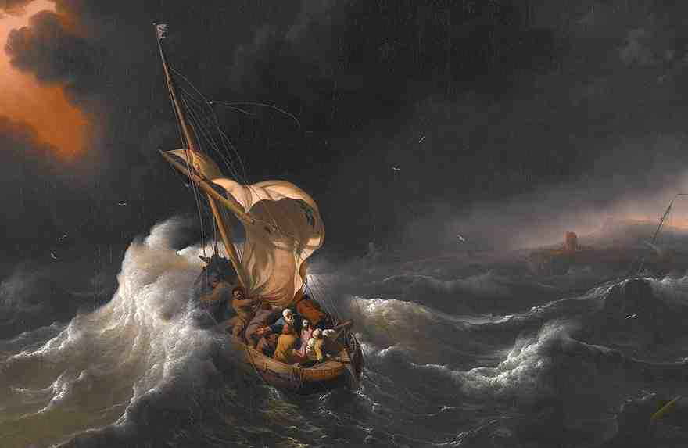
Jesus calming the storm..
³⁵ On the same day, when evening had come, He said to them, “Let us cross over to the other side.” ³⁶ Now when they had left the multitude, they took Him along in the boat as He was. And other little boats were also with Him.

Slide 3
Jesus calming the storm..
³⁷ And a great windstorm arose, and the waves beat into the boat, so that it was already filling. ³⁸ But He was in the stern, asleep on a pillow. And they awoke Him and said to Him, “Teacher, do You not care that we are perishing?”

Slide 4
Jesus calming the storm..
³⁹ Then He arose and rebuked the wind, and said to the sea, “Peace, be still!” And the wind ceased and there was a great calm. ⁴⁰ But He said to them, “Why are you so fearful? How is it that you have no faith?”

Slide 5
1 The Reality of Trials
John 16:33 These things I have spoken to you, that in Me you may have peace. In the world you will have tribulation; but be of good cheer, I have overcome the world.”

Slide 6
1 The Reality of Trials
James 1:2-4 My brethren, count it all joy when you fall into various trials, ³ knowing that the testing of your faith produces patience. ⁴ But let patience have its perfect work, that you may be perfect and complete, lacking nothing.
Rom 5:3-4 And not only that, but we also glory in tribulations, knowing that tribulation produces perseverance; ⁴ and perseverance, character; and character, hope.

Slide 7
2 The Battle of Emotion
Isaiah 41:10 Fear not, for I am with you; Be not dismayed, for I am your God. I will strengthen you, Yes, I will help you, I will uphold you with My righteous right hand.’
John 14:27 Peace I leave with you, My peace I give to you; not as the world gives do I give to you. Let not your heart be troubled, neither let it be afraid.

Slide 8
2 The Battle of Emotion
Sadness.. God near the broken hearted Psa 34:18
Hopeless.. Cast cares on the Lord Psa 55:22
Fears.. God is my rock in whom I trust Psa 18:2

Slide 9
3 The Power of Prayer
1 John 5:14-15 Now this is the confidence that we have in Him, that if we ask anything according to His will, He hears us. ¹⁵ And if we know that He hears us, whatever we ask, we know that we have the petitions that we have asked of Him.

Slide 10
3 The Power of Prayer
Phil 4:6-7 Be anxious for nothing, but in everything by prayer and supplication, with thanksgiving, let your requests be made known to God; ⁷ and the peace of God, which surpasses all understanding, will guard your hearts and minds through Christ Jesus.

Slide 11
4 Find Strength in the Lord
Psalm 46:1-3 God is our refuge and strength, A very present help in trouble. ² Therefore we will not fear, Even though the earth be removed, And though the mountains be carried into the midst of the sea.

Slide 12
God’s Presence in the Storms
Mark 4:35-40

