Slide 1
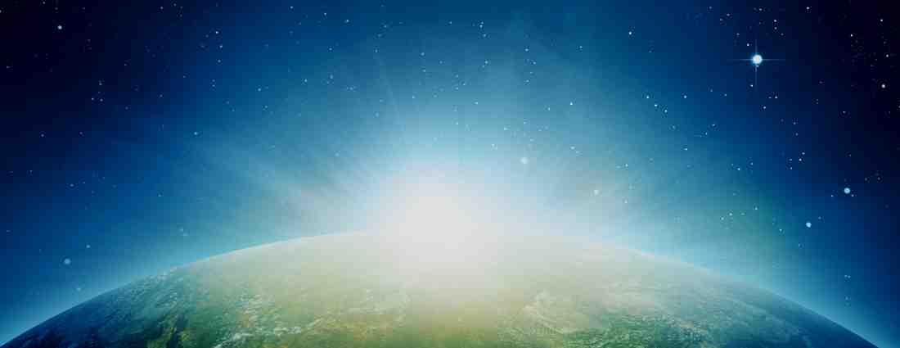
How Do We Know There is a God?
Romans 1:18-23

Slide 2
Most important question..
Does God exist?
Psalm 19:1 The heavens declare the glory of God; and the firmament shows His handiwork.
Psalm 8:3-4 When I consider Your heavens, the work of Your fingers, the moon and the stars, which You have ordained, ⁴ What is man that You are mind- ful of him, and the son of man that You visit him?
Consider the evidence for God..

Slide 3
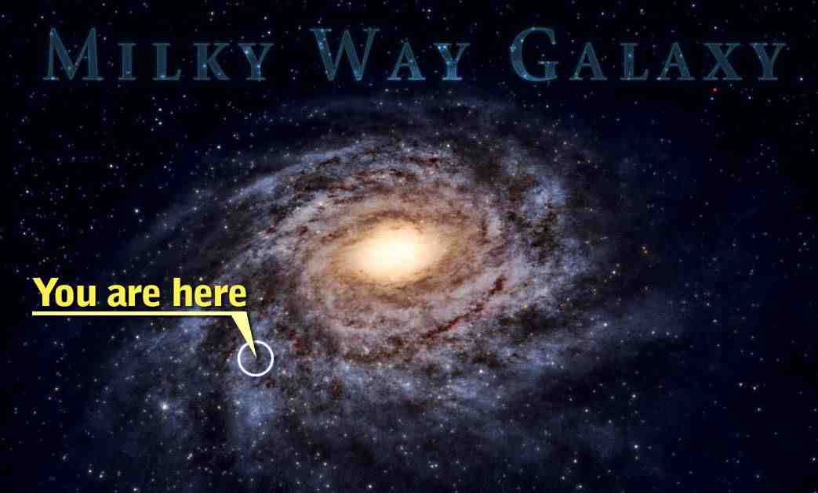

Slide 4
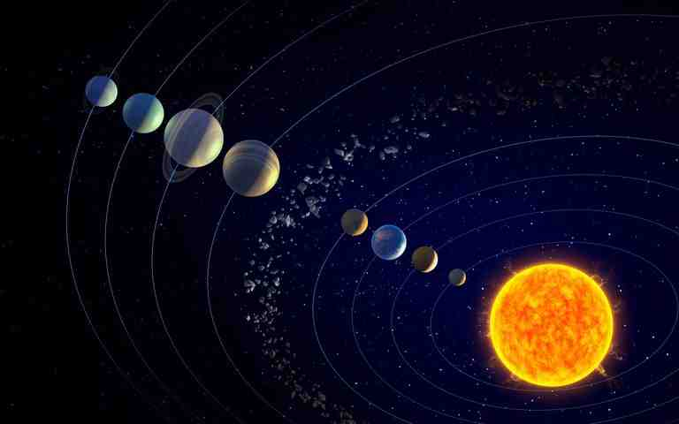
Our solar system..

Slide 5
Did it all happen by accident?
Genesis 1:1 In the beginning God created the heavens and the earth.
Romans 1:20 For since the creation of the world His invisible attributes are clearly seen, being understood by the things that are made, even His eternal power and Godhead, so that they are without excuse..

Slide 6
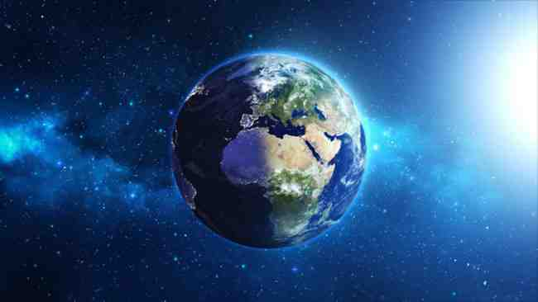

Slide 7
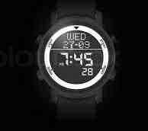
Was there a designer?

Slide 8
Was there a designer?
Hebrews 3:4 For every house is built by someone, but He who built all things is God.
Job 38:4-6 “Where were you when I laid the foundations of the earth? Tell Me, if you have understanding. ⁵ Who determined its measure-ments?Surely you know! Or who stretched the upon it? ⁶ To what were its foundations fastened? or who laid its cornerstone,

Slide 9
We walk by faith..
Heb 11:1 Now faith is the substance of things hoped for, the evidence of things not seen.
3 By faith we understand that the worlds were framed by the word of God, so that the things which are seen were not made of things which are visible.
6 But without faith it is impossible to please Him, for he who comes to God must believe that He is, and that He is a rewarder of those who diligently seek Him.

Slide 10
How Do We Know There is a God?
Romans 1:18-23

