Slide 1
Only God is Good
Mark 10:17-18

Slide 2
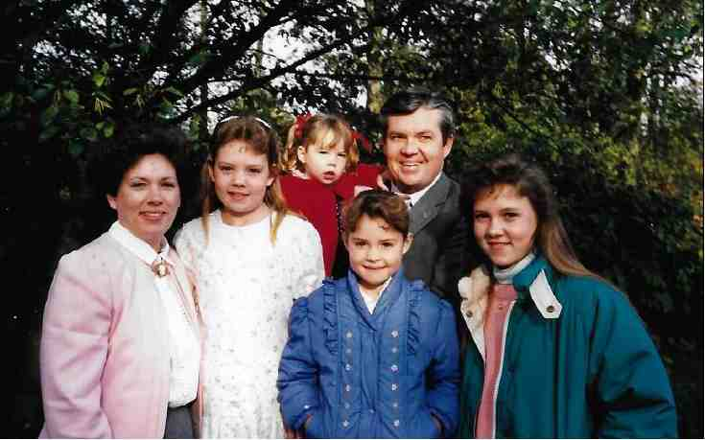
October 4, 1989

Slide 3
God’s Goodness is the Standard..
Mark 10:17-18 Now as He was going out on the road, one came running, knelt before Him, and asked Him, “Good Teacher, what shall I do that I may inherit eternal life?”
¹⁸ So Jesus said to him, “Why do you call Me good? No one is good but One, that is, God.

Slide 4
God’s Goodness is the Standard..
James 1:17 Every good gift and every perfect gift is from above, and comes down from the Father of lights, with whom there is no variation or shadow of turning.

Slide 5
God’s Goodness in His Character
Exodus 33:18-19 And he said, “Please, show me Your glory.”¹⁹ Then He said, “I will make all My goodness pass before you, and I will proclaim the name of the Lord before you. I will be gracious to whom I will be gracious, and I will have compassion on whom I will have compassion.”

Slide 6
God’s Goodness in His Character
Exodus 34:6-7 And the Lord passed before him and proclaimed, “The Lord, the Lord God, merciful and gracious, longsuffering, and abounding in goodness and truth, ⁷ keeping mercy for thousands, forgiving iniquity and transgression and sin, by no means clearing the guilty, visiting the iniquity of the fathers upon the children and the children’s children to the third and the fourth generation.”

Slide 7
God’s Goodness Demonstrated in His Provision
Genesis 1:27-31 Then God saw everything that He had made, and indeed it was very good. So the evening and the morning were the sixth day.
Matthew 5:45 that you may be sons of your Father in heaven; for He makes His sun rise on the evil and on the good, and sends rain on the just and on the unjust.

Slide 8
God’s Goodness Demonstrated in His Provision
1 Timothy 4:1-5 Now the Spirit expressly says that in latter times some will depart from the faith, giving heed to deceiving spirits and doctrines of demons, ² speaking lies in hypocrisy, having their own conscience seared with a hot iron, ³ forbidding to marry, and commanding to abstain from foods which God created to be received with thanksgiving by those who believe and know the truth. ⁴ For every creature of God is good, and nothing is to be refused if it is received with thanksgiving; ⁵ for it is sanctified by the word of God and prayer.

Slide 9
God’s Goodness Transcends the Negative
Romans 8:28 And we know that all things work together for good to those who love God, to those who are the called according to His purpose.
31 What then shall we say to these things? If God is for us, who can be against us? ³² He who did not spare His own Son, but delivered Him up for us all, how shall He not with Him also freely give us all things?

Slide 10
God’s Goodness Should Motivate Our Praise
Psalm 107:1-2 Oh, give thanks to the Lord, for He is good! For His mercy endures forever. ² Let the redeemed of the Lord say so, Whom He has redeemed from the hand of the enemy..

Slide 11
Only God is Good
Mark 10:17-18

