Slide 1
Gospel by the Numbers
2
The Number of Choice
Two Paths

Slide 2
Two Paths
Light and Darkness..John 1:1-5
Good and Evil..Psalm 37:27
Life and Death..Deut 30:19

Slide 3
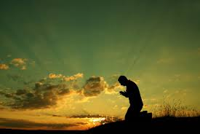
Two Attitudes
Two Criminals..Luke 23:32-43
Two Categories..1 Peter 3:10-12
Two Attitudes..1 Cor 2:14;Gal 5:16

Slide 4
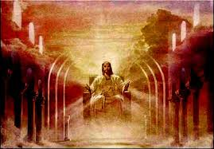
Two Destinies
Two Pathways..Matt 7:13-14,24-27
Two in Judgment..Matt 25:31-46
Two in the Church..Mt 13:23,Lk 15

Slide 5
Gospel by the Numbers
2
The Number of Choice

