Slide 1
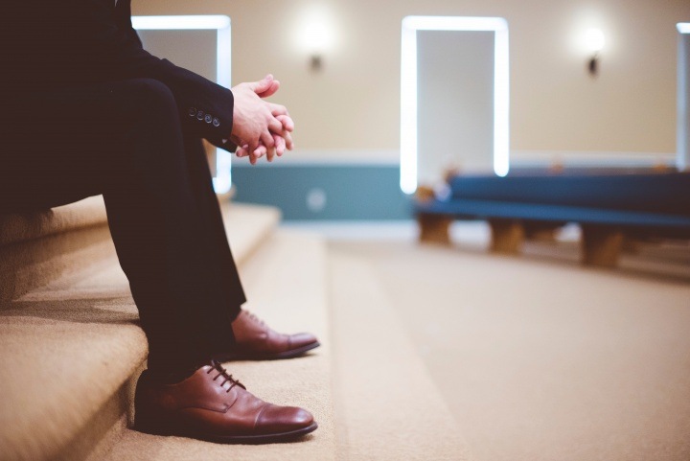
Don’t Show Favoritism
James 2:1-9

Slide 2
Warning against favoritism
James 2:1 My brethren, do not hold the faith of our Lord Jesus Christ, the Lord of glory, with partiality.
James 1:26-27 Pure religion..
2 Cor 8:9 For you know the grace of our Lord Jesus Christ, that though He was rich, yet for your sakes He became poor, that you through His poverty might become rich.

Slide 3
An example
James 2:2-4 For if there should come into your assembly a man with gold rings, in fine apparel, and there should also come in a poor man in filthy clothes, ³ and you pay attention to the one wearing the fine clothes and say to him, “You sit here in a good place,” and say to the poor man, “You stand there,” or, “Sit here at my footstool,” ⁴ have you not shown partiality among yourselves, and become judges with evil thoughts?
Don’t presume to know which person will respond to the gospel

Slide 4
God lifts up the poor
James 2:5-7 Listen, my beloved brethren: Has God not chosen the poor of this world to be rich in faith and heirs of the kingdom which He promised to those who love Him? ⁶ But you have dishonored the poor man. Do not the rich oppress you and drag you into the courts? ⁷ Do they not blaspheme that noble name by which you are called?
Matt 5:3; Luke 6:28; Gal 2:10, 1 Cor 1:26

Slide 5
The Royal Law of scripture
James 2:8-9 If you really fulfill the royal law according to the Scripture, “You shall love your neighbor as yourself,” you do well; ⁹ but if you show partiality, you commit sin, and are convicted by the law as transgressors.
Lev 19:18; Deut 6:4 Mark 12:28-31

Slide 6
Jesus looked at the heart
Knew what is within – John 2:24-25
Showed kindness to the unloved
John 4 – woman at the well
Luke 7:36-50 – sinful woman
Luke 10:25-39 – Who is my neighbor?

Slide 7
Parable of the Sower
Luke 8:5-15 Seed sown on every kind of soil
Soils represented people’s hearts
We don’t know people’s hearts
We plant and allow God to give increase

Slide 8
Don’t Show Favoritism
James 2:1-9

