Slide 1
Faith That is Not Afraid
Hebrews 11:23-27

Slide 2
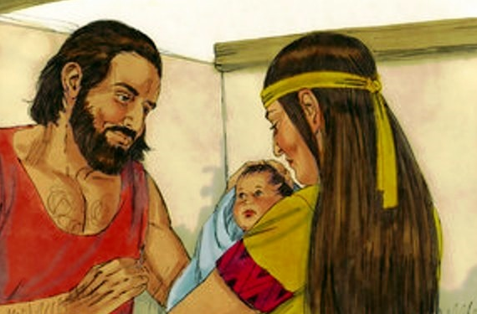
Hebrews 11:23 By faith Moses, when he was born, was hidden three months by his parents, because they saw he was a beautiful child; and they were not afraid of the king’s command.

Slide 3
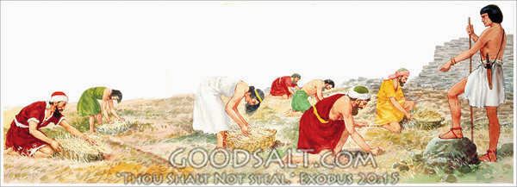
Exodus 1:13-14 So the Egyptians made the children of Israel serve with rigor. ¹⁴ And they made their lives bitter with hard bondage—in mortar, in brick, and in all manner of service in the field. All their service in which they made them serve was with rigor.

Slide 4
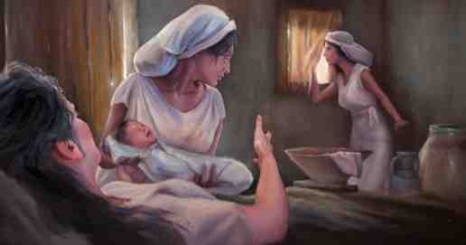
Exodus 1:17-21 But the midwives feared God, and did not do as the king of Egypt commanded them, but saved the male children alive. ¹⁸ So the king of Egypt called for the midwives and said to them, “Therefore God dealt well with the midwives, and the people multiplied and grew very mighty.

Slide 5
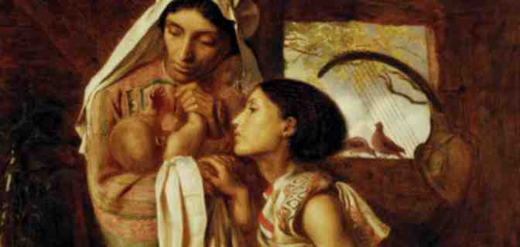
Exodus 2:1-2 And a man of the house of Levi went and took as wife a daughter of Levi. ² So the woman conceived and bore a son. And when she saw that he was a beautiful child, she hid him three months.

Slide 6
Exodus 2:3-4 But when she could no longer hide him, she took an ark of bulrushes for him, daubed it with asphalt and pitch, put the child in it, and laid it in the reeds by the river’s bank. ⁴ And his sister stood afar off, to know what would be done to him.

Slide 7
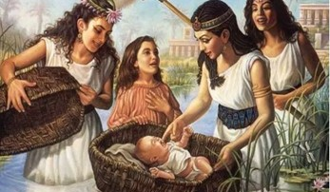
Exodus 2:5-7 Then the daughter of Pharaoh came down to bathe at the river. And her maidens walked along the riverside; and when she saw the ark among the reeds, she sent her maid to get it. ⁶ And when she opened it, she saw the child, and behold, the baby wept. So she had compassion on him, and said, “This is one of the Hebrews’ children.” ⁷ Then his sister said to Pharaoh’s daughter, “Shall I go and call a nurse for you from the Hebrew women, that she may nurse the child for you?”

Slide 8
Exodus 2:8-10 And Pharaoh’s daughter said to her, “Go.” So the maiden went and called the child’s mother. ⁹ Then Pharaoh’s daughter said to her, “Take this child away and nurse him for me, and I will give you your wages.” So the woman took the child and nursed him. ¹⁰ And the child grew, and she brought him to Pharaoh’s daughter, and he became her son. So she called his name Moses, saying, “Because I drew him out of the water.”

Slide 9
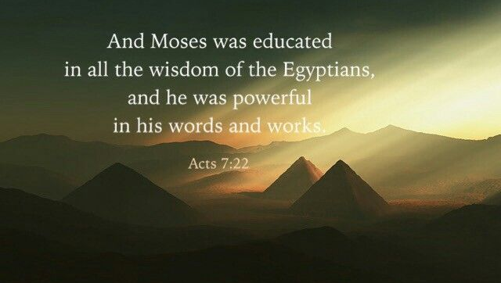
Acts 7:17-22 “But when the time of the promise drew near which God had sworn to Abraham, the people grew and multiplied in Egypt ¹⁸ till another king arose who did not know Joseph. ¹⁹ This man dealt treacherously with our people, and oppressed our forefathers, making them expose their babies, so that they might not live.

Slide 10
Acts 7:20 At this time Moses was born, and was well pleasing to God; and he was brought up in his father’s house for three months. ²¹ But when he was set out, Pharaoh’s daughter took him away and brought him up as her own son. ²² And Moses was learned in all the wisdom of the Egyptians, and was mighty in words and deeds.

Slide 11
Faith acts rationally..
They saw he was a beautiful child, wanted to save his life
Faith takes courage..
They were not afraid of the king’s command
Faith is rewarded..
God worked things out

Slide 12
Daniel’s friends..Daniel 3:16-18
Dan 3:16-18 Shadrach, Meshach, and Abed-Nego answered and said to the king, “O Nebuchadnezzar, we have no need to answer you in this matter. ¹⁷ If that is the case, our God whom we serve is able to deliver us from the burning fiery furnace, and He will deliver us from your hand, O king. ¹⁸ But if not, let it be known to you, O king, that we do not serve your gods, nor will we worship the gold image which you have set up.”
The apostles in Jerusalem.. Acts 4:18-20
Acts 4:18-20 So they called them and commanded them not to speak at all nor teach in the name of Jesus. ¹⁹ But Peter and John answered and said to them, “Whether it is right in the sight of God to listen to you more than to God, you judge. ²⁰ For we cannot but speak the things which we have seen and heard.”

Slide 13
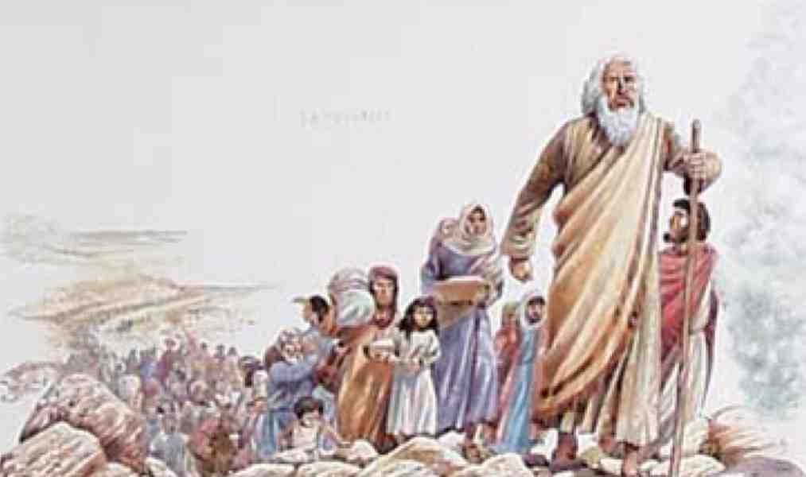
Their faith brought real dividends to the nation..

Slide 14
Faith That is Not Afraid
Hebrews 11:23-27

