Slide 1
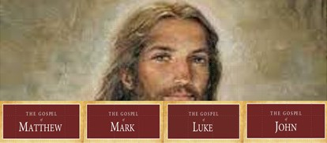
Four Gospels One Gospel
Luke 1:1-4

Slide 2
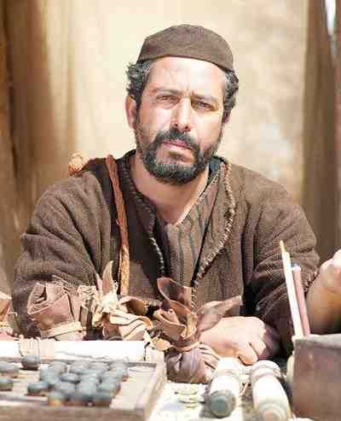
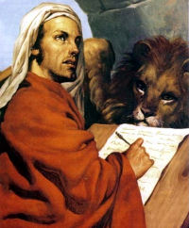
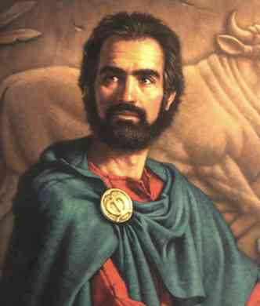
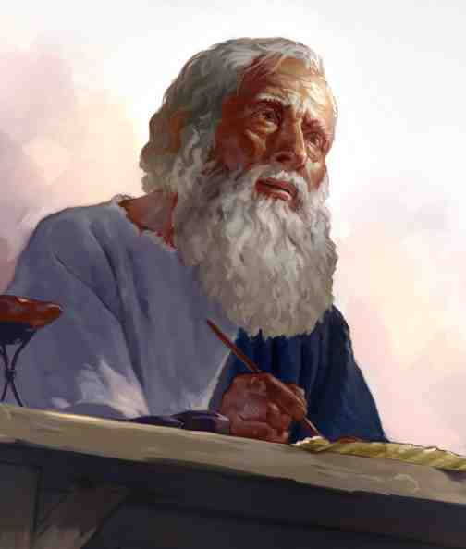
Why Four Gospels?
Four Writers
Four Audiences Four Portraits
Four Purposes Four Emphases
ONE GOSPEL

Slide 3
Matthew – to the Jews
Jesus the King (the promised Messiah)
OT prophecies fulfilled
The kingdom of heaven
Jesus the son of David
The church
The words of Jesus
Jewish (but Gentiles also)
Key verses:
Matt 1:1-17
ch 5-7
16:13-16
20:28

Slide 4
Mark – the Romans
Jesus the Servant of God
A non Jewish audience
Latin terms (for Roman audience)
To encourage Christians in Rome
Emphasizes Jesus’ deeds/actions
Jesus the Son of God (testimony)
Key verses:
Mark 1:1
8:29
10:45
15:39

Slide 5
Luke – the Greeks
Jesus the Son of Man
Only Gentile writer
Physician/careful historian
Like Mark, a non Jewish audience
To Theophilus 1:3-4
For Greeks – the perfect man
Humans aspects of Jesus’ life
Key verses:
Luke 1:1-4
4:1-13
19:10

Slide 6
John – for all Men
Jesus the Son of God (Deity)
For all ethnic groups
So that we will believe 20:30-31
Case for the Divine Nature of Jesus
Very selective (only 30 days)
The I am’s (claims of Jesus)
The key miracles
Key verses:
John 1:1-3
3:16
8:58
20:30-31

Slide 7
Why Four Gospels?
Four Writers
Four Audiences Four Portraits
Four Purposes Four Emphases
ONE GOSPEL

Slide 8
Four Gospels One Gospel
Luke 1:1-4

