Slide 1
COURAGE
Psalm 27:11-14

Slide 2
Faith and Courage
¹³ I would have lost heart, unless I had believed That I would see the goodness of the Lord In the land of the living.
¹⁴ Wait on the Lord; Be of good courage, And He shall strengthen your heart; Wait, I say, on the Lord!

Slide 3
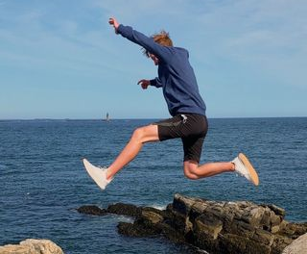

Slide 4
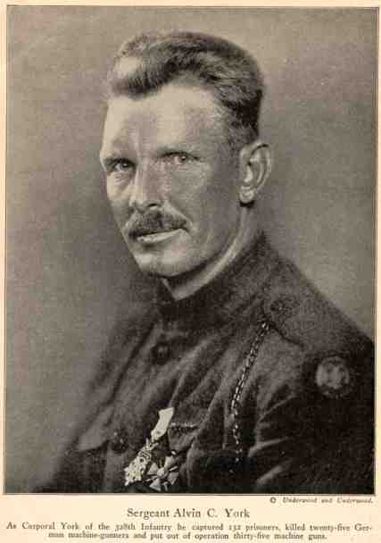

Slide 5
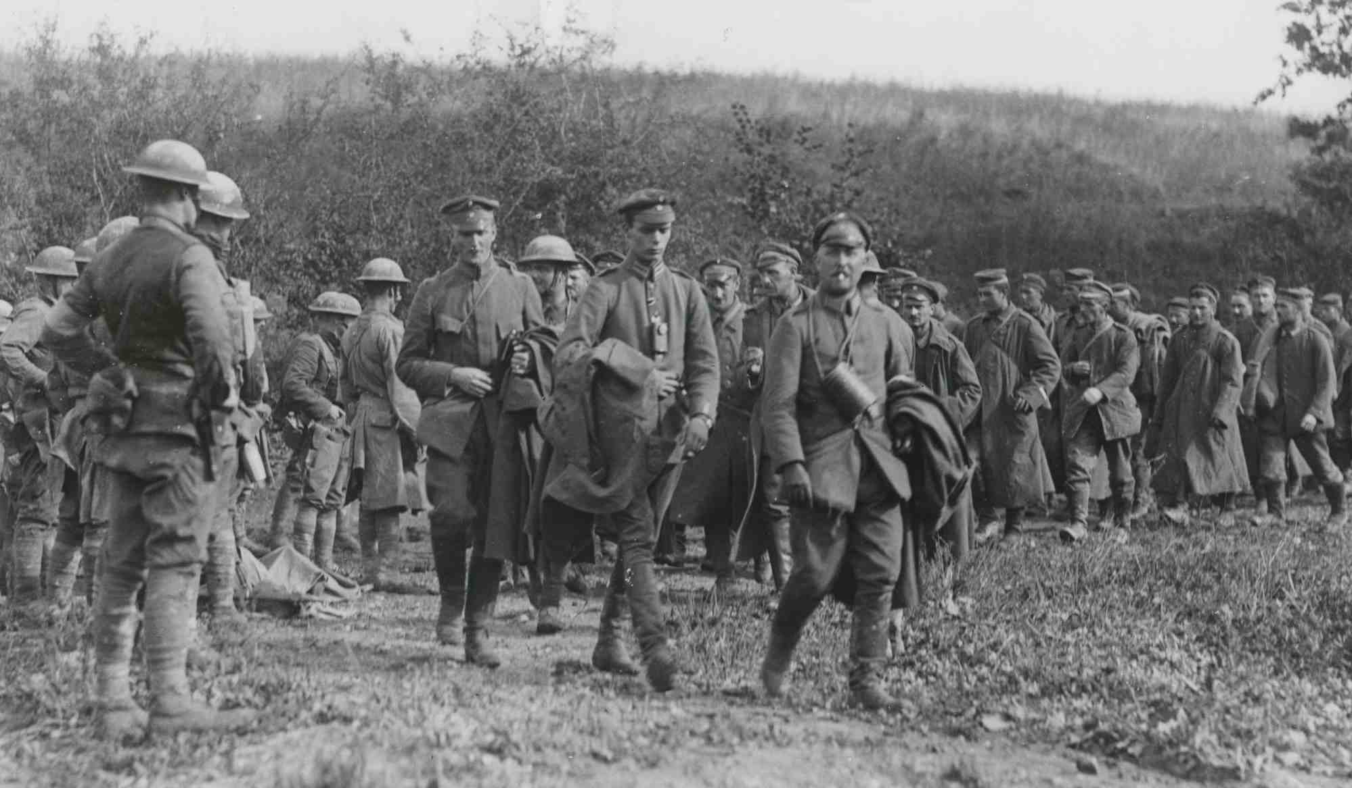

Slide 6
What is Courage?
Webster: That quality of mind which enables one to encounter danger and difficulties with firmness, or without fear, or fainting of heart; valor; boldness; resolution.
From Latin “cor” “heart” (being motivated from the heart to do something brave; the ability to do something that frightens one)
Heb “chazaq” To show oneself strong

Slide 7
Courage quotes
“Courage is being scared to death…and saddling up anyway.” – John Wayne
“Success is not final, failure is not fatal: it is the courage to continue that counts.” – Winston Churchill
“Courage is fear holding on a minute longer” – George S. Patton
He who is not courageous enough to take risks will accomplish nothing in life.” – Muhammad Ali
“Courage is not simply one of the virtues, but the form of every virtue at the testing point.” – C.S. Lewis

Slide 8
Biblical Courage
Joshua and Caleb – Numbers 13-14
Joshua 1:1-9 Joshua to lead the people into promised land
5 No man shall be able to stand before you all the days of your life; as I was with Moses, so I will be with you. I will not leave you nor forsake you. ⁶ Be strong and of good courage, for to this people you shall divide as an inheritance the land which I swore to their fathers to give them.

Slide 9
Biblical Courage
David and Goliath – 1 Samuel 17
Shadrach, Meshach, Abednego – Daniel 3
¹⁶ “O Nebuchadnezzar, we have no need to answer you in this matter. ¹⁷ If that is the case, our God whom we serve is able to deliver us from the burning fiery furnace, and He will deliver us from your hand, O king. ¹⁸ But if not, let it be known to you, O king, that we do not serve your gods, nor will we worship the gold image which you have set up.”
The apostles (Peter and John) – Acts 3-4

Slide 10
The Basis for Courage
The promise of the Lord’s presence with His people
Deut 31:7-8 Be strong and of good courage, for you must go with this people to the land which the Lord has sworn to their fathers to give them, and you shall cause them to inherit it. ⁸ And the Lord, He is the One who goes before you. He will be with you, He will not leave you nor forsake you; do not fear nor be dismayed.”
1 Chron 28:20 “Be strong and of good courage, and do it; do not fear nor be dismayed, for the Lord God—my God—will be with you. He will not leave you nor forsake you, until you have finished all the work for the service of the house of the Lord.

Slide 11
The Basis for Courage
The promise of the Lord’s presence with His people
Psalm 27:14 Wait on the Lord; Be of good courage, And He shall strengthen your heart; Wait, I say, on the Lord!
Psalm 31:23-24Oh, love the Lord, all you His saints! For the Lord preserves the faithful, And fully repays the proud person. ²⁴ Be of good courage, And He shall strengthen your heart, All you who hope in the Lord.

Slide 12
The Basis for Courage
The promise of the Lord’s presence with His people
Matthew 28:20 teaching them to observe all things that I have commanded you; and lo, I am with you always, even to the end of the age.” Amen.
Romans 8:33-37 What then shall we say to these things? If God is for us, who can be against us? ³² He who did not spare His own Son, but delivered Him up for us all, how shall He not with Him also freely give us all things? ³³ Who shall bring a charge against God’s elect? It is God who justifies. ³⁴ Who is he who condemns? It is Christ who died, and furthermore is also risen, who is even at the right hand of God, who also makes intercession for us.

Slide 13
Personal Courage
We all have intense personal demonstrations of bravery
Trusting God as over all in your life – John 19:9-11
Psalm 46:1-3; Psalm 118:6; Isaiah 41:10
We know God can deliver us; but we know He doesn’t always do so – 2 Cor 12:9-10
Heroes of faith persevered – Heb 11
11:29-34 Sometimes God delivered them
11:35-40 Sometimes He didn’t; but He was still with them

Slide 14
COURAGE
Psalm 27:11-14

