Slide 1
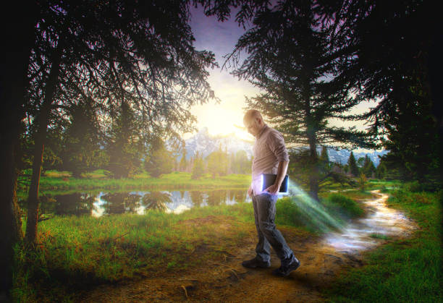
Walking in the Truth
2 John 1-13

Slide 2
From the last living apostle
1-3 The Elder, To the elect lady and her children, whom I love in truth, and not only I, but also all those who have known the truth, ² because of the truth which abides in us and will be with us forever:
³ Grace, mercy, and peace will be with ^{[b]}you from God the Father and from the Lord Jesus Christ, the Son of the Father, in truth and love.

Slide 3
From the last living apostle
John writes as “the Elder”
Near end of 1st century (90 AD)
One who was so close to Jesus
What he has to say at end of his life
To the elect lady and her children
A congregation and its members?
A real person and her physical children
(Either way, the point is the same)

Slide 4
Our relationship to the truth
v 4 I rejoiced greatly that I have found some of your children walking in truth, as we received commandment from the Father.
Their relationship is based on truth (5 times)
The truth is under attack/Postmodernism
“Whatever you think is right is right for you”
Core tenet to deny the concept of objective truth
Religiously (whatever makes you happy is fine)

Slide 5
The life lived because of truth
5-6 And now I plead with you, lady, not as though I wrote a new commandment to you, but that which we have had from the beginning: that we love one another. ⁶ This is love, that we walk according to His commandments. This is the commandment, that as you have heard from the beginning, you should walk in it.
John does not write a new commandment
Hold on to what has already been given
That we love one another (John 13:34)
True love is obeying His commandments (Jn 14:15)

Slide 6
Warning: Beware of deceivers
7-8 For many deceivers have gone out into the world who do not confess Jesus Christ as coming in the flesh. This is a deceiver and an antichrist. ⁸ Look to yourselves, that we do not lose those things we worked for, but that we may receive a full reward.
Deceivers/antichrist
90 AD most had not seen Jesus
Denying Jesus was a real person
The truth matters (1 Tim 3:16)

Slide 7
Our fellowship is limited by truth
9-10 Whoever transgresses and does not abide in the doctrine of Christ does not have God. He who abides in the doctrine of Christ has both the Father and the Son. ¹⁰ If anyone comes to you and does not bring this doctrine, do not receive him into your house nor greet him; ¹¹ for he who greets him shares in his evil deeds.
Difficult for Christians (Jesus wants us to love everybody)
Being open to everyone can lead to compromise
When you leave the teaching of Jesus, you leave the fellowship
Truth is the reason we are saved (1 Peter 1:22)

Slide 8
Walking in the Truth
2 John 1-13

