Slide 1
Philip Goes on the Road
Acts 8:1-40

Slide 2
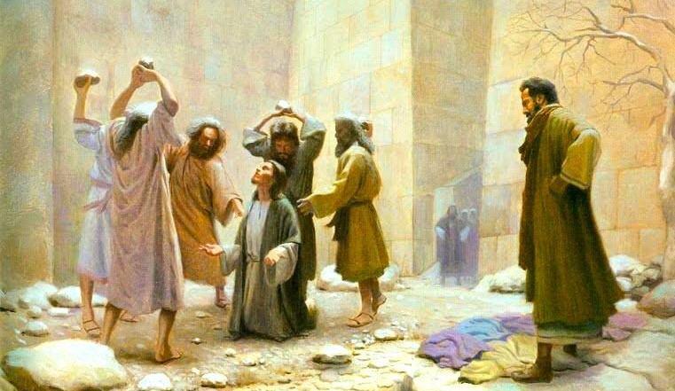
Context of Philip’s Preaching 1-8

Slide 3
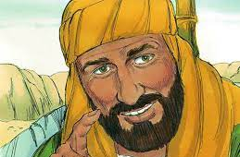
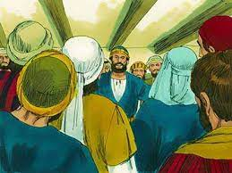
Context of Philip’s Preaching
1-3 Persecution led by Saul
God turns this to carry out
His greater purpose
4 Those scattered went every-
where preaching the word
5-8 Philip preaching to Samaria
Philip preaches/performs miracles
The Samaritans heeded Philip
The gospel brings great joy

Slide 4
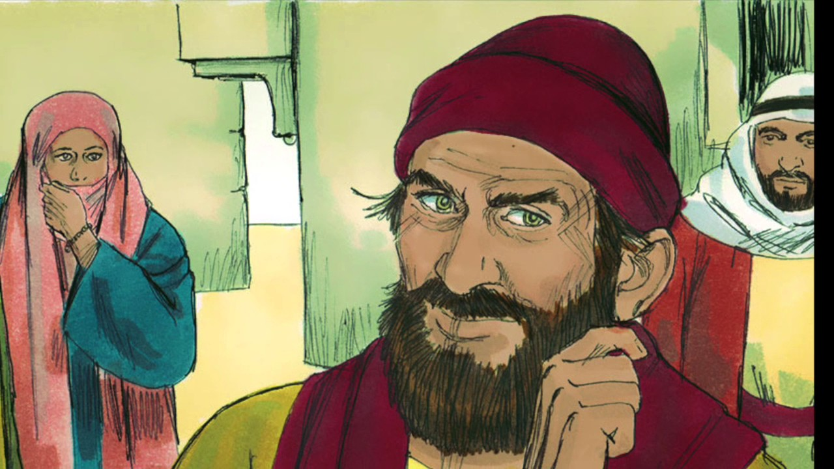
Con Man of Samaria 9-13

Slide 5
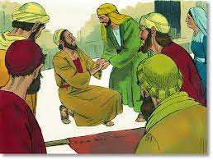
Con Man of Samaria
9-11 What Philip was up against
Power of Christ vs Satan
12-13 The People see the truth
Philip’s message is clear
Men and Women baptized
Simon sees and is amazed

Slide 6
Conflict of Truth and Error 14-25
14-17 Jerusalem hears, sends Peter and John
The Holy Spirit had not been give
Insight: Philip possessed miracle working power
but could not confer it to others.. only by apostles’ hands
18-19 Simon’s true heart emerges
20-25 Salvation is not for sale
Simon is still offered the opportunity to repent
“If perhaps the thought of your heart may be forgiven”

Slide 7
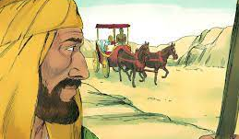
Contact with the Seeker 26-35

Slide 8
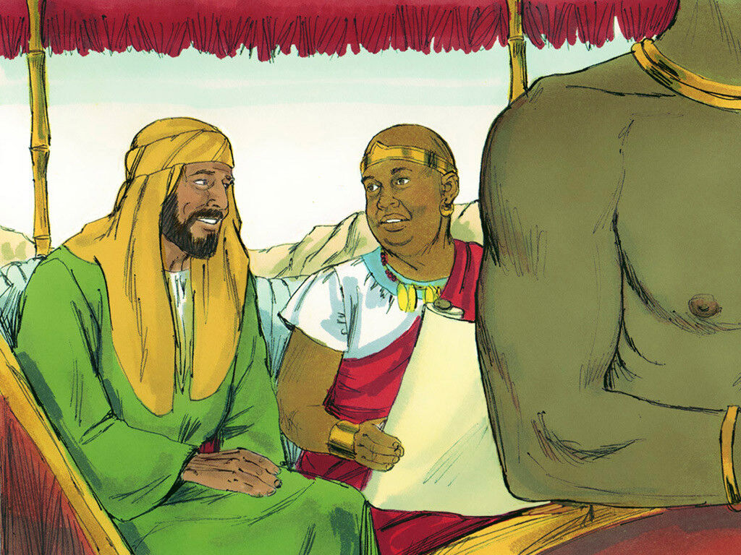
Contact with the Seeker 14-25
26-29 The angel and the Spirit bring Philip in contact
30-35 Philip catches the chariot
Ethiopian returning from Jerusalem
Reading prophet Isaiah (ch 53)
Philip’s ideal question and opening
Philip preaches Christ from this same scripture

Slide 9
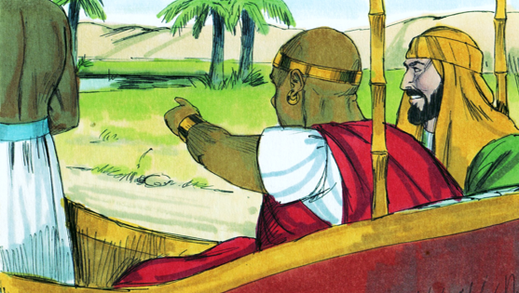
Convert in the Desert 36-40

Slide 10
Philip Goes on the Road
Acts 8:1-40

