Slide 1
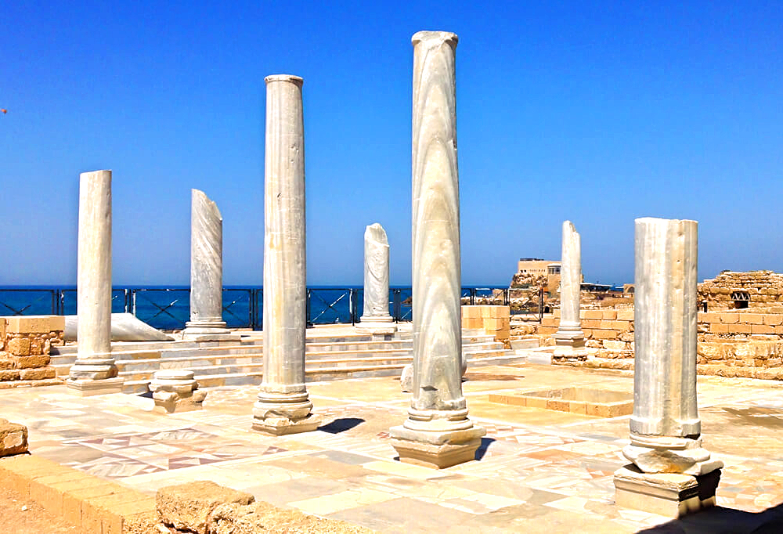
Two Visions, Two Conversions
Acts 10:1-48

Slide 2
Meet Cornelius v1-2
Roman officer stationed in Caesarea
Centurion of the Italian Regiment
Devout worshiper of the God of Israel
Gave much alms/Prayed to God always

Slide 3
Vision #1: Cornelius 3-8
At ninth hour saw an angel, was afraid
His prayers/alms have been noticed
Send for Peter/he will tell you what to do
Cornelius is obedient, sends three men

Slide 4
Vision #2: Peter 9-23
At sixth hour, Peter praying on roof
Sheet let down with all kinds of animals
God: Rise, kill & eat/ Peter: Not so, Lord
“What God has cleansed, call not common”
The men arrive: Peter sent to Caesarea

Slide 5
Peter’s meets Cornelius 24-33
Cornelius welcomes Peter
Waiting for Peter with family/friends
Falling down at Peter’s feet, told to stand up
Peter explains his presence/His vision
Cornelius relates his vision/man in bright clothing

Slide 6
Peter’s sermon 24-33
Begins with what he now understands
God shows no partiality/accepts all who fear Him
God sent Jesus to Israel, preaching peace
God anointed Jesus with Holy Spirit/power
Put to death in Jerusalem but raised by God
Prophets testify remission of sins in His name

Slide 7
Two Conversions 44-48
Unexpected outpouring of Holy Spirit
As Peter spoke, Holy Spirit fell on those who heard
The Jews were astonished the gift poured on Gentiles
Who can forbid these water to be baptized?
#1: Conversion of Cornelius to Christ
#2: Conversion of Peter to true meaning of salvation

Slide 8
What Peter had missed..
Luke 2:32 Jesus would be a light to the Gentiles
Luke 3:6 All mankind will see the salvation of God
Luke 4 Two OT stories God sending his servants to Gentiles
Luke 7 Jesus’ praise for faith of Roman centurion
Luke 24:47 Forgiveness to be preached to all nations
Acts 1:8 they would be witnesses to ends of the earth
Acts 2:17-21 God would pour out His Spirit on all flesh

Slide 9
What this teaches us..
The reason Peter didn’t get it: the way he was raised
Today we understand that God loves all people
Lessons for us..
Conversion is not a one-time event, but continuing process
God continues to lead us into deeper insight, obedience
It is too easy for us to reach point we no longer want to grow
As we grow we must be willing to be like Peter

Slide 10
Two Visions, Two Conversions
Acts 10:1-48

