Slide 1
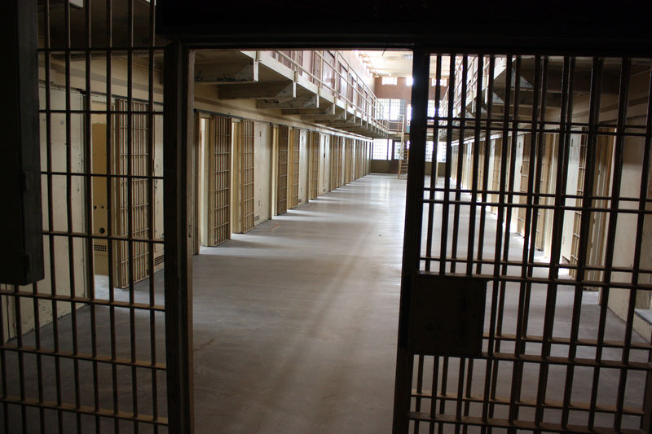
Prison break
ACTS 12:1-25

Slide 2
Powerful King/Praying Church
Overwhelming Opposition 1-4
Cruelty of Herod
James’ death/Peter’s arrest
Timing of the feast
Prayers of the Church 5
Impossible Situation
Prayed all week/nothing

Slide 3
God Takes Action
Awakening Angel 5-11
Peter sleeping soundly
Touched by an angel
Dream or Reality
Awkward Church 12-17
Peter at the gate
Rhoda must be crazy

Slide 4
Herod’s Bad Day
Morning news 18-19
Prisoner has escaped
Innocent guards executed
Herod leaves town
Herod gets his 20-23
Receives divine praise
Struck by an angel

Slide 5
Herod’s Bad Day
Morning news 18-19
Prisoner has escaped
Innocent guards executed
Herod leaves town
Herod gets his 20-23
Receives divine praise
Struck by an angel

Slide 6
Dead King/Dynamic Church
Herod’s agonizing death 23
Learns his lesson
The gospel is not harmed 24-25
Word of God grew & multiplied
Barnabas & Saul return with Mark

Slide 7
Dead King/Dynamic Church
Layers of irony
Luke’s use of humor
Deeper irony
Mortals aren’t allowed on God’s throne
The church prayed, but didn’t believe
Everything they prayed for came to pass

Slide 8
Believing in Prayer
Lack of understanding
Lack of control
Lack of faith
Lack of practice

Slide 9
Prison break
ACTS 12:1-25

