Slide 1
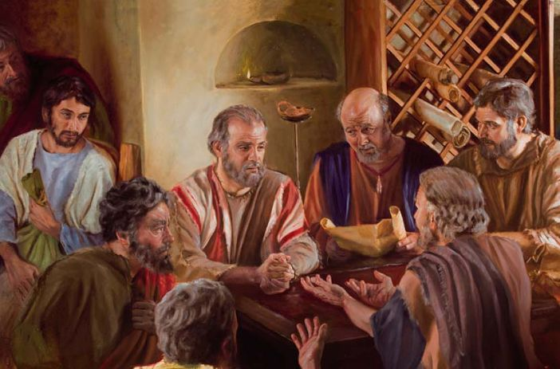
Building Each Other Up
Acts 20:1-38

Slide 2
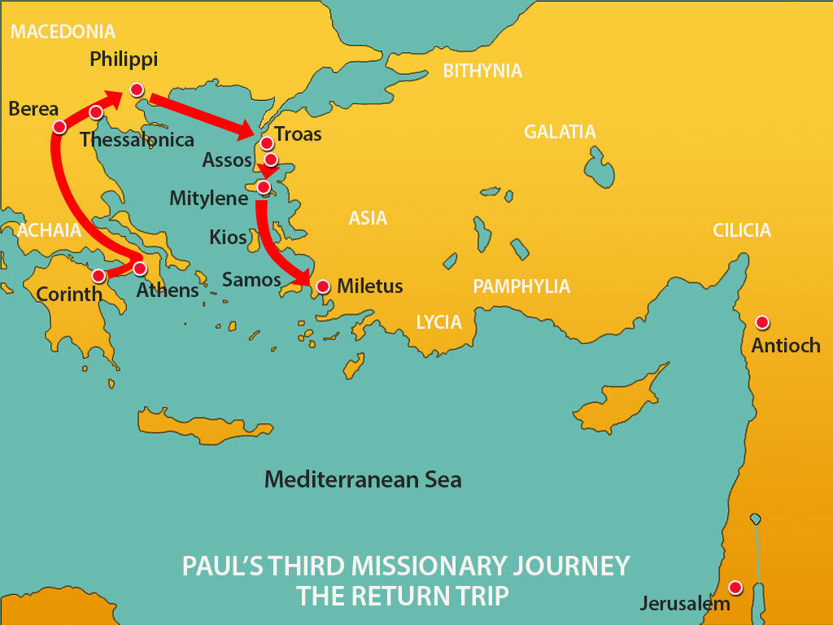

Slide 3
Personal Encouragement
Paul’s example vs 1-6
When leaving Ephesus (embraced the disciples)
Revisiting Macedonia (encouraged with many words)
Three months in Greece (Corinth, wrote to Romans)
Collection for needy saints (Judea) 1 Cor 16:1-3
Plot against Paul causes change of plans
Men travelling with him from churches

Slide 4
Personal Fellowship
First day of week in Troas 7-12
The day Jesus rose / Day the church began
Disciples came together to break bread
Teaching from the word
Unfortunate event (young man fell from window)
Tragedy reversed to bring great comfort

Slide 5
Personal Integrity
Travelling from Troas to Miletus 13-16
Sending for the elders from Ephesus 17-24
Paul reminds them of his manner of life
Serving with humility, facing many trials
Kept back nothing helpful to all
Not knowing the future, but goal to finish race

Slide 6
Personal Responsibility
Paul may not see them again 25-31
Innocent of the blood of all men
Exhortation to the elders/shepherd the flock
Jesus purchased the church with His blood
Warns of dangers of apostasy

Slide 7
Personal Example
When Christians part 32-35
Commit each other to God
God’s word (grace, being built up, inheritance)
Remember to not covet material things
Concern for the weak and needy
Emotional farewell 36-38

Slide 8
Personal Application
Love each other because Jesus bought Christians with his own blood.
Be patient with people and help them grow in the Lord.
Encourage other believers every opportunity God gives you.
Be willing to pray and when appropriate cry with other Christians.
Determine to finish your own race and complete the task the Lord has given you.

Slide 9
Building Each Other Up
Acts 20:1-38

