Slide 1
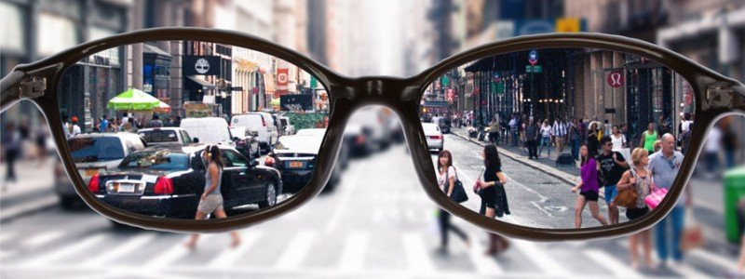
Wisdom to Think Biblically in Today’s World
Matthew 10:16-33

Slide 2
Living/Thinking by Faith..
Hebrews 11:1,3,6..
Noah.. Abraham.. Moses applied biblical thinking
Joseph in Egypt understood that God reveals dreams
Moses took his stand with God and spoke His word
Daniel spoke wisely before the king of Babylon
Paul spoke to the men of Athens
1 Peter 3:15 and always be ready to give a defense to everyone who asks you a reason for the hope that is in you, with meekness and fear..

Slide 3
Biblical Worldview
Secular Worldview
God created World/man
Man made in His image
God revealed His word
God as moral lawgiver
Human life is purposeful
Man is loved by God
Life matters
Not evidence for God
Life from natural processes
Man is his own authority
No higher moral law
Human life is an accident
No such thing as moral evil
Can’t condemn any action

Slide 4
There is objective evidence..
Cosmological Argument
The universe began to exist/Has to be a CAUSE
Design Argument
The universe shows design/Has to be a DESIGNER
Moral Argument
Man inherently believes certain things Right/Wrong

Slide 5
Reclaiming what belongs to the Biblical Worldview
Who defines Good and Evil?
Secular worldview: we are free to do what we want to do
There is no higher authority than ourselves
There is no basis for telling others what is good/evil
Yet our culture has strong ideas of what is right/wrong
Equality/diversity/tolerance (rights for all)
Who makes us equal/gives us our rights?
Without God, there is nothing to say we have any rights
Human rights and freedom come from God/not man

Slide 6
Reaffirming Biblical Morality
Secular world today practices “virtue signalling”
“Saying things publicly to indicate to the world you are kind, decent, virtuous without actually doing anything”
Plays vital role in promoting secular morals vs Biblical
Nonbiblical morals are being “marketed” today
Successful Marketing Model (AIDA)
Awareness, Interest, Desire, Action
Adapting this same model to Moral “Buy-In”
Redefinition, Normalization, Celebration

Slide 7
Reaffirming Biblical Morality
Reaffirm God as THE Moral Authority
Christians say we believe this, but don’t live as if He is
When secular culture makes emotional case, we give in
Trusting our own reasoning over God’s word
Judges 21:25 In those days there was no king in Israel; everyone did what was right in his own eyes.
Romans 3:10 “There is none righteous, no, not one..
Matthew 5:14 Let your light shine before men..

Slide 8
Wisdom to Think Biblically in Today’s World
Matthew 10:16-33

