Slide 1
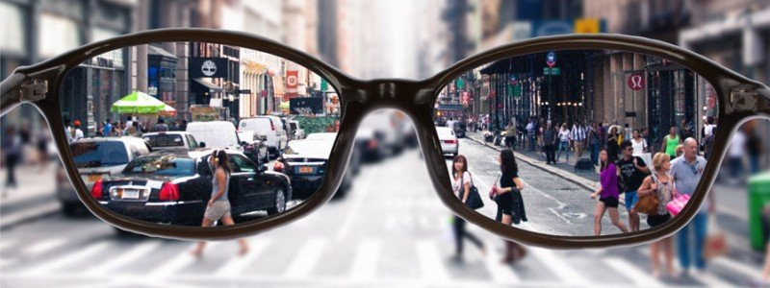
Living the Truth in a Cancel Culture
1 Peter 3:8-17

Slide 2
Living in a Secular Culture..
John 17:11-17 Now I am no longer in the world, but these are in the world, and I come to You. Holy Father, keep through Your name those whom You have given Me, that they may be one as We are.
I have given them Your word; and the world has hated them because they are not of the world, just as I am not of the world. ¹⁵ I do not pray that You should take them out of the world, but that You should keep them from the evil one. ¹⁶ They are not of the world, just as I am not of the world. ¹⁷ Sanctify them by Your truth. Your word is truth.

Slide 3
Rooted and Grounded in the Faith..
Colossians 1:9-11 we do not cease to pray for you, and to ask that you may be filled with the knowledge of His will in all wisdom and spiritual understanding; ¹⁰ that you may walk worthy of the Lord, fully pleasing Him, being fruitful in every good work and increasing in the knowledge of God..
21-23 and you, who once were alienated and enemies in your mind by wicked works, yet now He has reconciled ²² in the body of His flesh through death, to present you holy, and blameless, and above reproach in His sight— ²³ if indeed you continue in the faith, grounded and steadfast, and are not moved away from the hope of the gospel..

Slide 4
Wisdom to think Biblically in the World..
Matthew 10:16-33 “Behold, I send you out as sheep in the midst of wolves. Therefore be wise as serpents and harmless as doves.. ²² And you will be hated by all for My name’s sake. But he who endures to the end will be saved.
27-33 “Whatever I tell you in the dark, speak in the light; and what you hear in the ear, preach on the housetops. ²⁸ And do not fear those who kill the body but cannot kill the soul. ³¹ Do not fear therefore; you are of more value than many sparrows. “Therefore whoever confesses Me before men, him I will also confess before My Father who is in heaven. ³³ But whoever denies Me before men, him I will also deny before My Father who is in heaven.

Slide 5
Marketing Changing Moral Values
Redefinition
(Awareness)
Normalization
(Interest)
Celebration
(Desire)
“BUY IN”
(Purchase)

Slide 7
“Virtue signalling”
Saying things publicly (social media) to indicate to the world you are kind, decent, virtuous without actually doing anything
An effort to demonstrate one’s high moral standing by expressing opinions on political and social issues that will likely be agreeable to others, often with little or no intent to act on said opinions
The sharing of one’s point of view on a social or political issue in order to garner praise or acknowledgment of one’s righteousness from others who share that point of view or to passively rebuke those who do not

Slide 8
“Cancel Culture”
The mass withdrawal of support from public figures who have said or done something that isn’t considered socially acceptable.. social media outrage, boycotting their work or demand for their termination from a job
the practice or tendency of engaging in mass canceling as a way of expressing disapproval and exerting social pressure
Cancel culture can also direct efforts toward businesses, organizations, institutions to condemn the organization for supporting a cause which secular culture has condemned
Example: Girl scouts expressing support for Amy Coney Barrett being appointed to Supreme Court

Slide 9
Learning to speak with wisdom..
Ephesians 4:14-15 we should no longer be children, tossed to and fro and carried about with every wind of doctrine.. ¹⁵ but, speaking the truth in love, may grow up in all things into Him who is the head—Christ—
We have responsibility to speak the truth where truth is being distorted, challenged, and denied
Our response needs to be Christlike out of love (not angry, condescending, mocking, or vicious)
Speaking truth out of our love for God and others

Slide 10
Example of Paul in Athens..
Acts 17:16-17 Paul was distressed by the idolatry
Now while Paul waited for them at Athens, his spirit was provoked within him when he saw that the city was given over to idols. ¹⁷ Therefore he reasoned in the synagogue with the Jews and with the Gentile worshipers, and in the marketplace daily with those who happened to be there.
18-21 Worldly culture lacks understanding of Christianity
And some said, “What does this babbler want to say?” Others said, “He seems to be a proclaimer of foreign gods,” because he preached to them Jesus and the resurrection. ¹⁹ And they took him and brought him to the Areopagus, saying, “May we know what this new doctrine is of which you speak? ²⁰ For you are bringing some strange things to our ears. Therefore we want to know what these things mean.”

Slide 11
Example of Paul in Athens..
22-25 Observe the culture and find a connecting point.. Be confident in speaking THE truth (not a truth or our truth)
“Men of Athens, I perceive that in all things you are very religious; ²³ for as I was passing through and considering the objects of your worship, I even found an altar with this inscription: TO THE UNKNOWN GOD. Therefore, the One whom you worship without knowing, Him I proclaim to you: ²⁴ God, who made the world and everything in it, since He is Lord of heaven and earth, does not dwell in temples made with hands. ²⁵ Nor is He worshiped with men’s hands, as though He needed anything, since He gives to all life, breath, and all things.

Slide 12
Example of Paul in Athens..
26-29 Paul talked about man in relationship to God
And He has made from one blood every nation of men to dwell on all the face of the earth, and has determined their preappointed times and the boundaries of their dwellings, ²⁷ so that they should seek the Lord, in the hope that they might grope for Him and find Him, though He is not far from each one of us; ²⁸ for in Him we live and move and have our being, as also some of your own poets have said, ‘For we are also His offspring.’
²⁹ Therefore, since we are the offspring of God, we ought not to think that the Divine Nature is like gold or silver or stone, something shaped by art and man’s devising.

Slide 13
Example of Paul in Athens..
30-31 Preach the need for repentance but emphasize God has given proof by raising Jesus from the dead (objective truth)
Truly, these times of ignorance God overlooked, but now commands all men everywhere to repent, ³¹ because He has appointed a day on which He will judge the world in righteousness by the Man whom He has ordained. He has given assurance of this to all by raising Him from the dead.”
32-33 Speak truth, knowing not everyone will embrace it
And when they heard of the resurrection of the dead, some mocked, while others said, “We will hear you again on this matter.” ³³ So Paul departed from among them. ³⁴ However, some men joined him and believed, among them Dionysius the Areopagite, a woman named Damaris, and others with them.

Slide 14
Questions to ask before speaking truth..
Is this something worth speaking up about?
Is this a good time to say something?
Where is the person coming from/what is their attitude?
What is my motivation for saying something? (to win an argument, look smart, feel virtuous, make someone feel foolish, put someone in their place?)
Should I say something publicly or privately? (will they be embarrassed by my comments?)
What is the best way to say what I want to say? (start from beliefs in common, assume the best, emphasize the biblical viewpoint, biblical view compared with secular)

Slide 15
Living the Truth in a Cancel Culture
1 Peter 3:8-17

